Slide 1



Celebrating Our Partnerships!
“Alone we can do so little. Together we can do so much.”
– Helen Keller

Slide 2
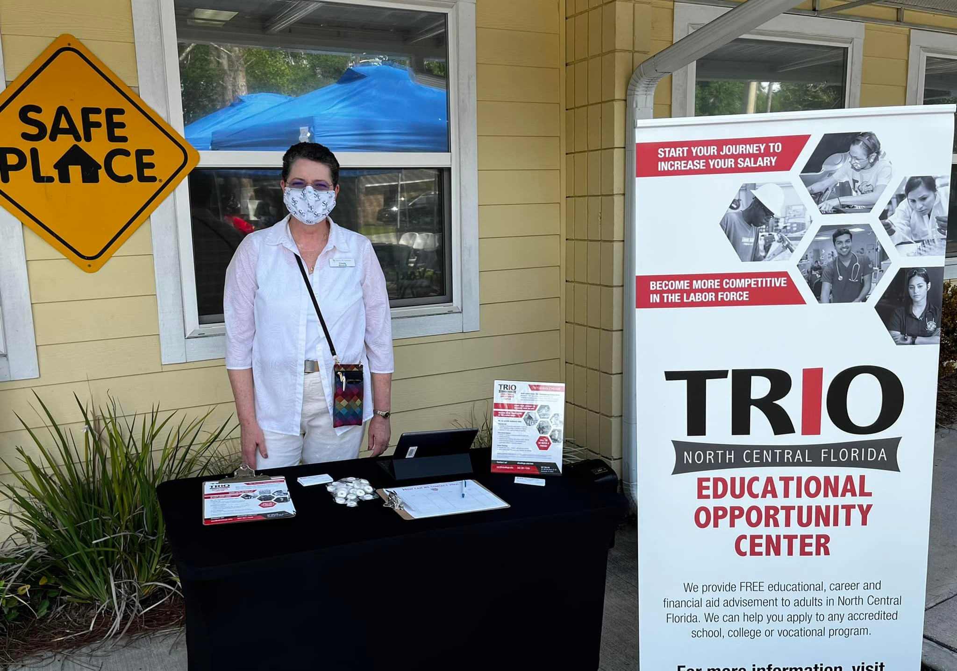

Slide 3
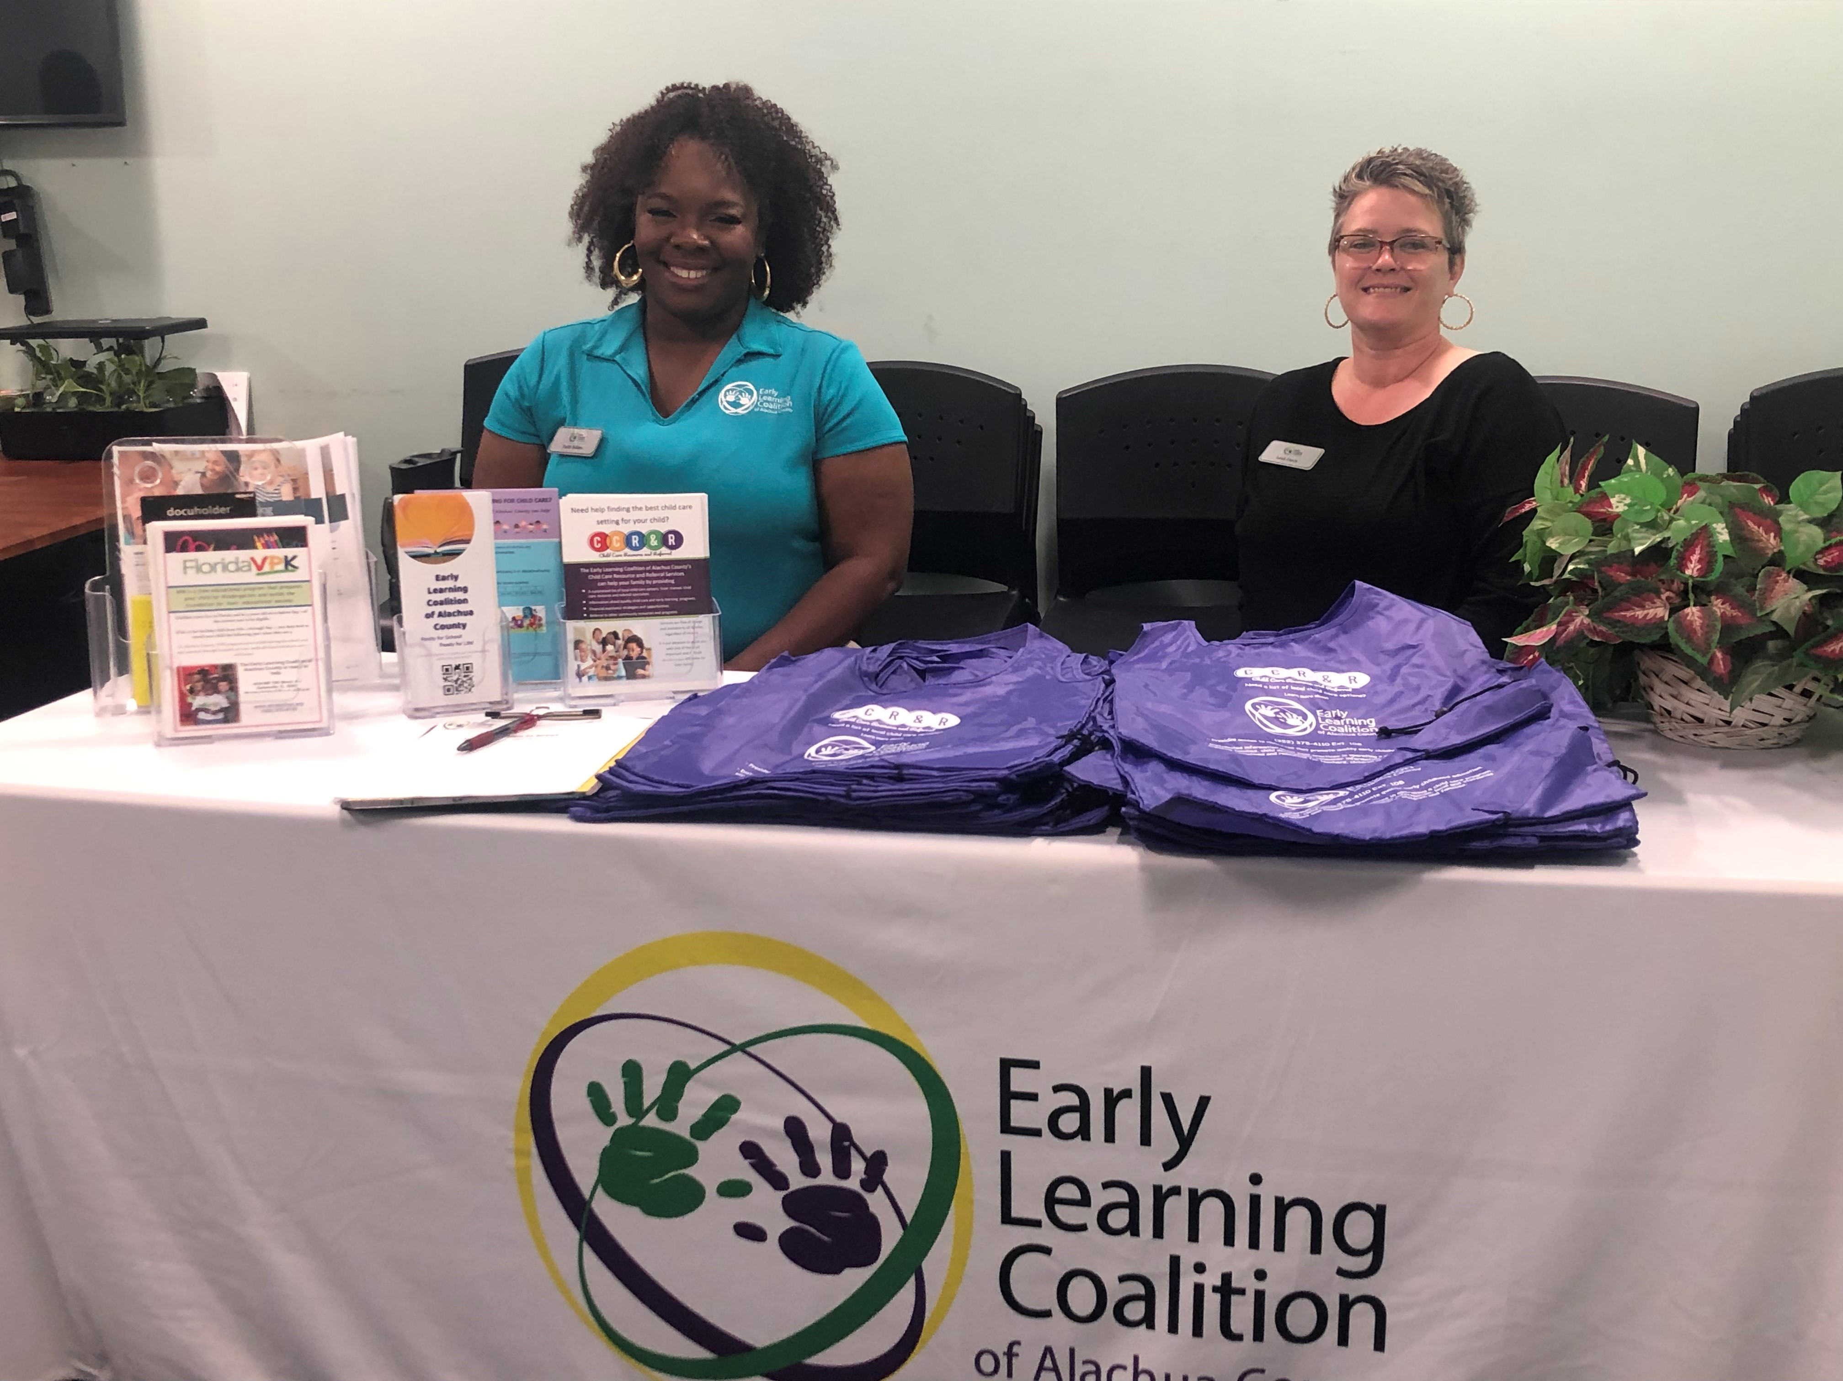

Slide 4
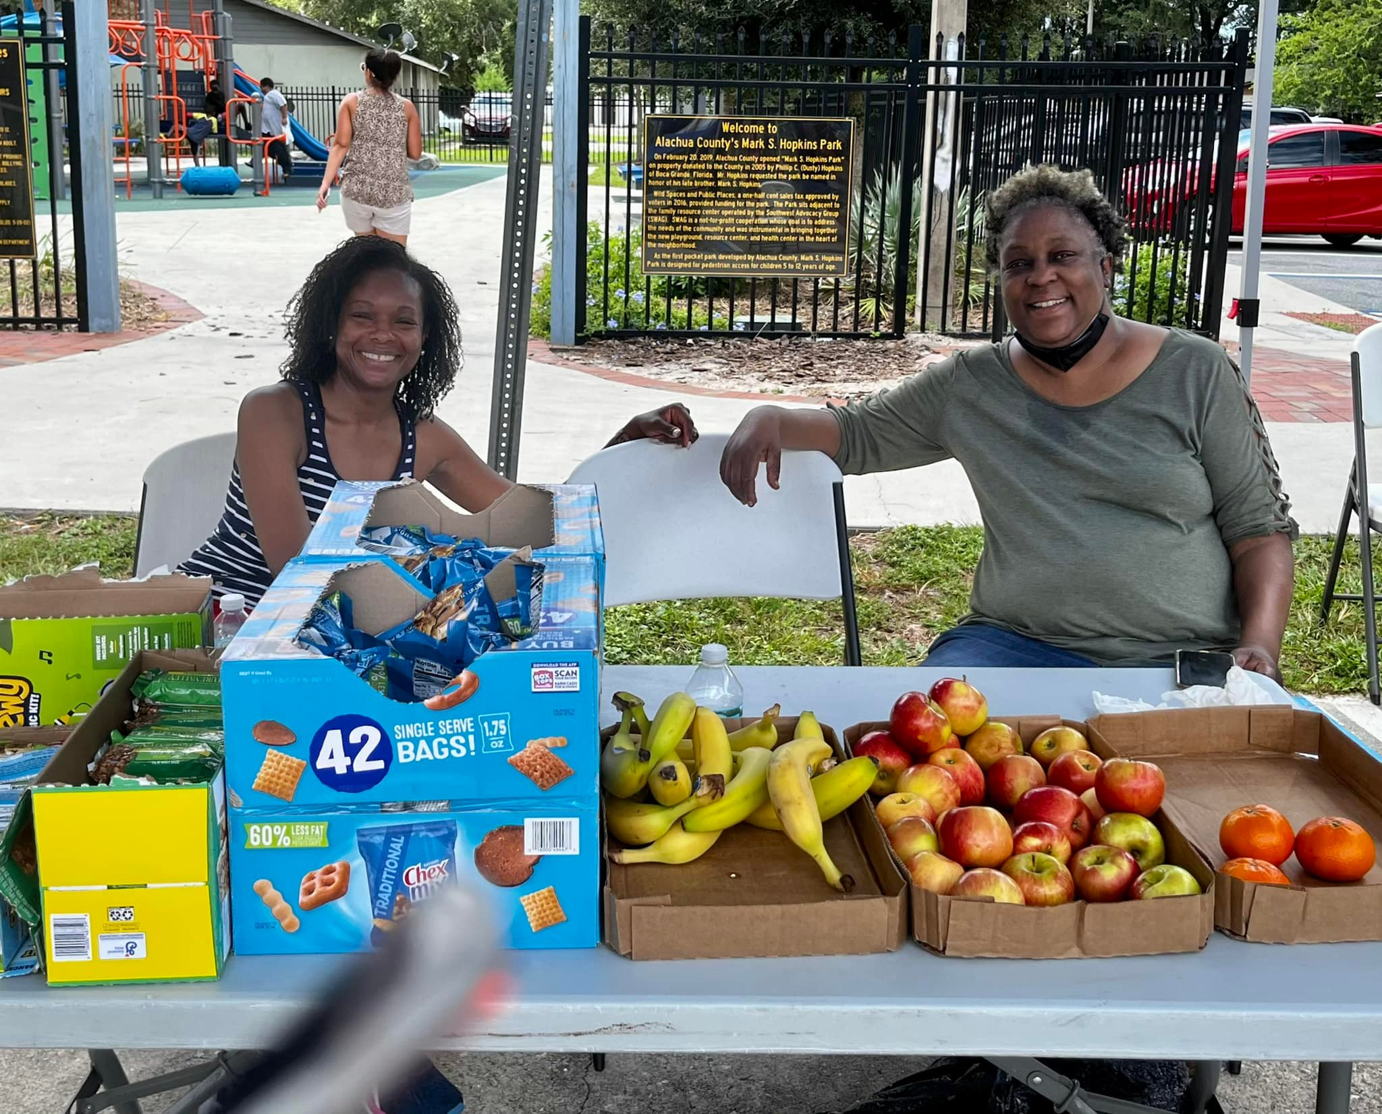

Slide 5
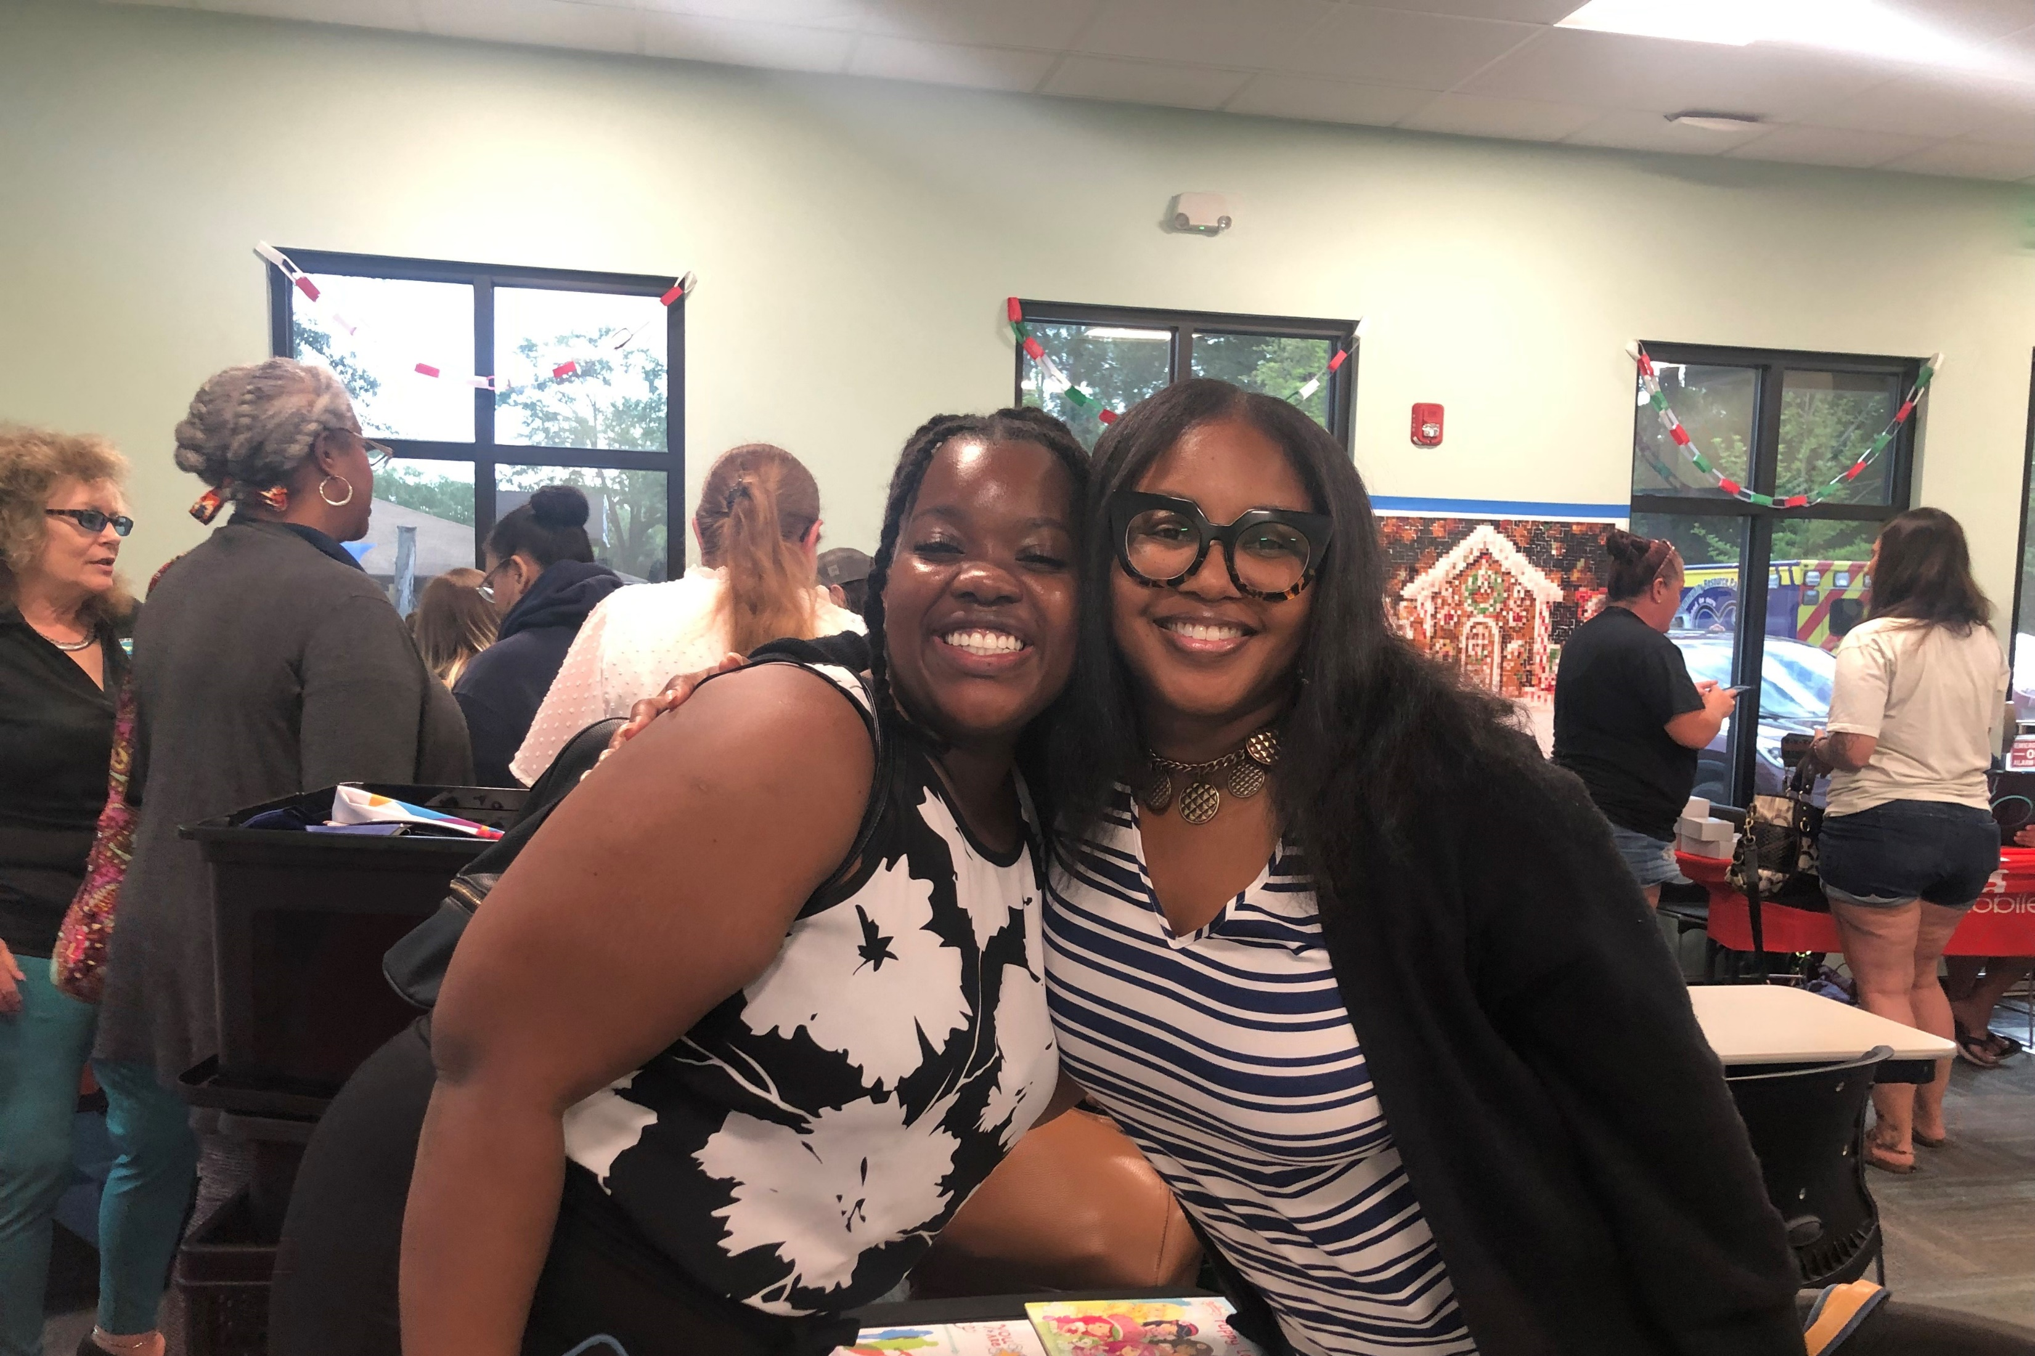

Slide 6
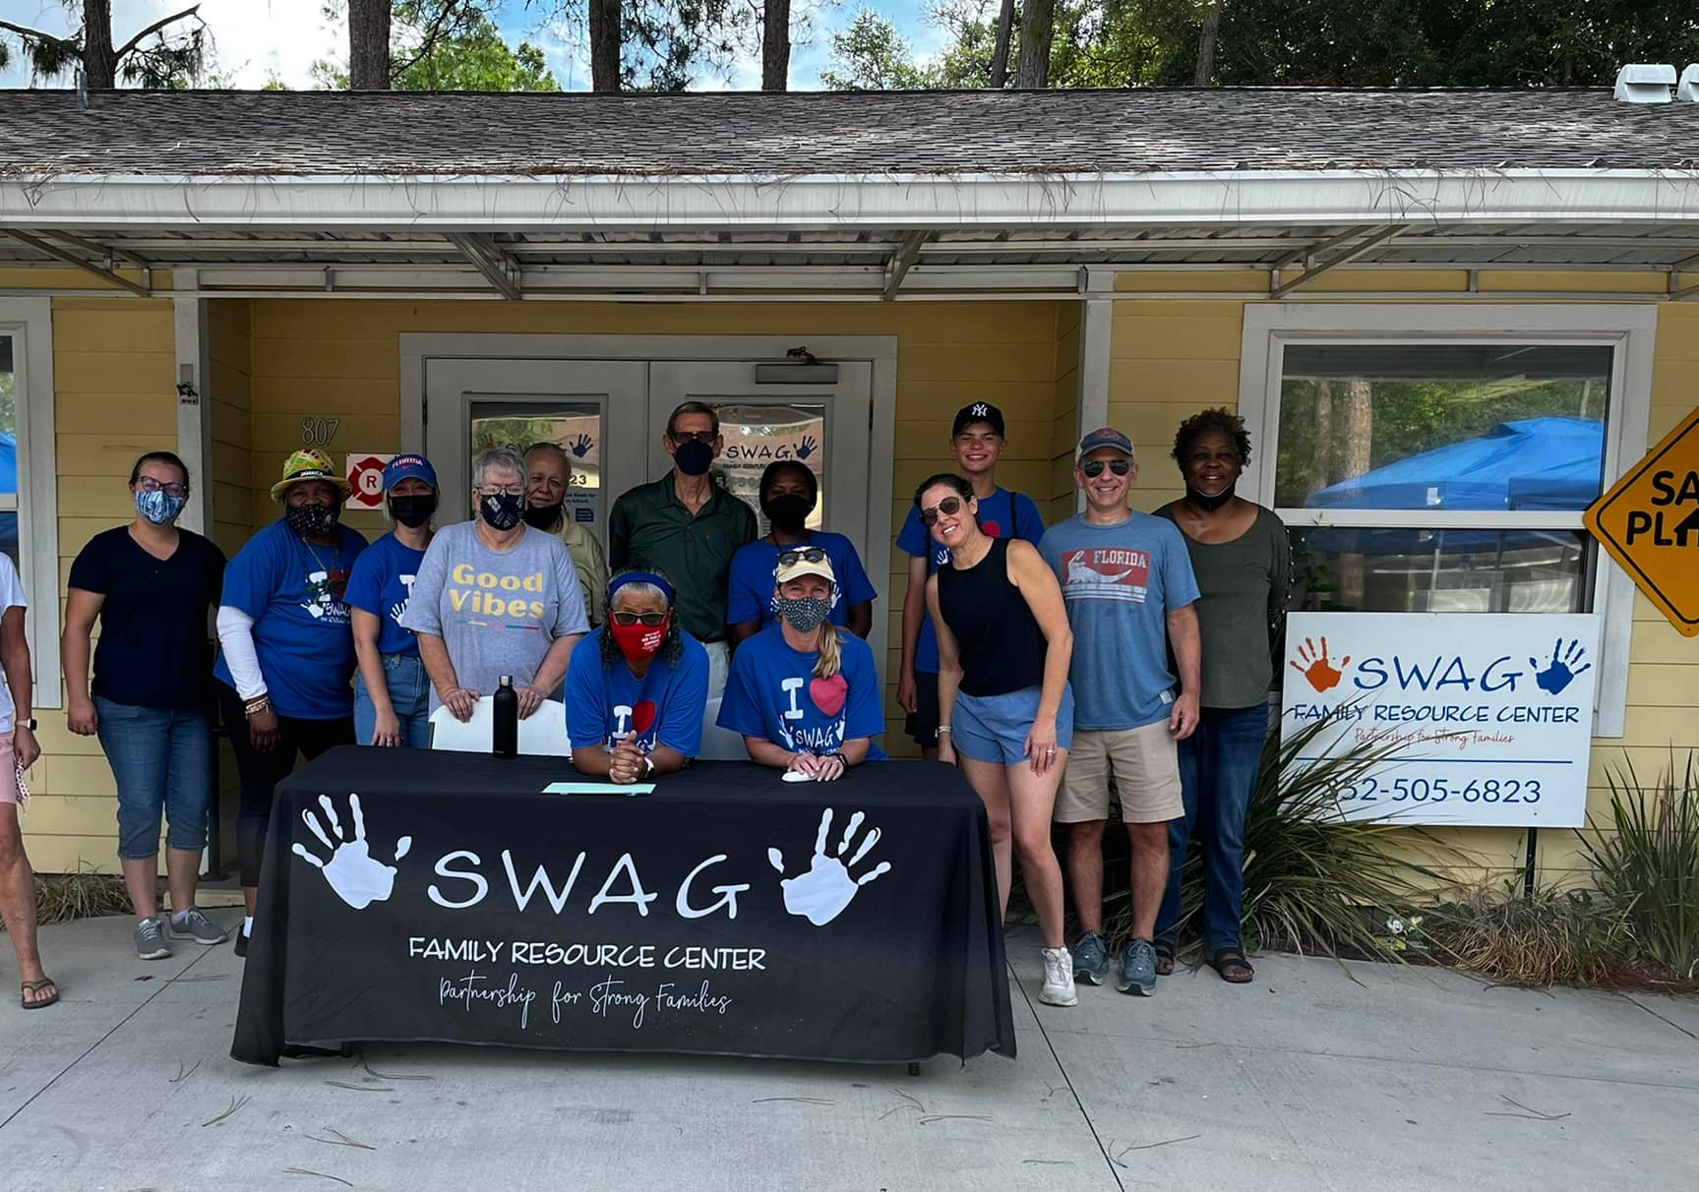

Slide 7
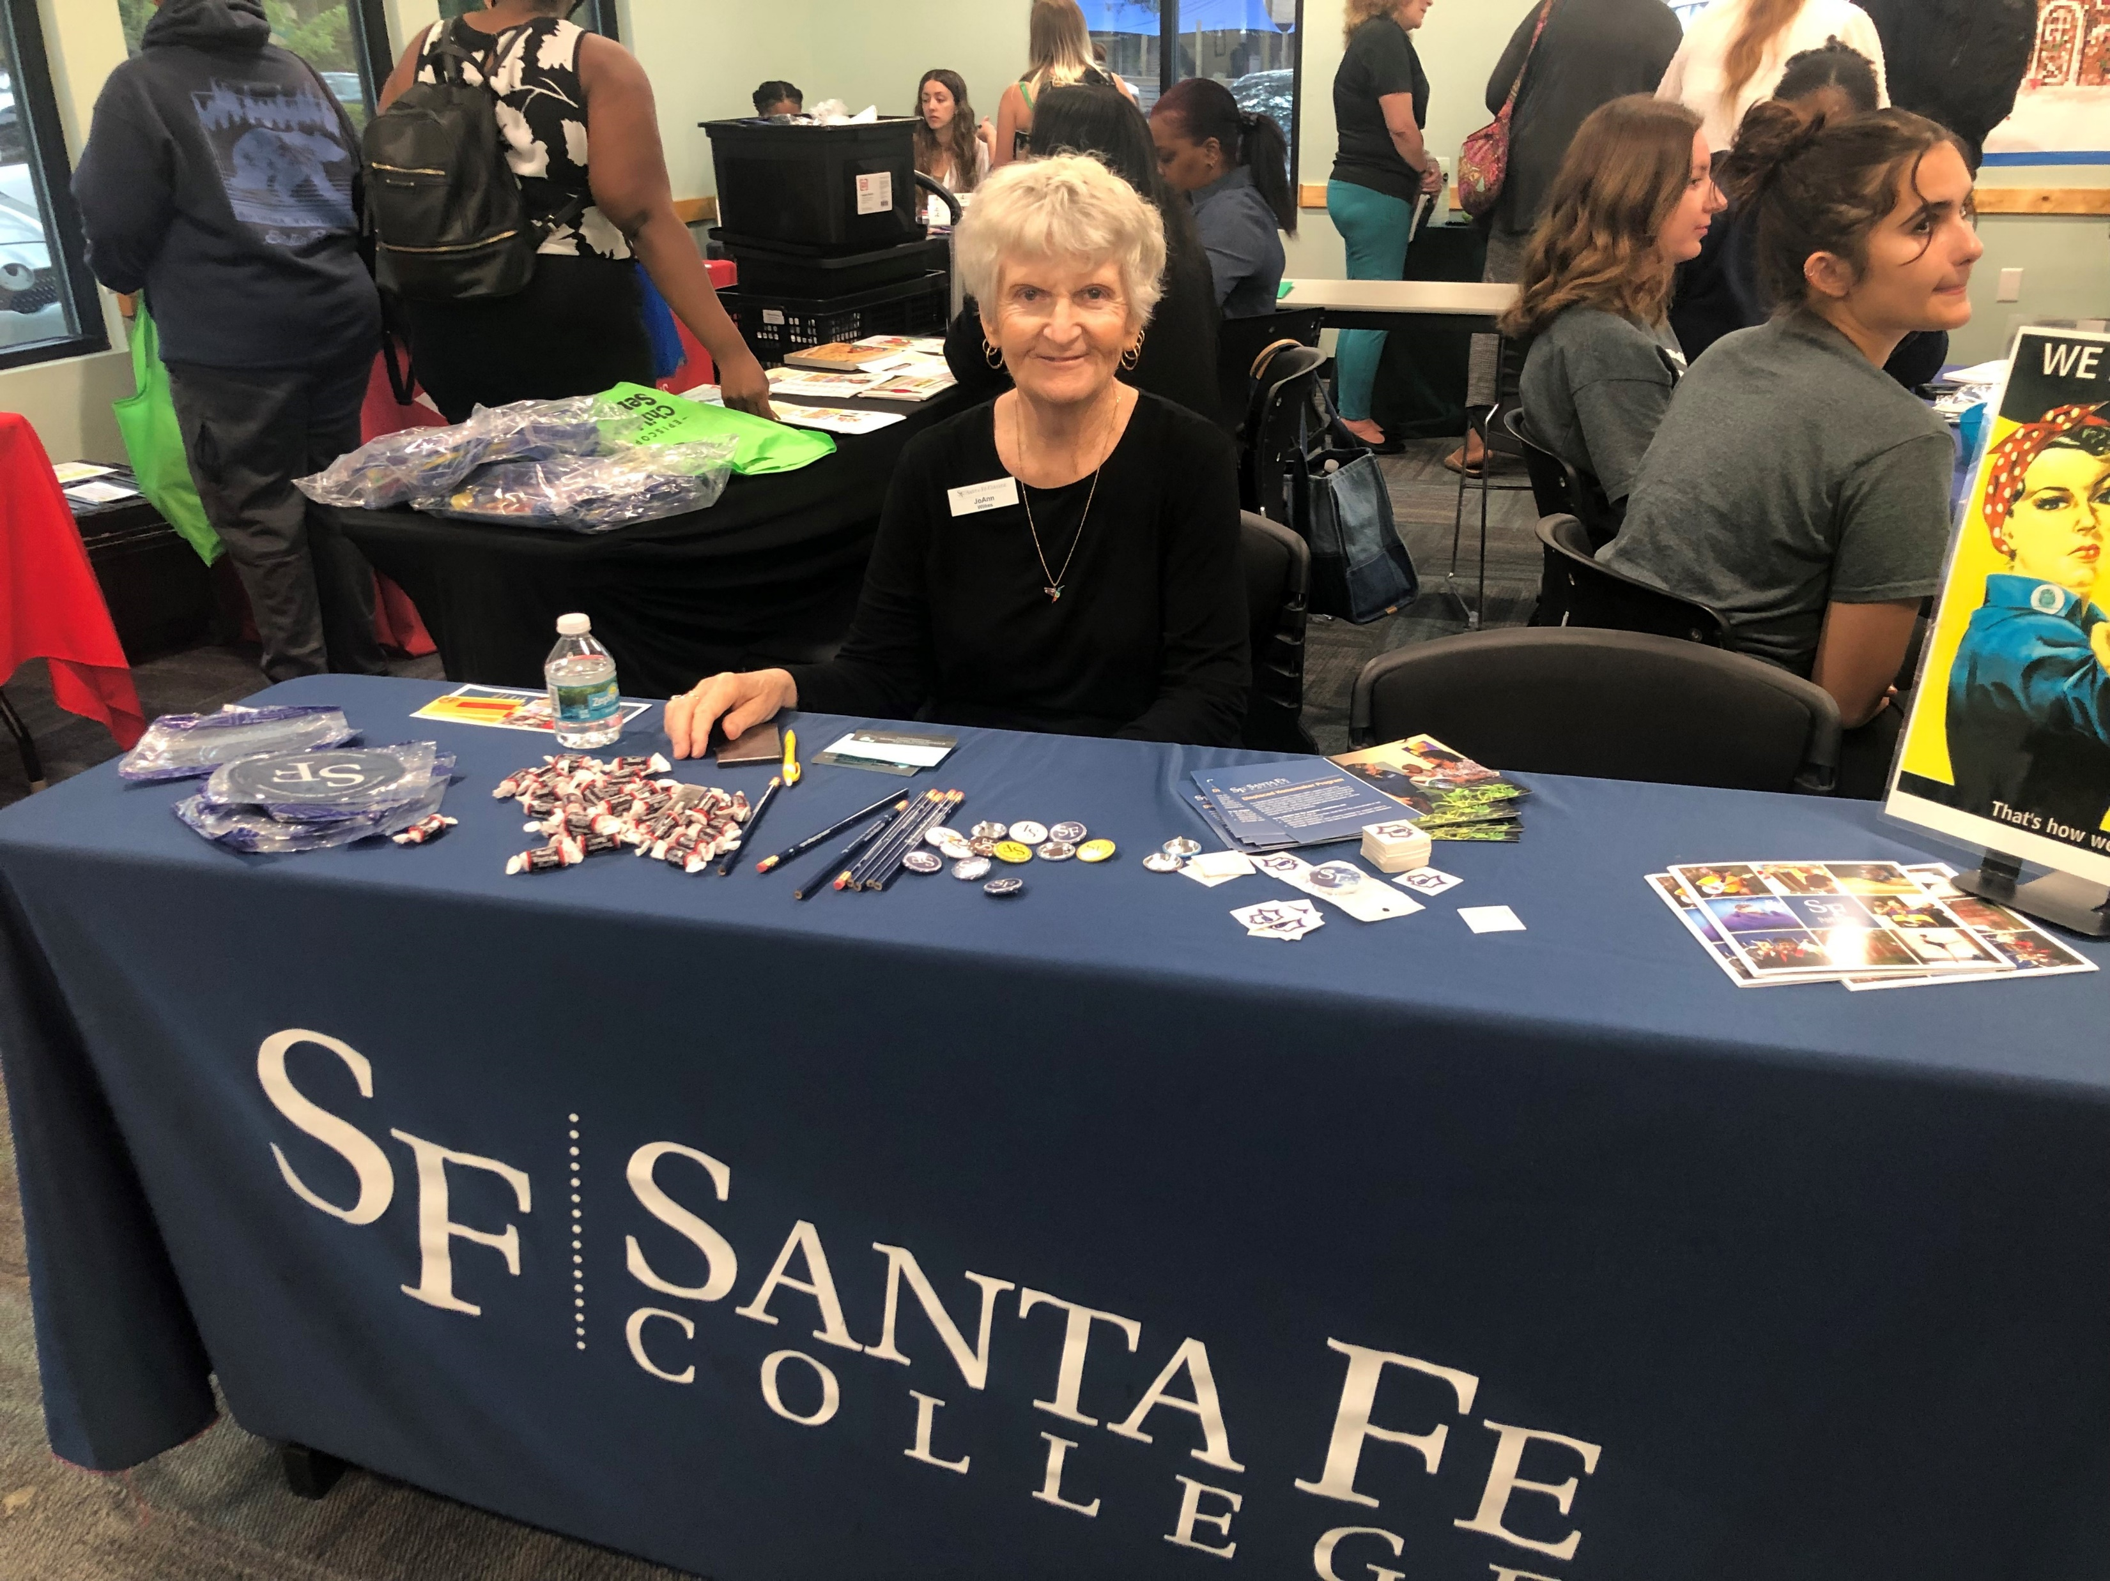

Slide 8
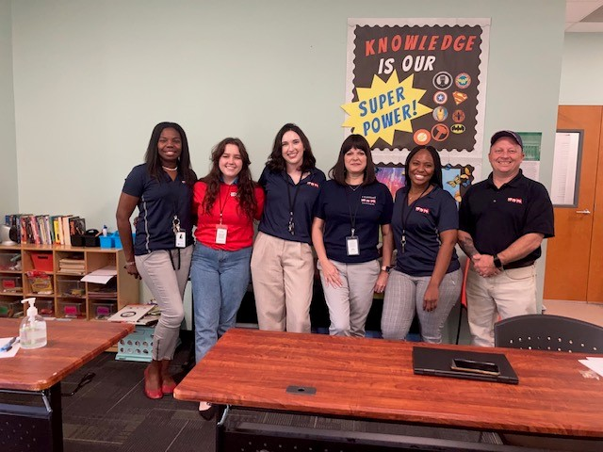

Slide 9
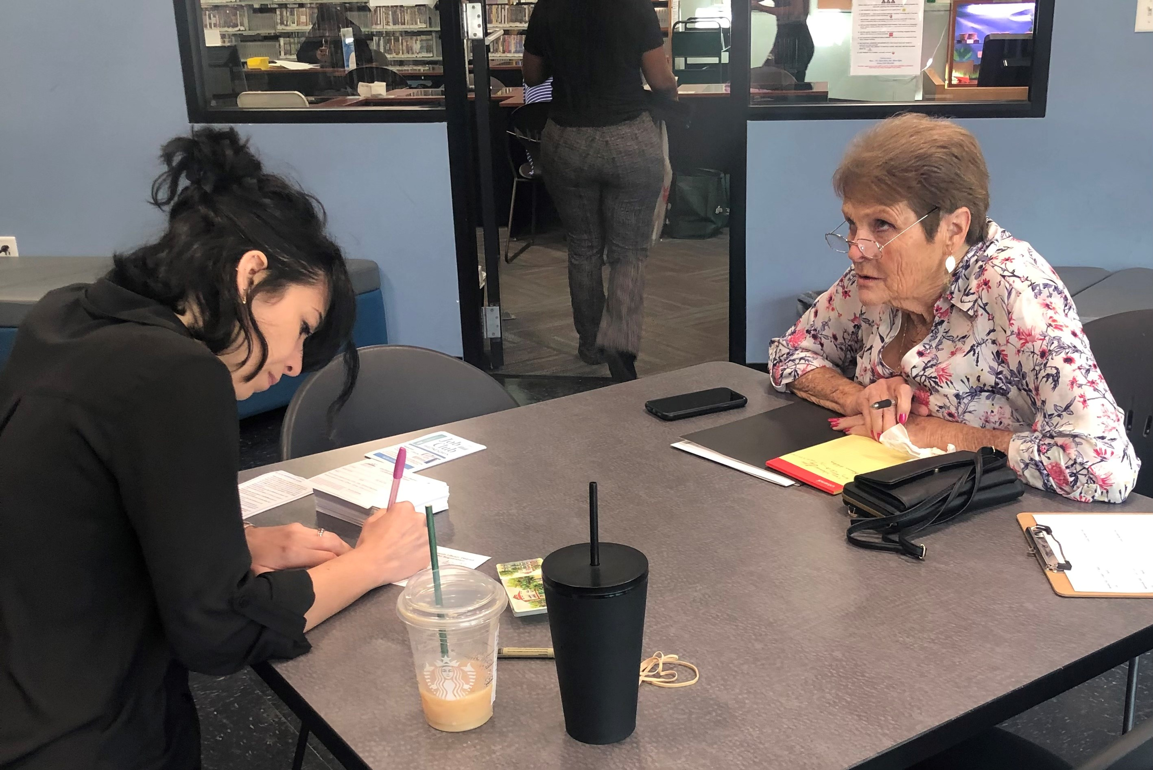

Slide 10
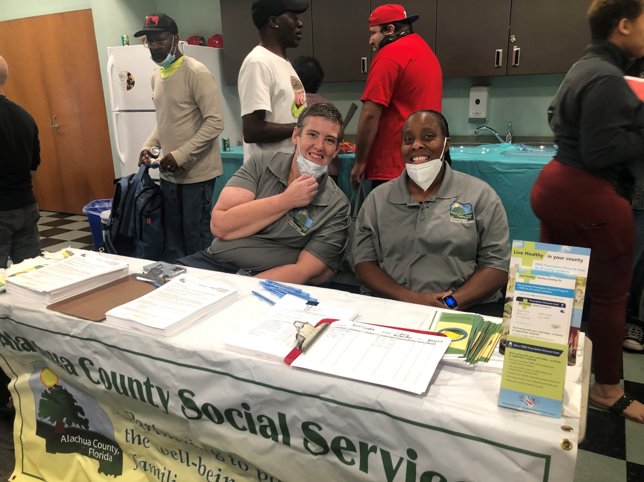

Slide 11
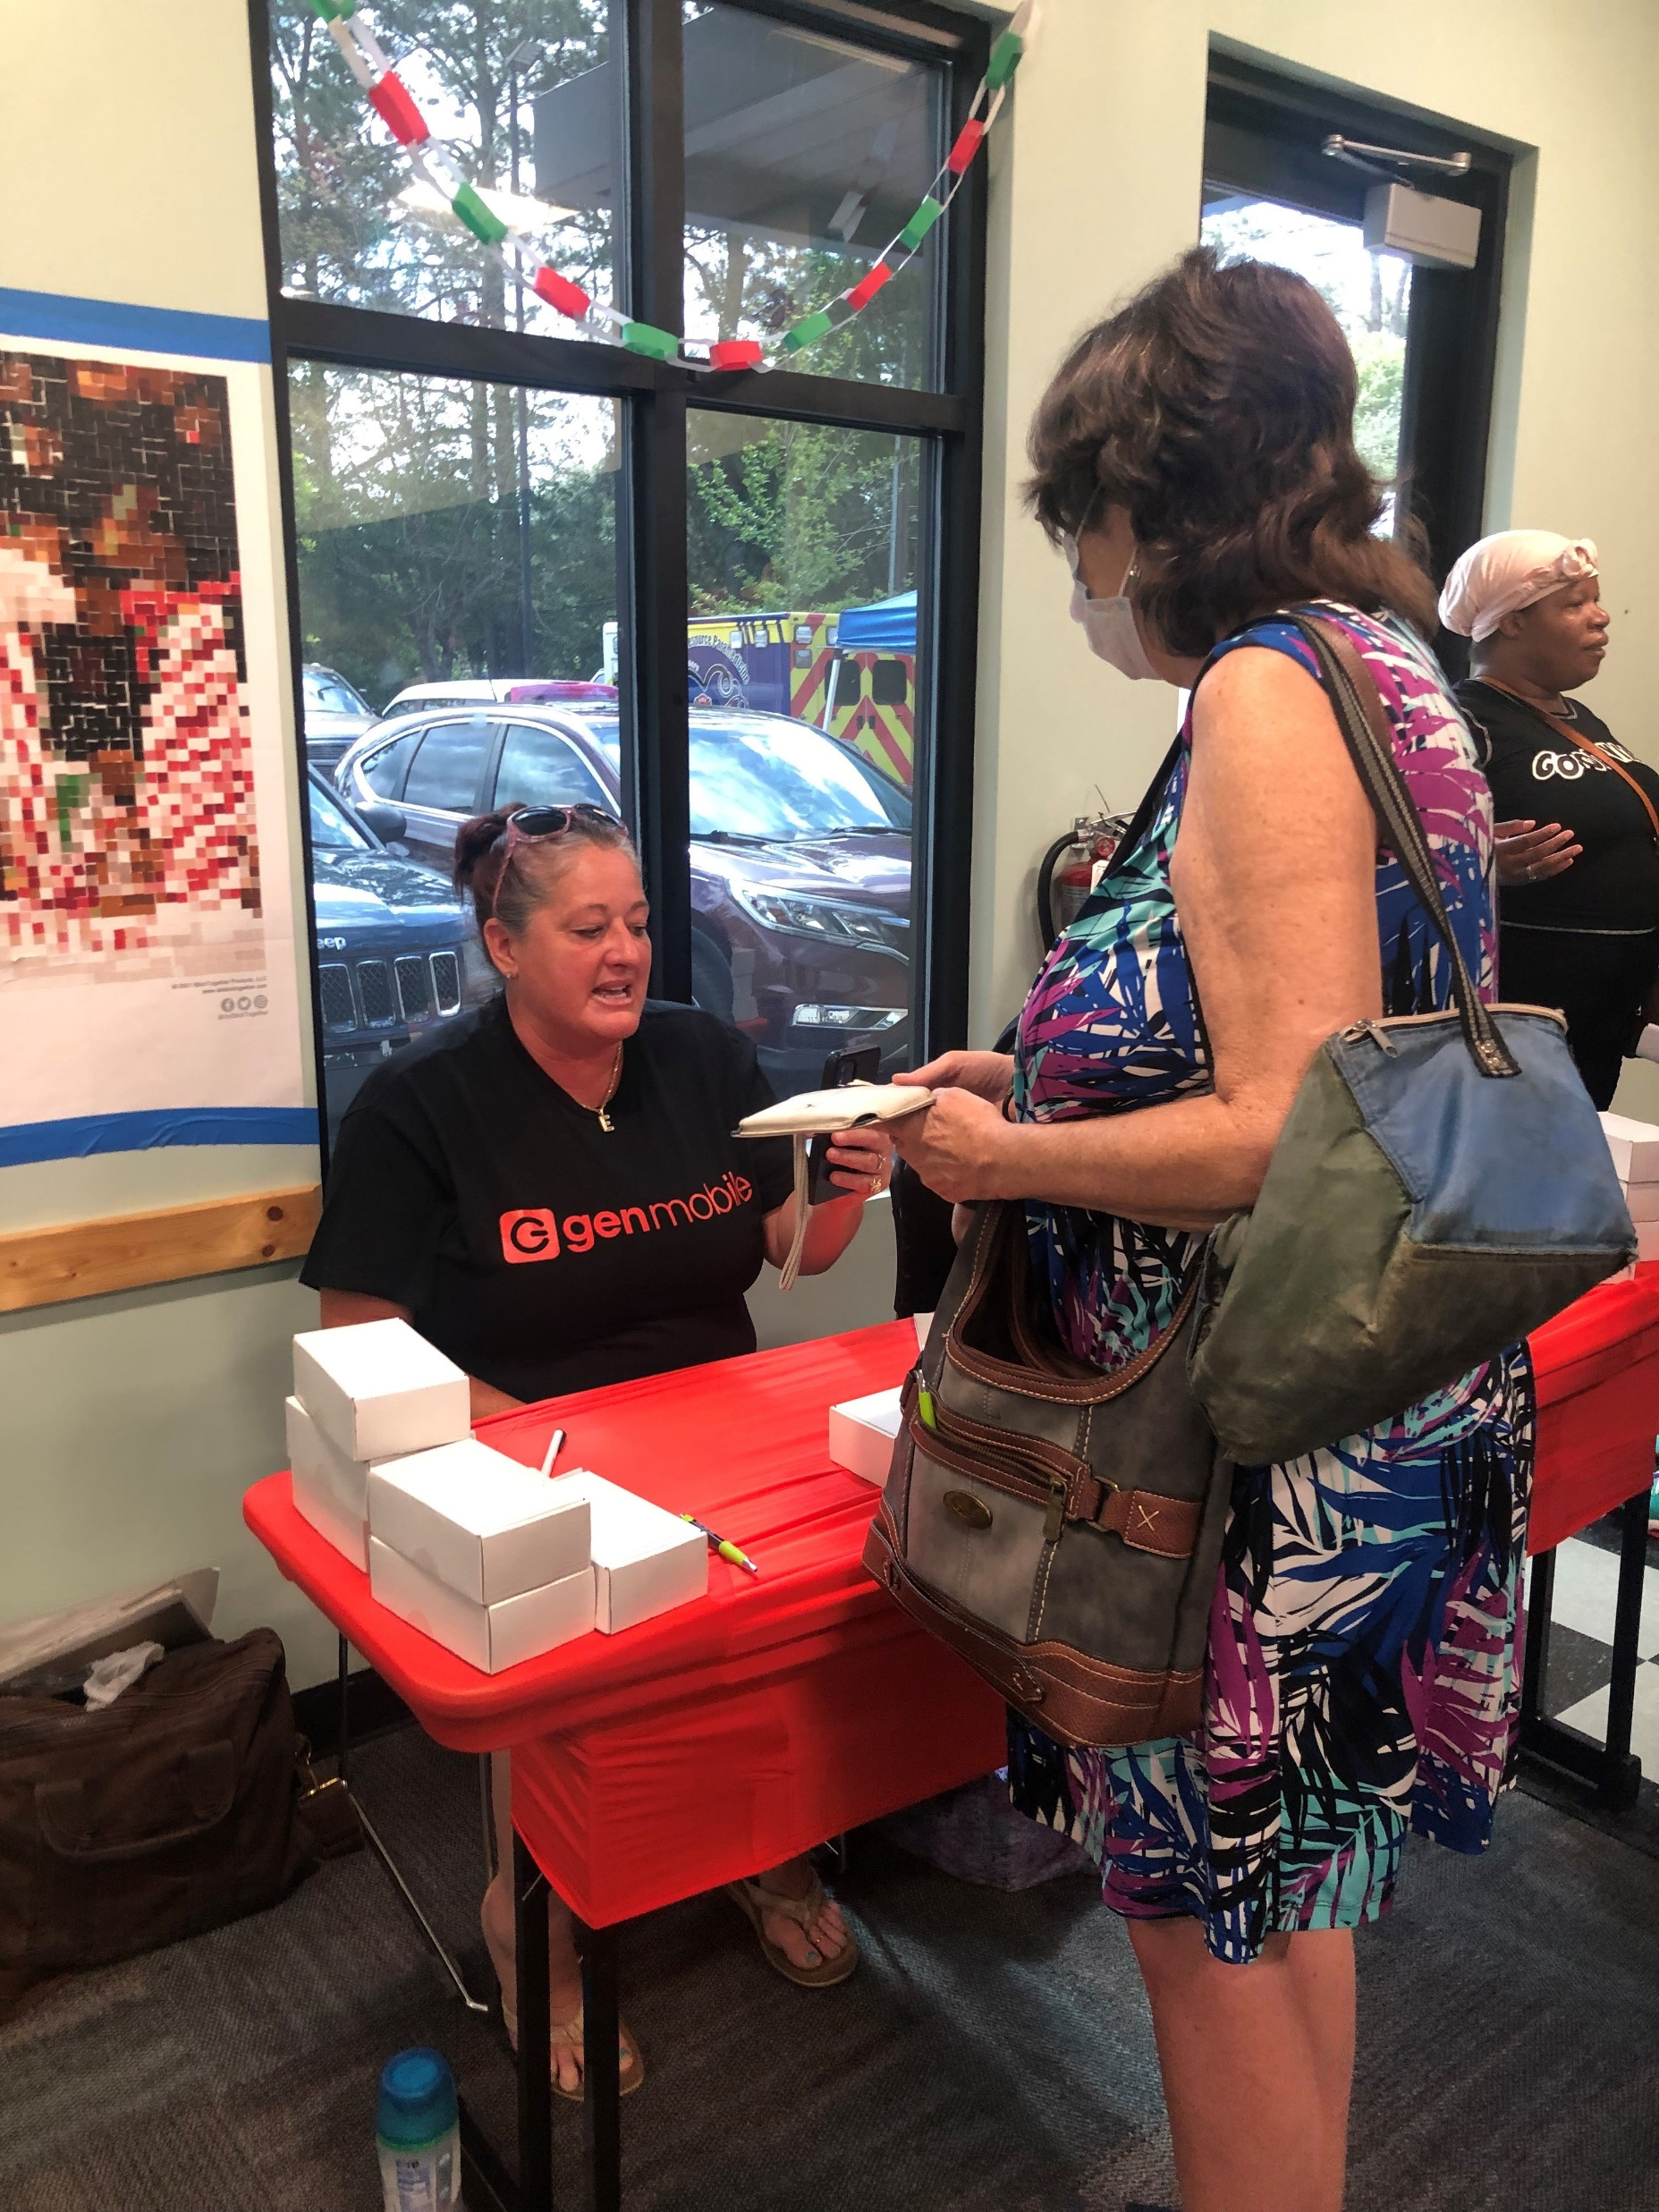

Slide 12
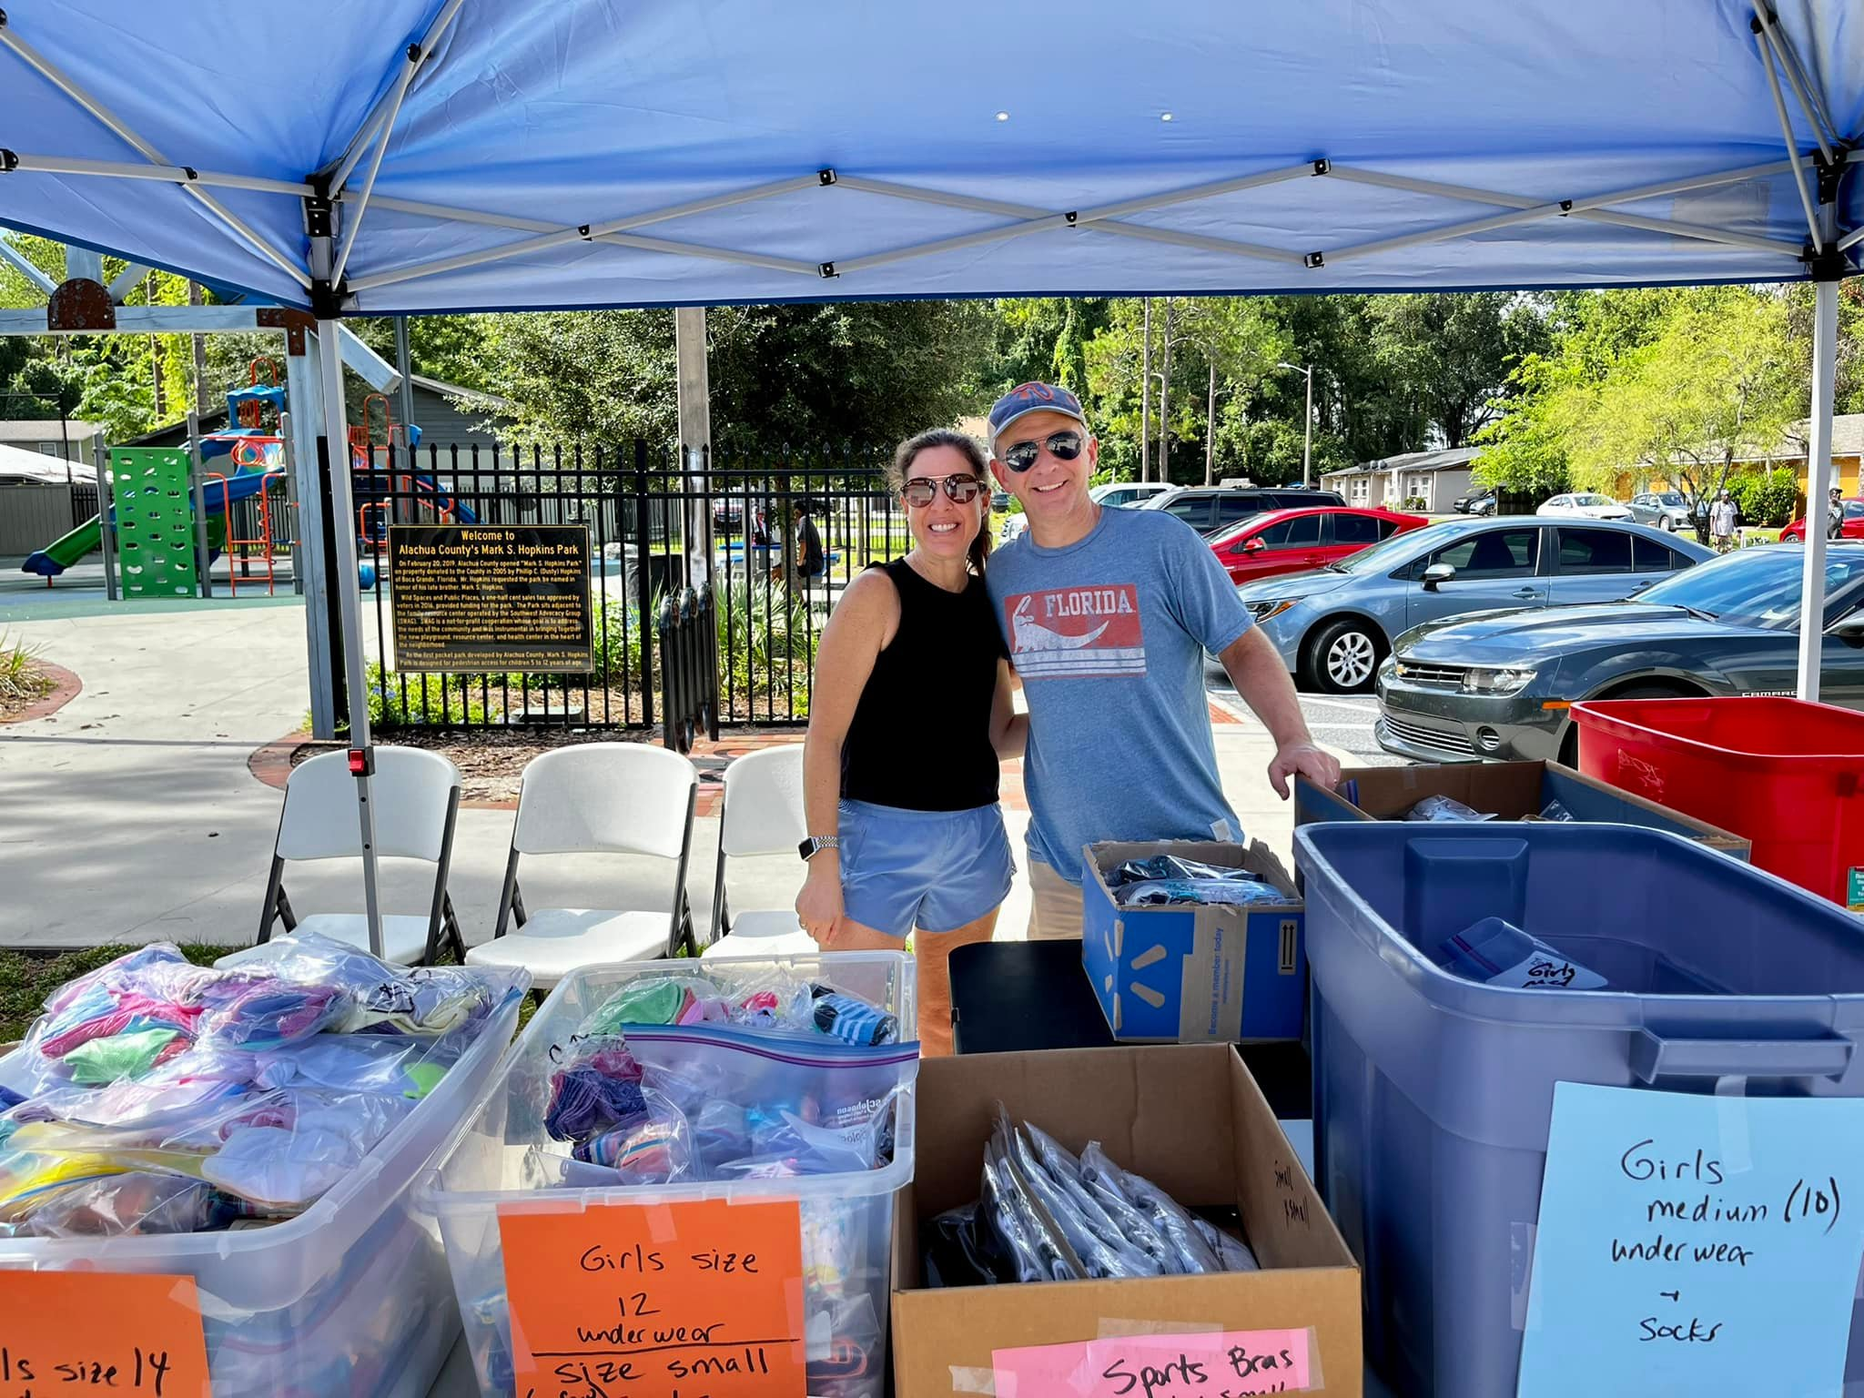

Slide 13
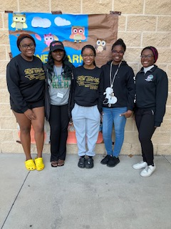

Slide 14
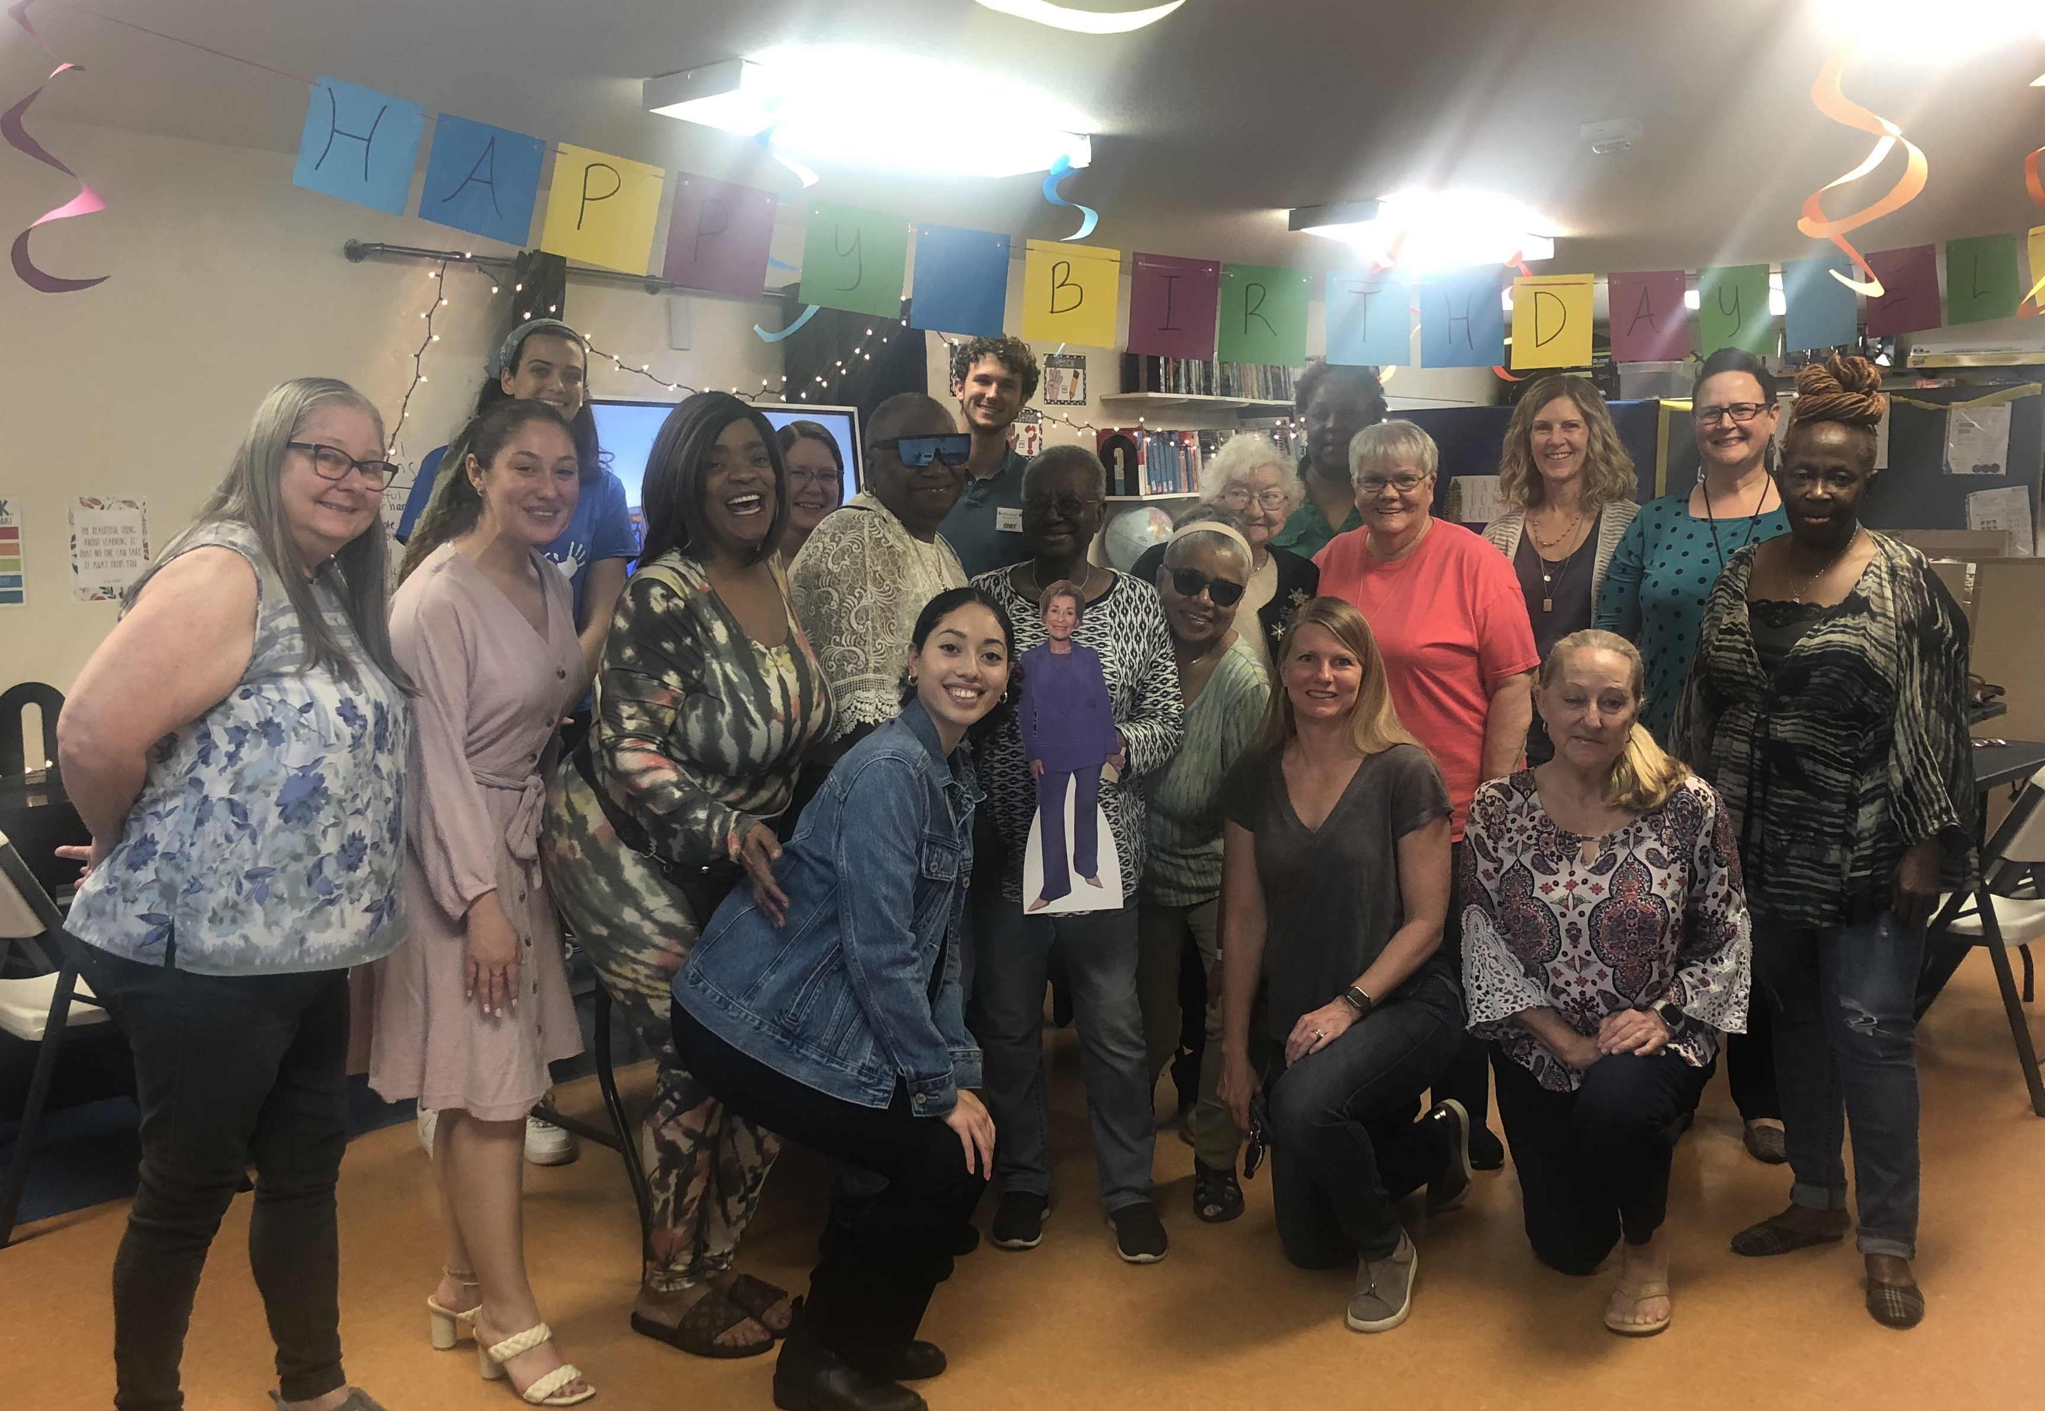

Slide 15
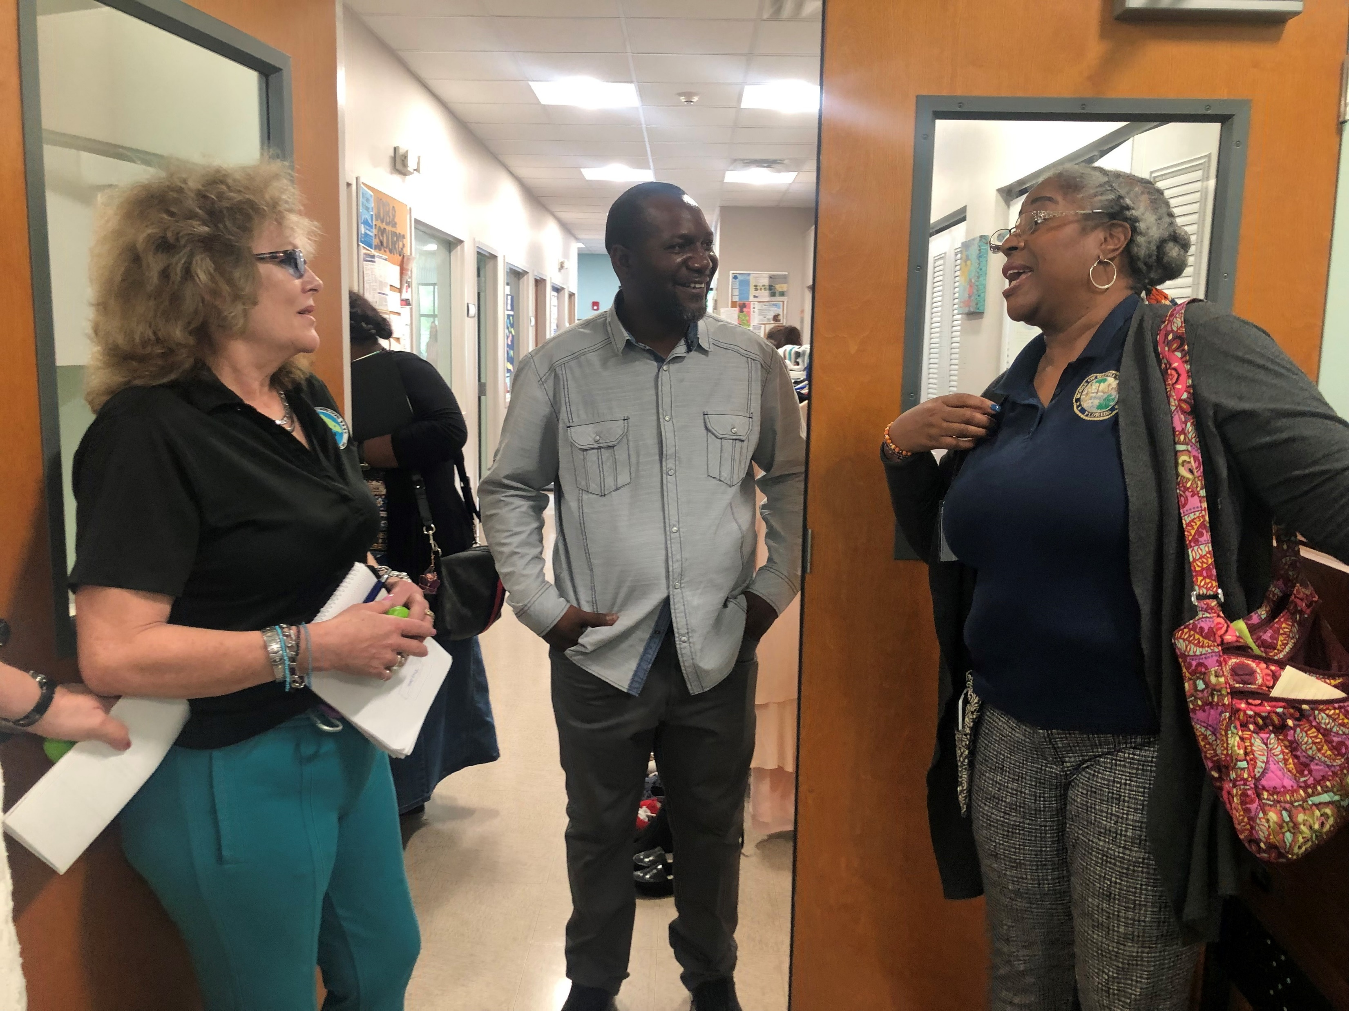

Slide 16
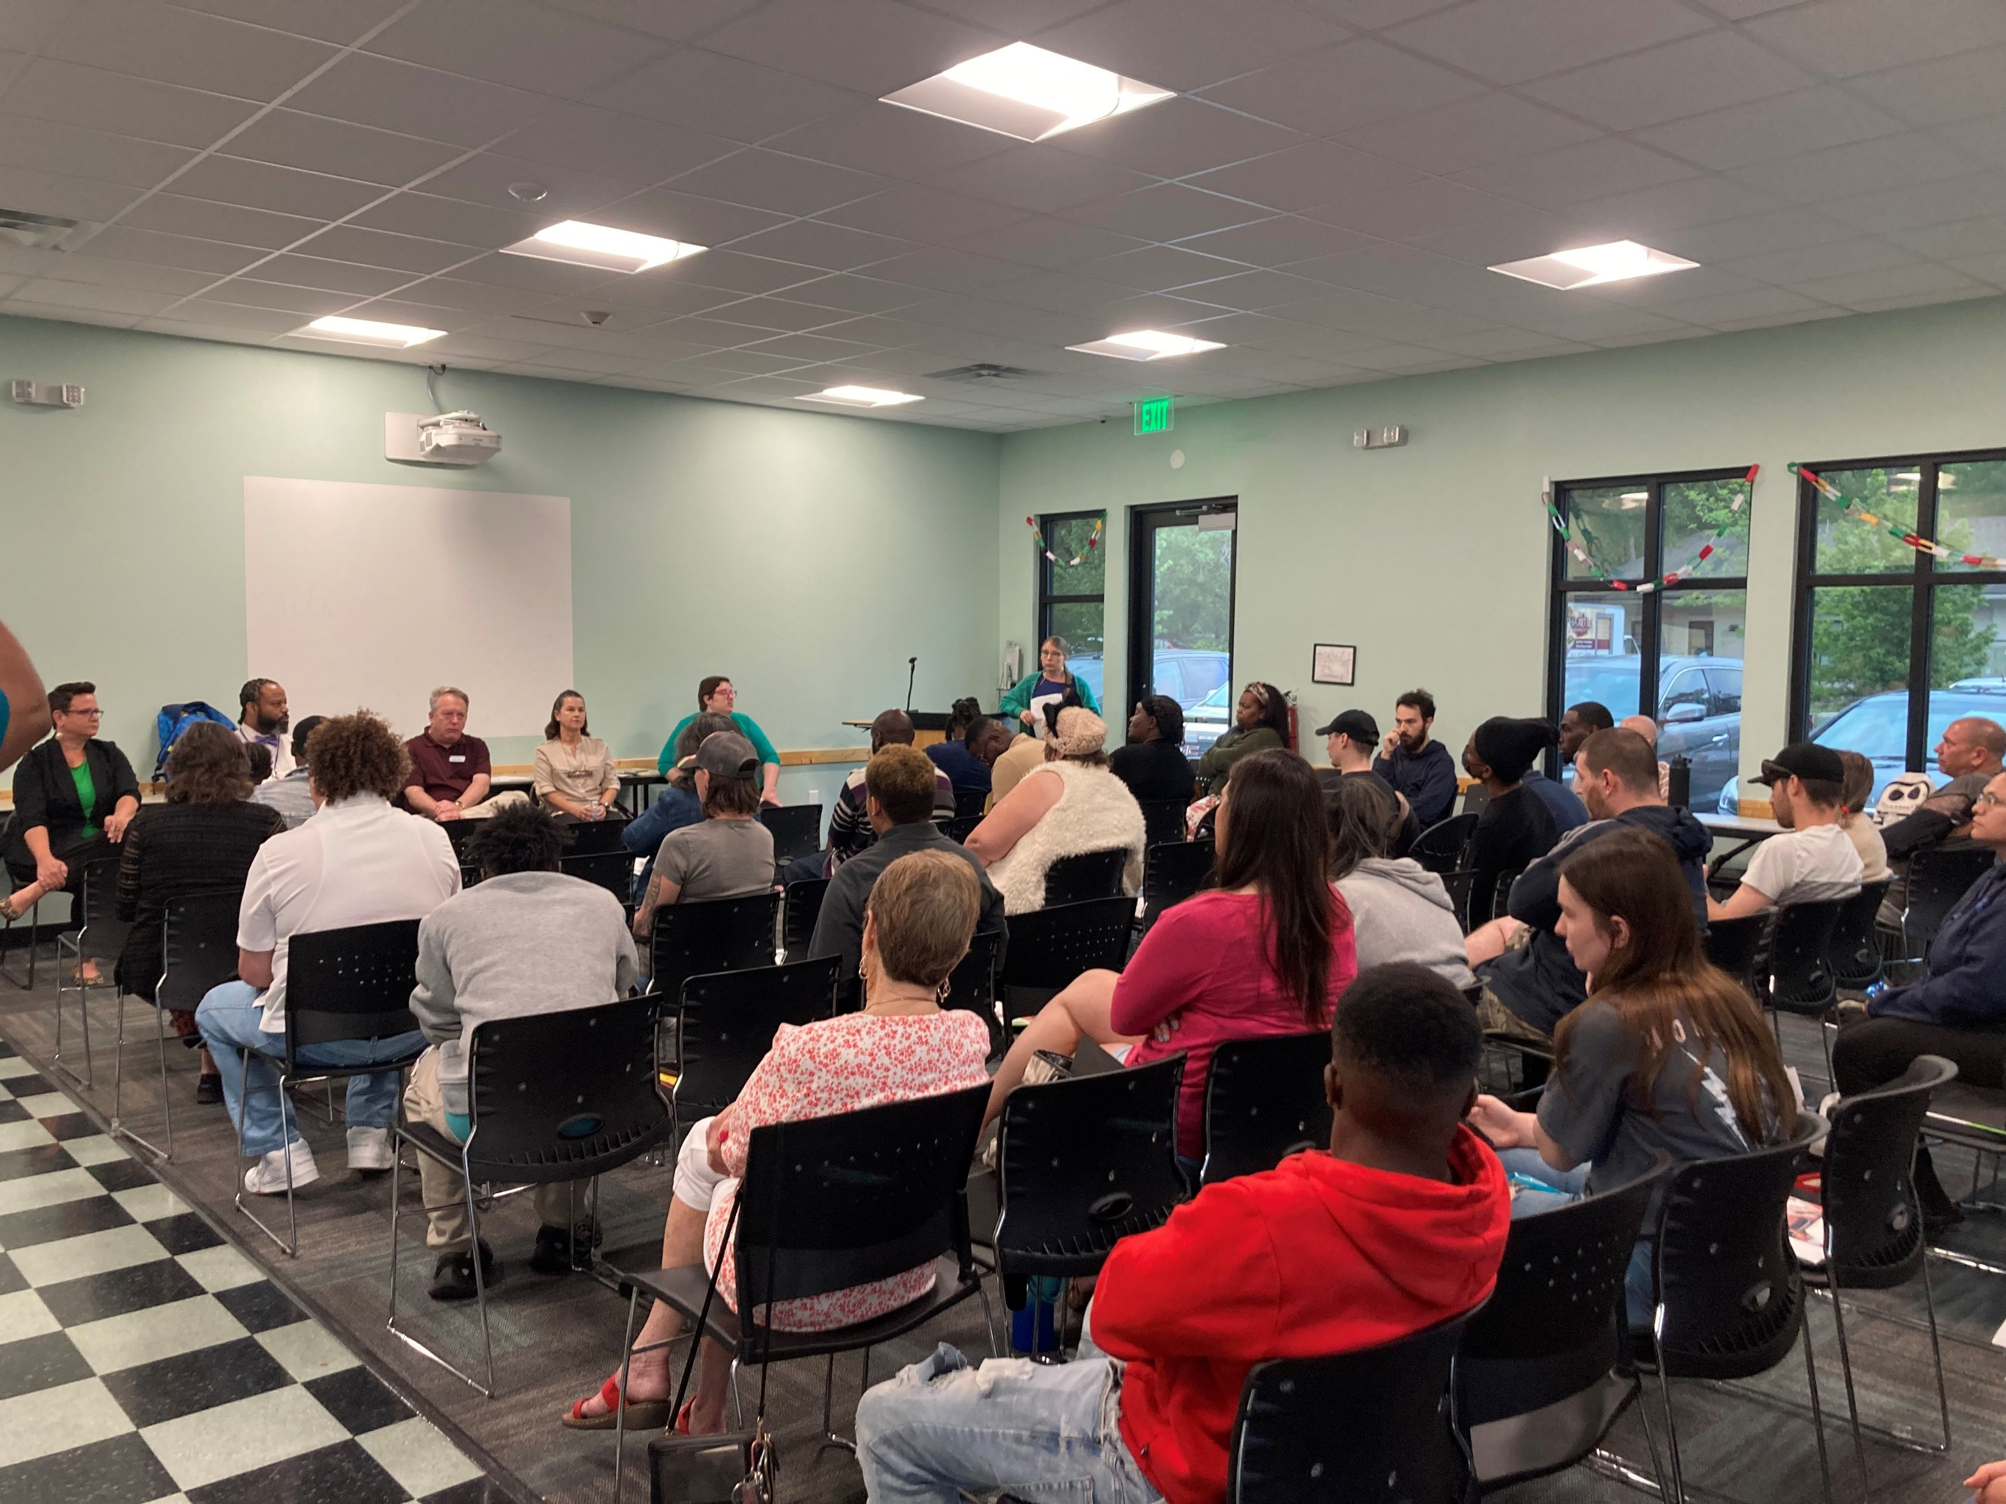
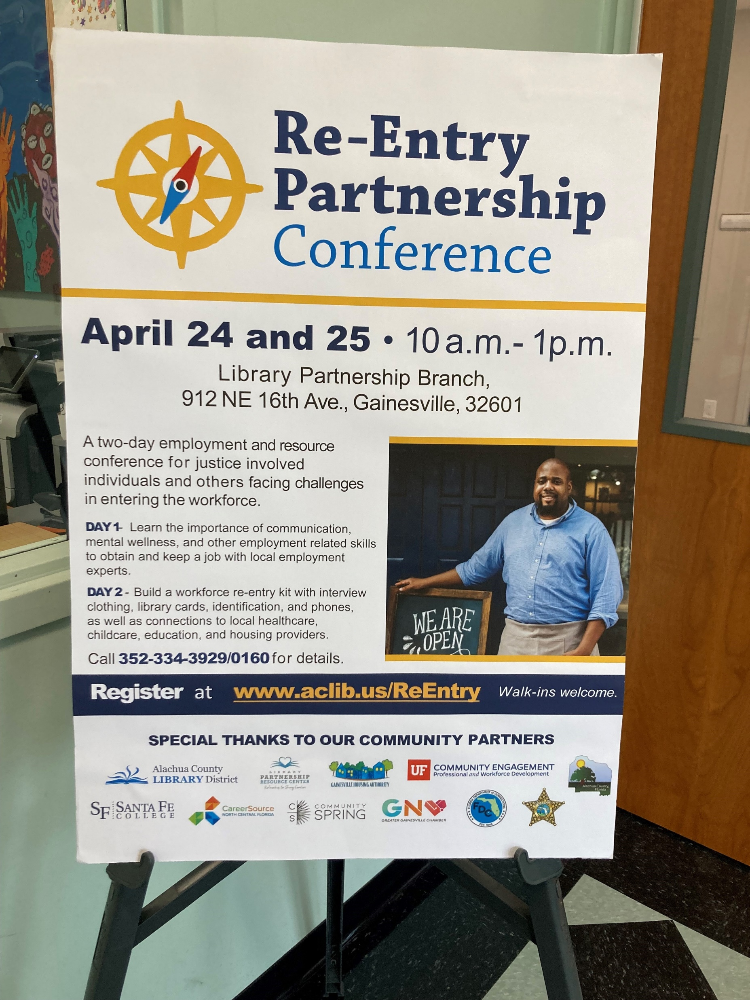

Slide 18



Of the 27,478 visits to the Family Resource Centers in 2022, 24% directly involved services for children between the ages of 0-17.
Notes:
A hallmark of Partnership’s system of care is the belief that child abuse and neglect is preventable.
Research has found that successful interventions must both reduce risk factors and promote protective factors to ensure the well-being of children and families. Focusing on promoting protective factors is a more productive approach than reducing risk factors alone.
Promoting healthy development, facilitating nurturing relationships, and providing resources, supports, and coping strategies serve to build upon the existing strengths and assets within families and the community.

Slide 19
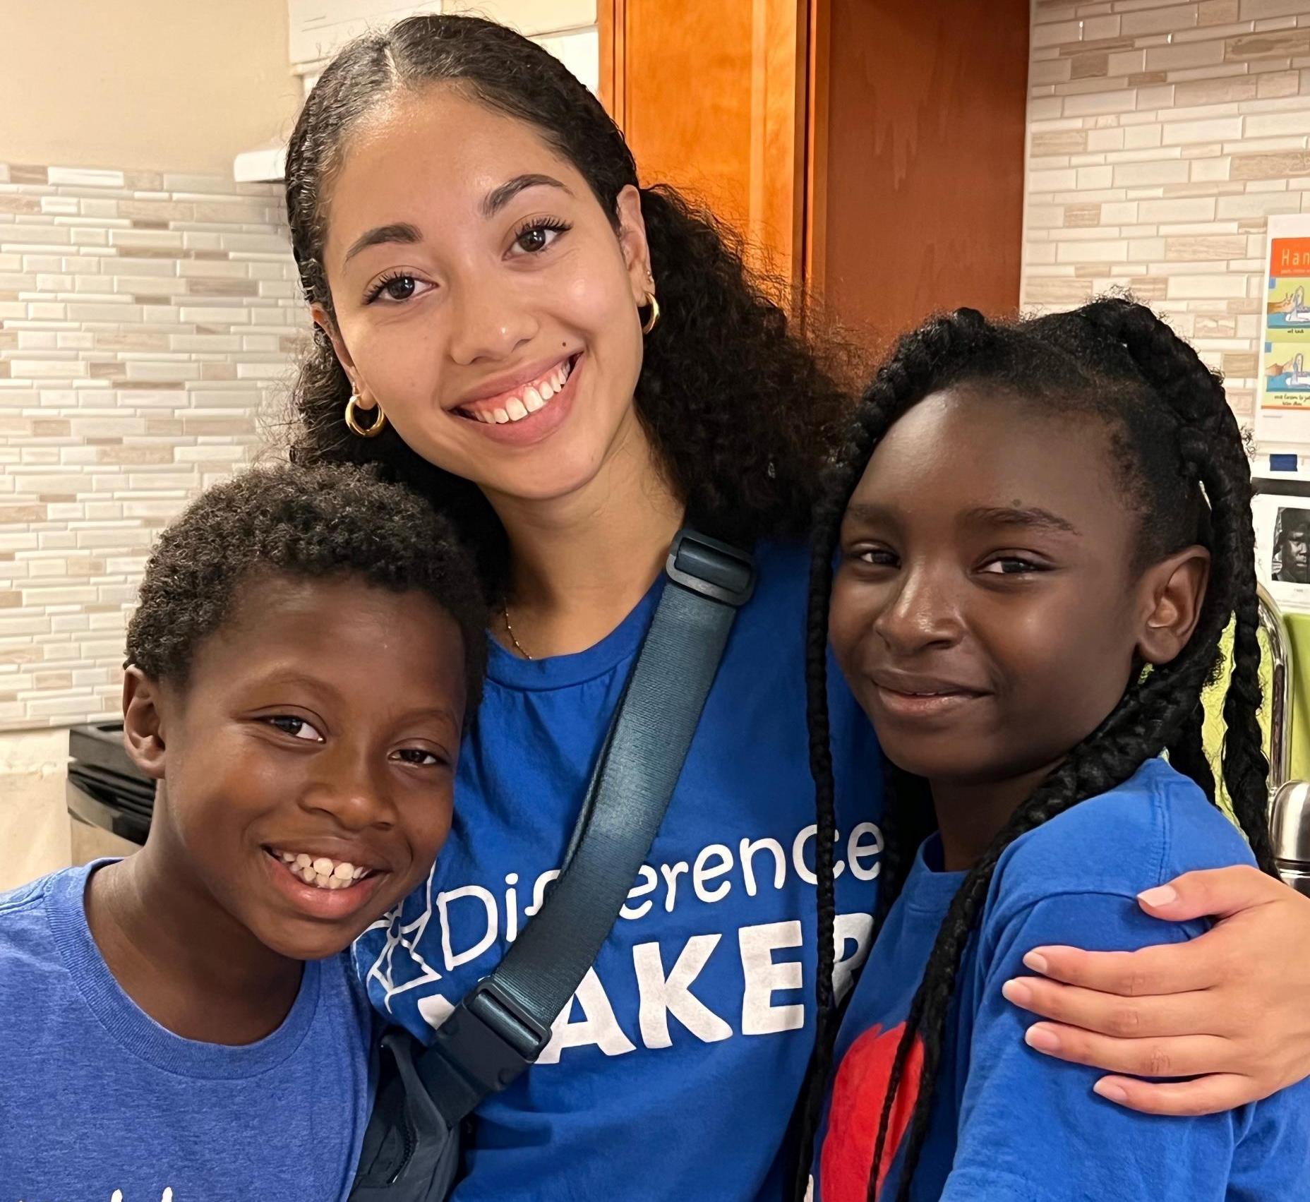

Slide 20
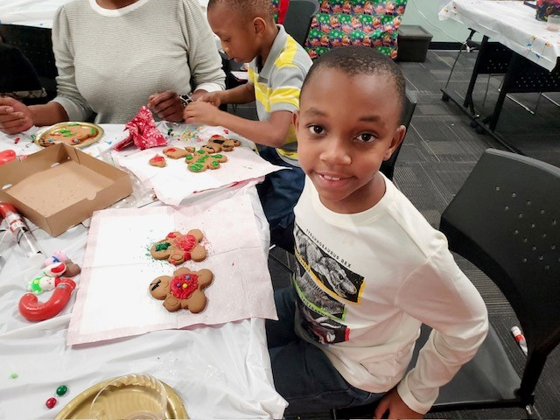

Slide 21
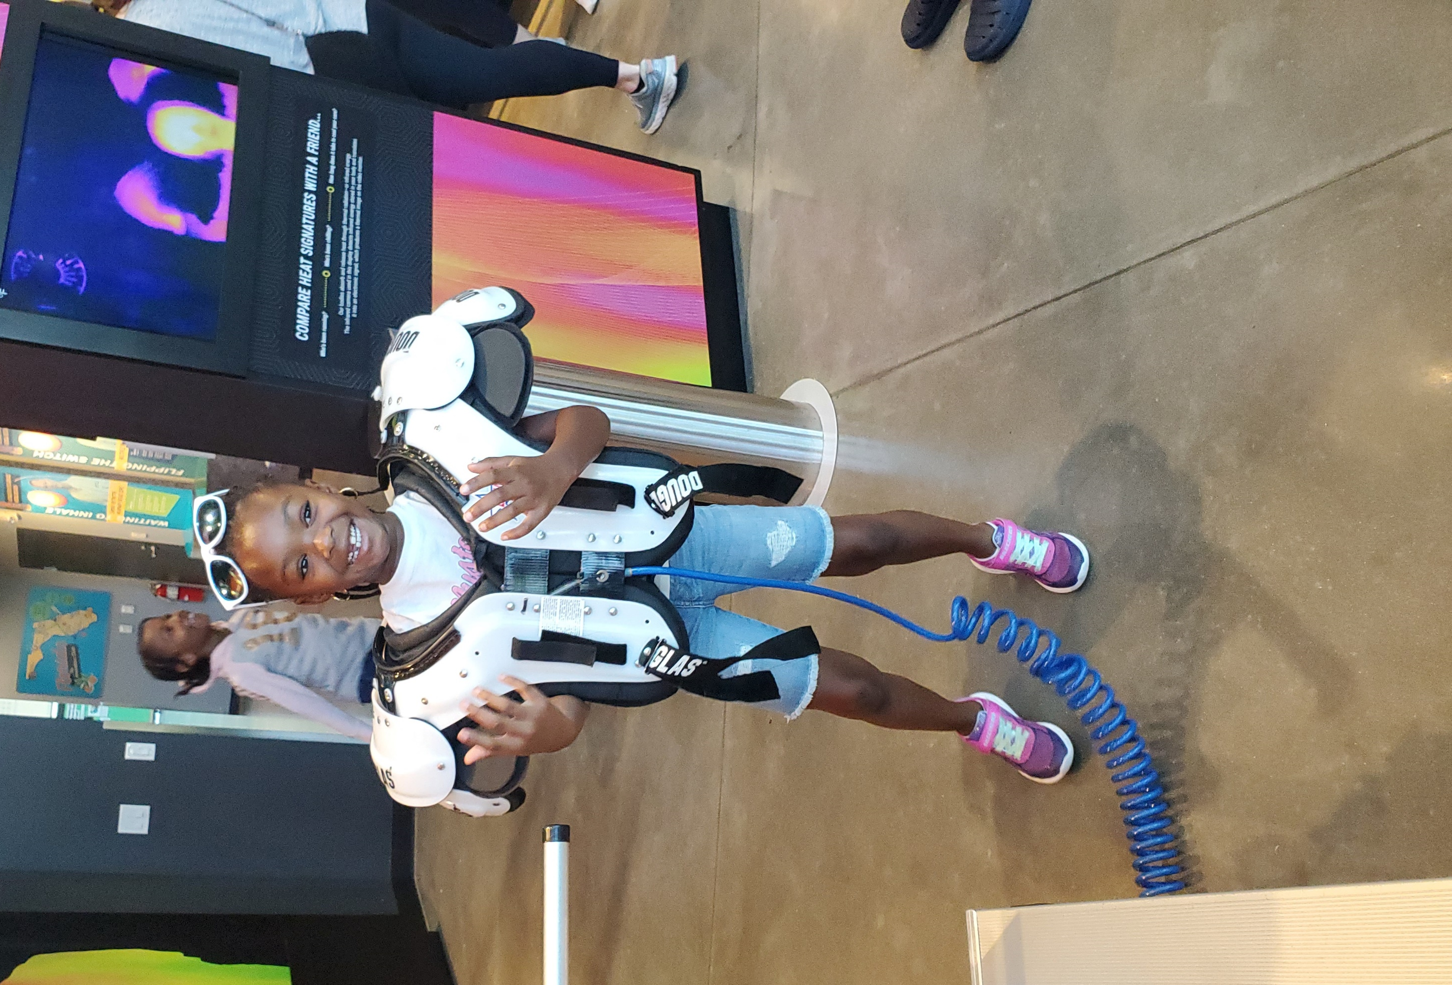
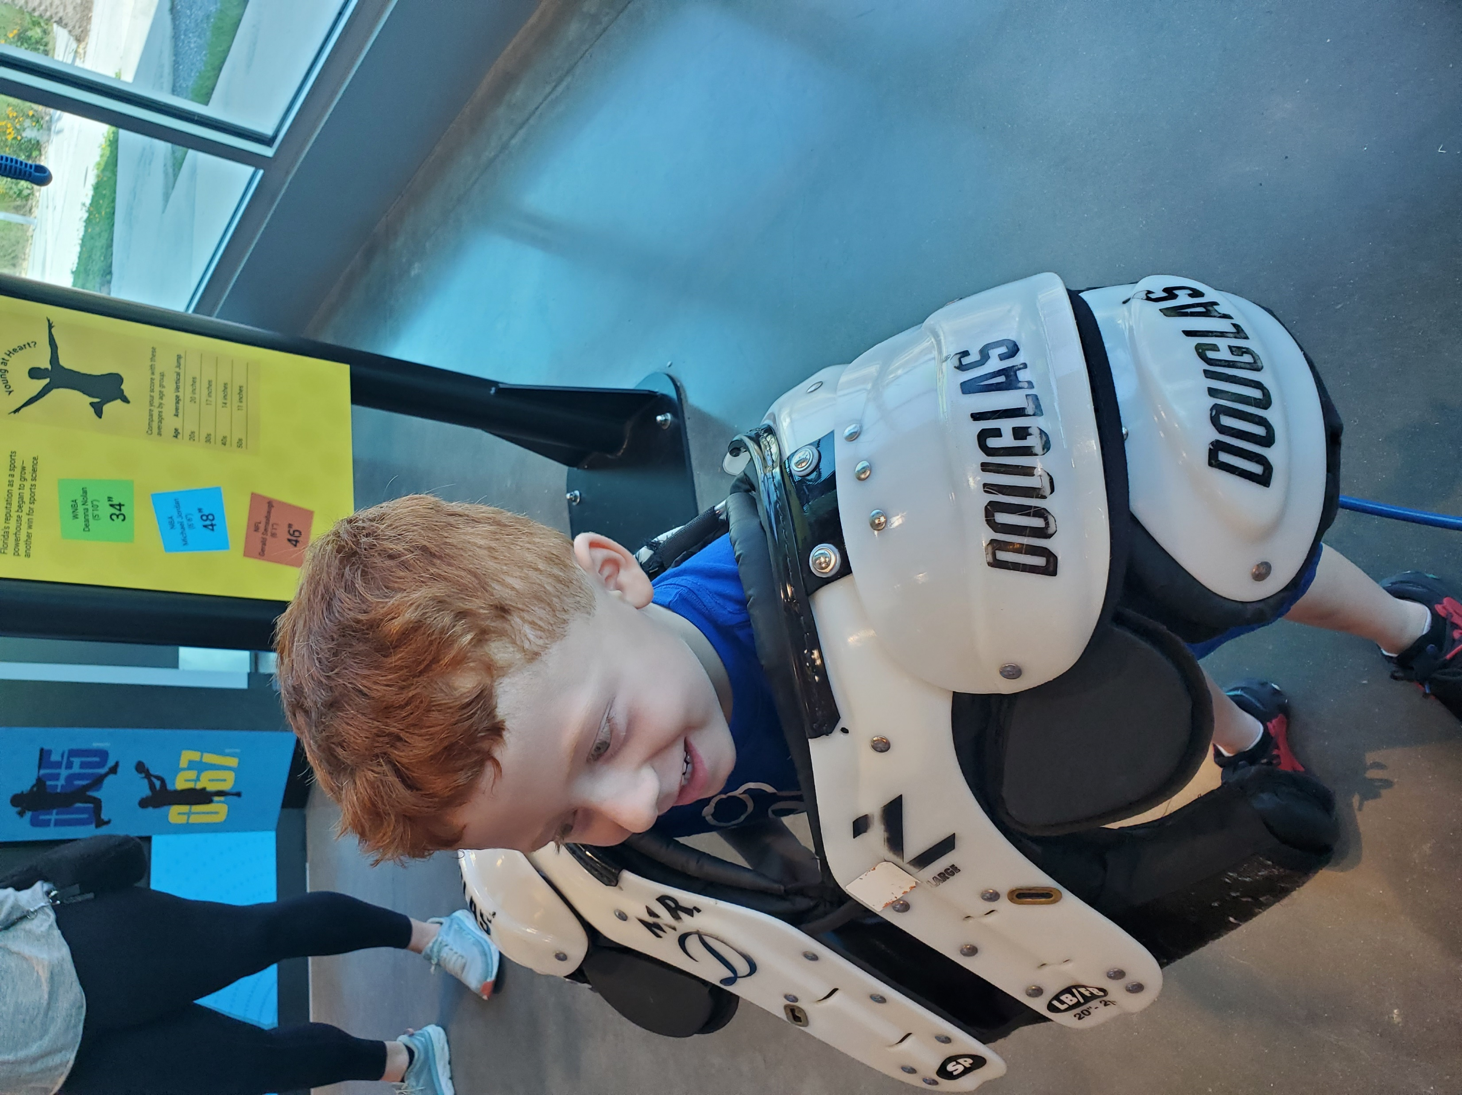

Slide 22
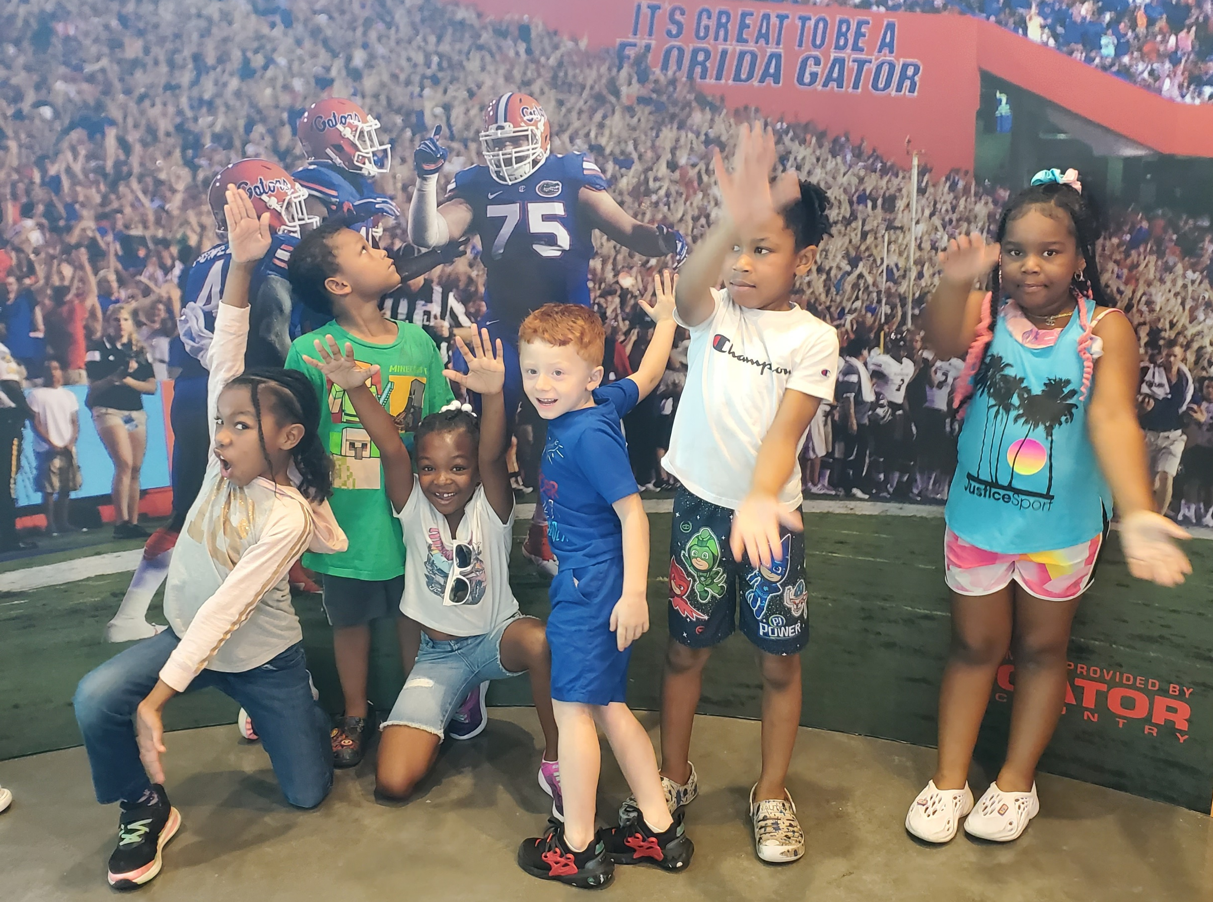

Slide 23
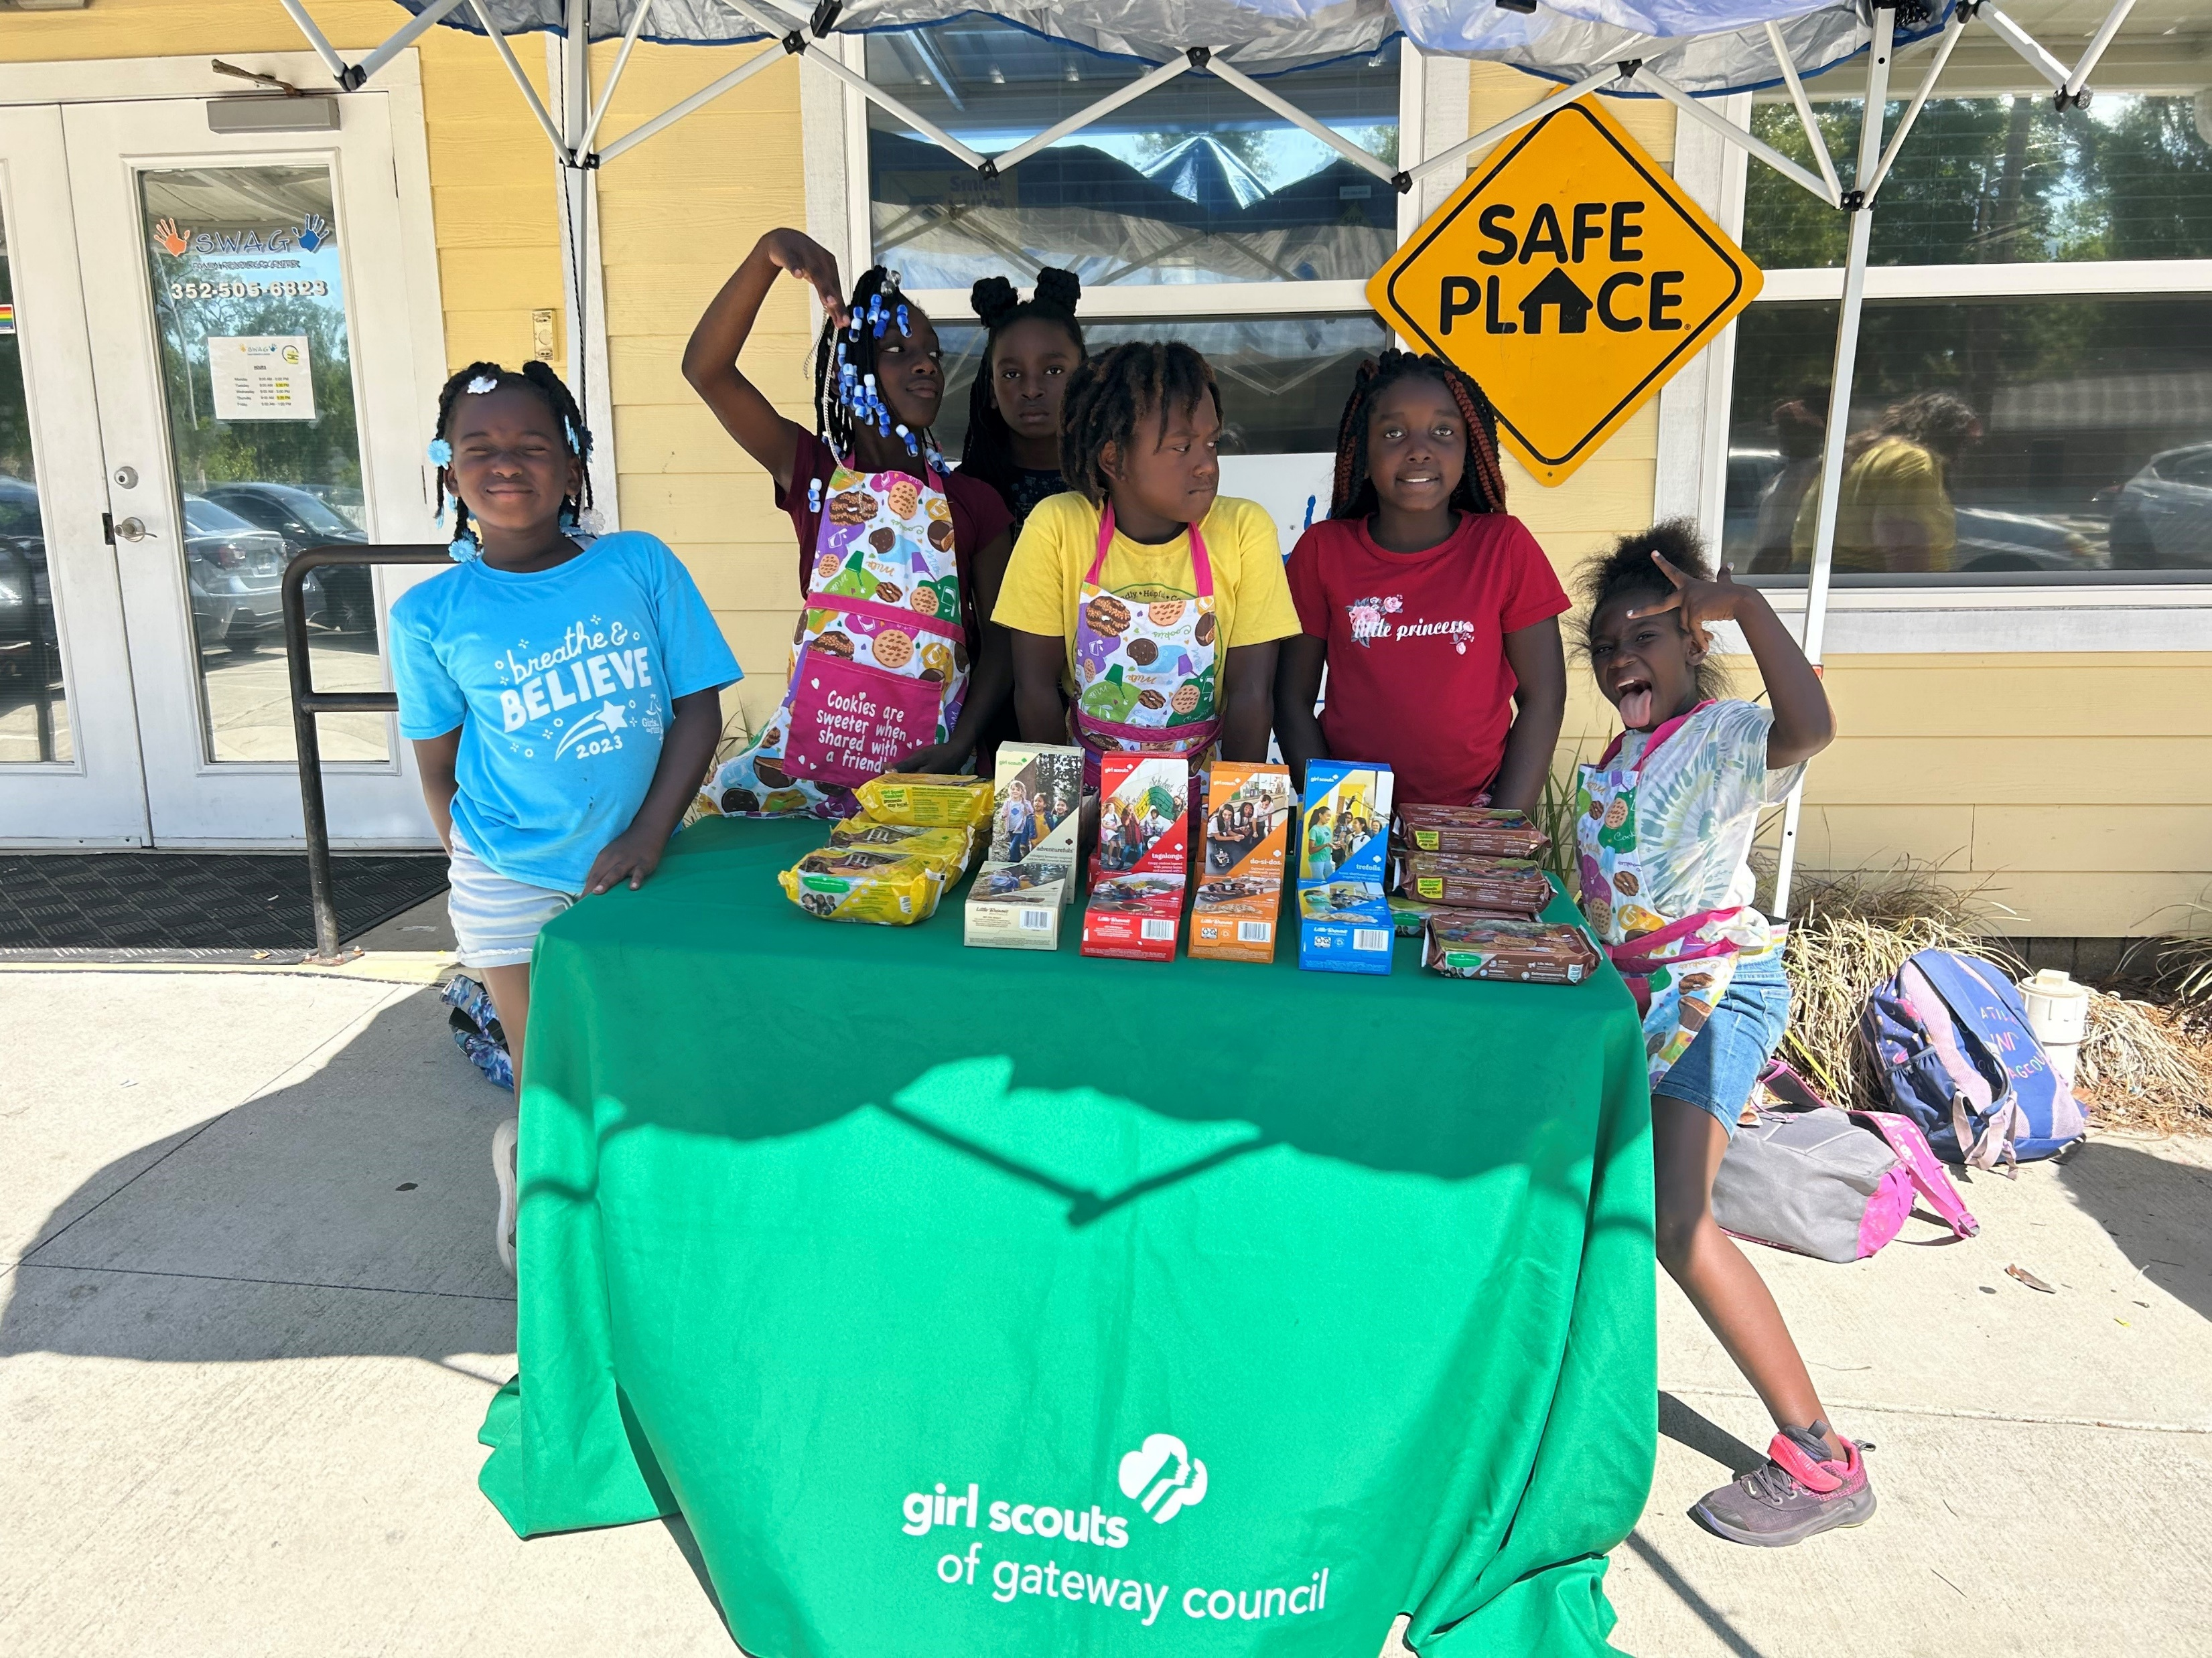

Slide 24
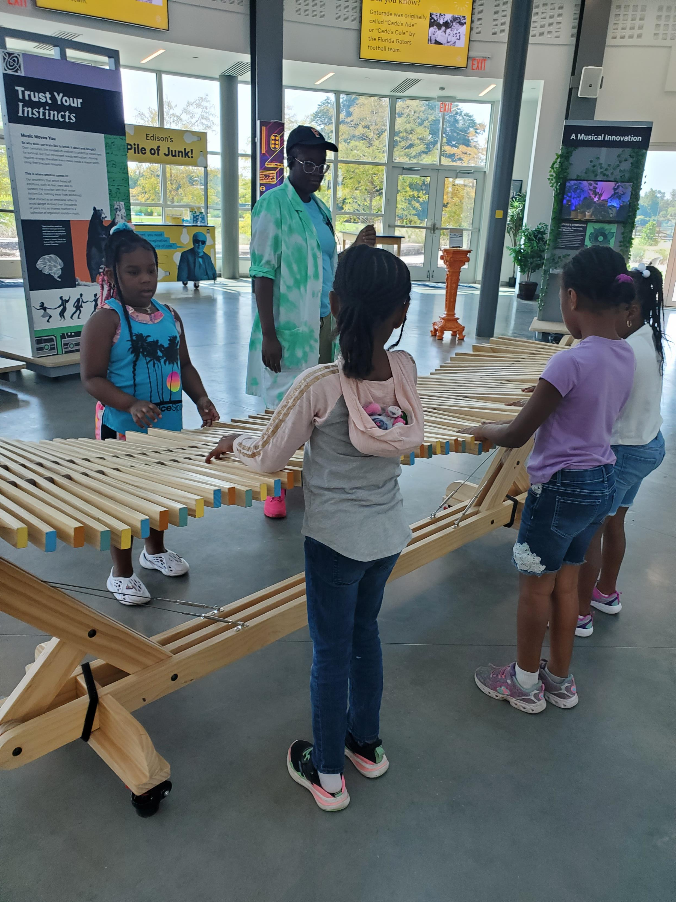

Slide 25
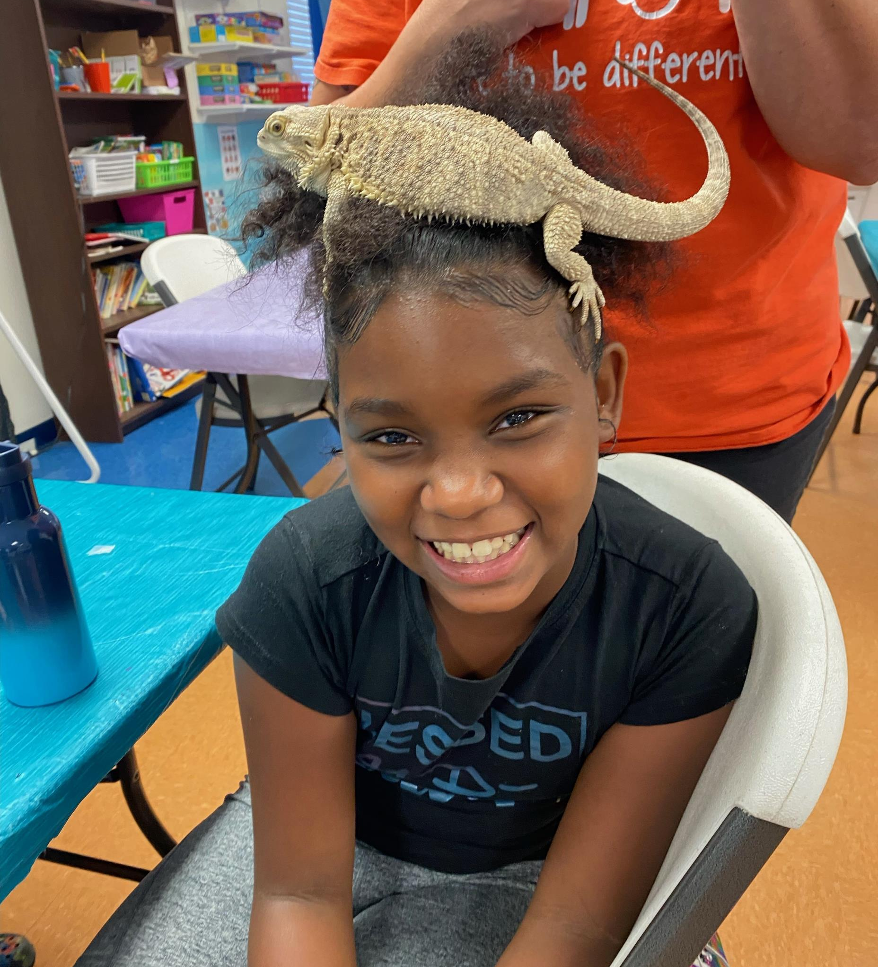

Slide 26
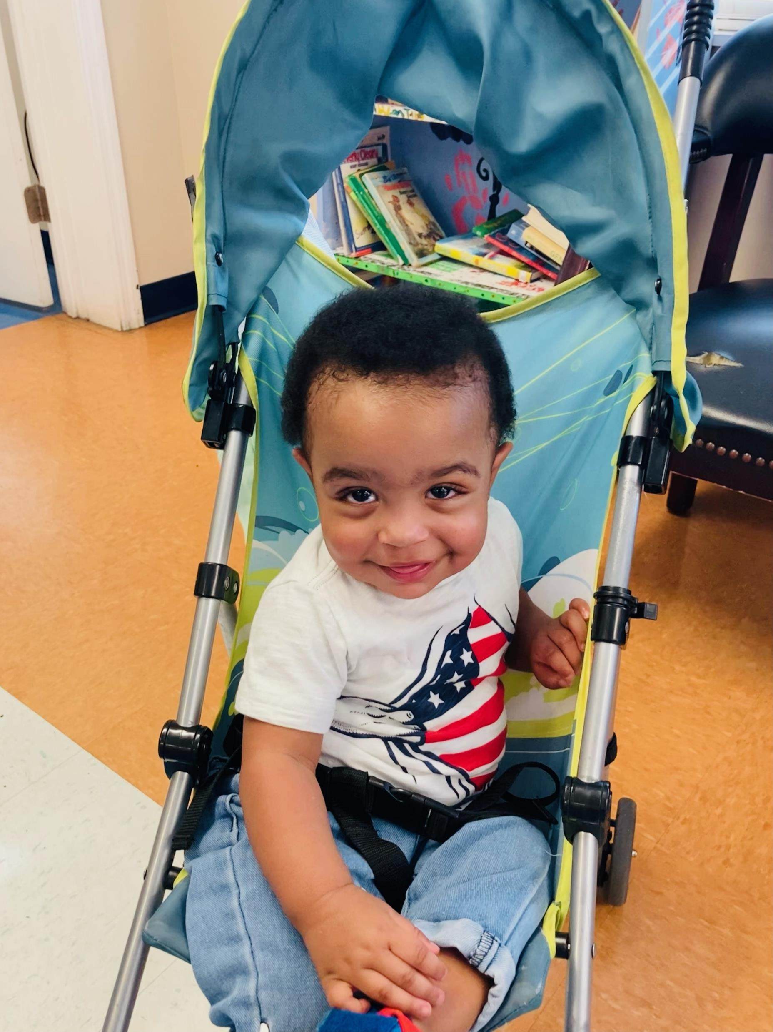

Slide 27
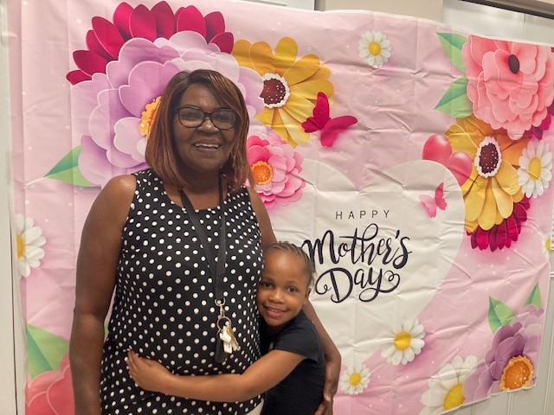

Slide 28
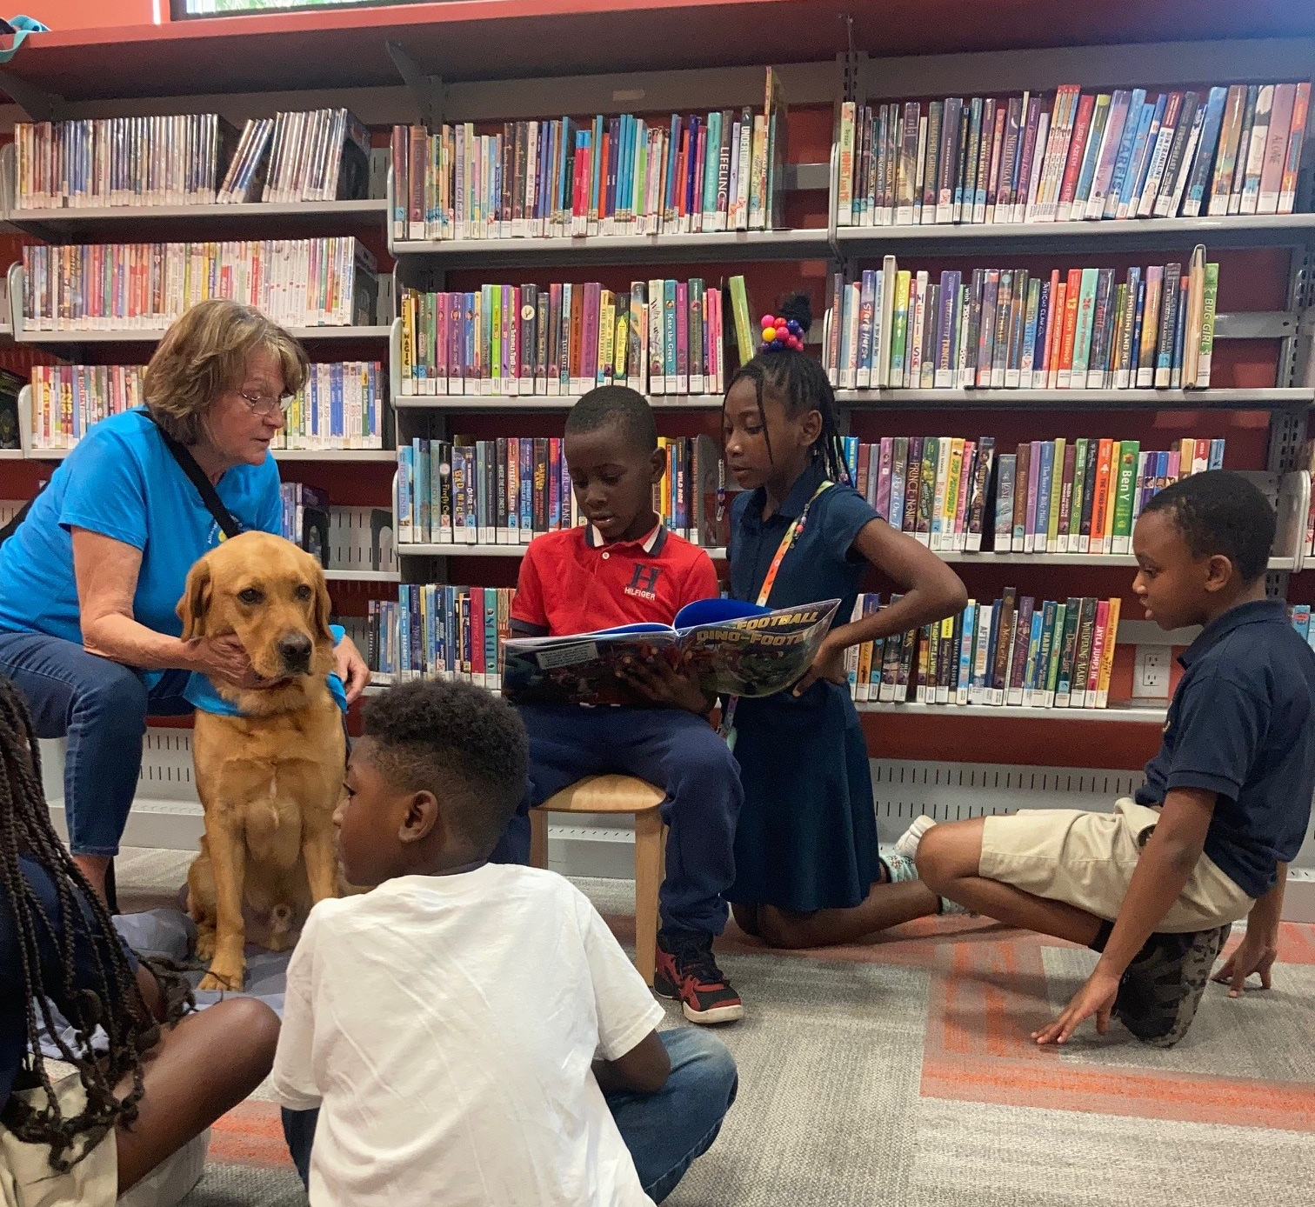

Slide 29
Alachua County-CAPP
Children's Bureau-ACF
Children's Trust of Alachua County
Clay Electric Foundation
Florida Blue
Infotech
Satchel’s Pizza
Southwest Advocacy Group
Sunshine Health
Trinity United Methodist
United Way of N Central FL
United We Care
Women's Giving Circle
& More
2022-2023
Grants
&
Donations

Slide 30

Community
Resource Navigation
Program
PSF has expanded provision of family support services to three rural communities, Alachua, High Springs and Micanopy through our Community Resource Navigation Program funded by the Children’s Trust of Alachua County (CTAC).
Please drop by our Family Resource Center table to learn more!
CTAC also provides funding for some FRC programs and services.

Slide 31

Community Collaborations to Strengthen
& Preserve Families
PSF is 1 of 9 awardees of a multi-year, federal grant through the Children’s Bureau. Funds are being used to more rigorously evaluate, refine and expand our Model to Lake City.

Slide 32
We love our partners!
Thank you for working
along side us to support
local families and
build stronger communities!

Slide 33

Spotlight Partner
Youth Services & Recreation Division

