Slide 1

July 21, 2021
Schedule of Events
10:00 AM Welcome & RC Presentation
10:15 AM Spotlight Partner: Circles
Gainesville
10:30 AM Refreshments & Networking
RESOURCE CENTERS
Community Partner
Networking Fair
Register to win 1 of 3 chance drawings. Visit our Spotlight Partner and
PSF Community Research Coordinators’ tables to increase your chances
of winning!

Slide 2
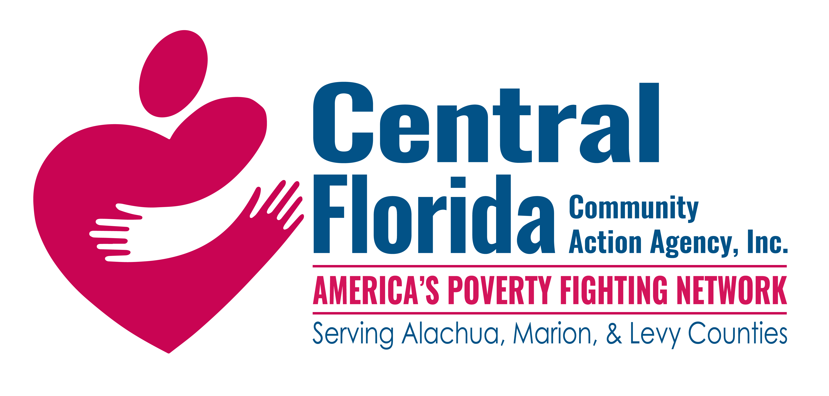




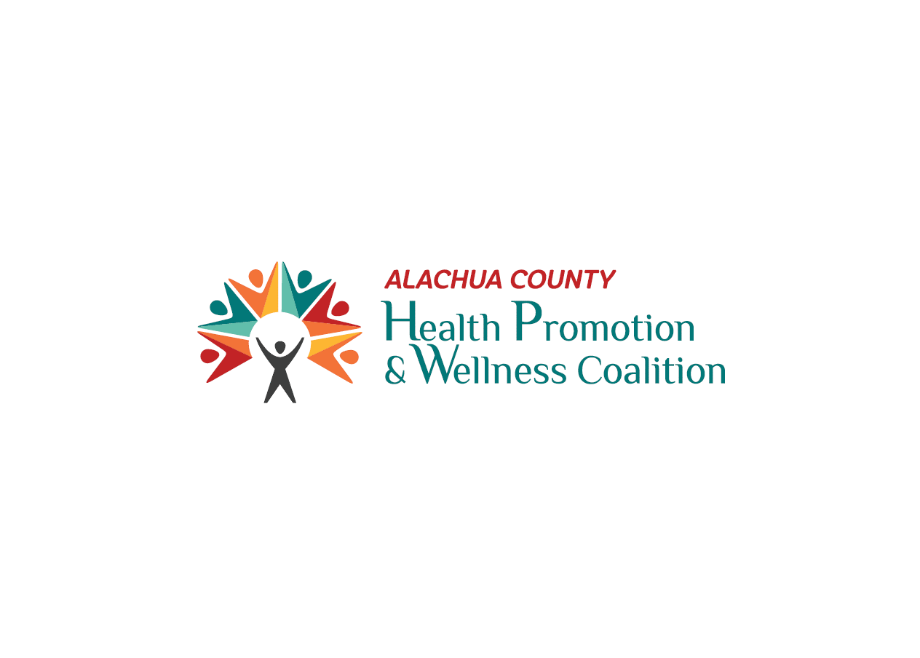





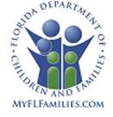






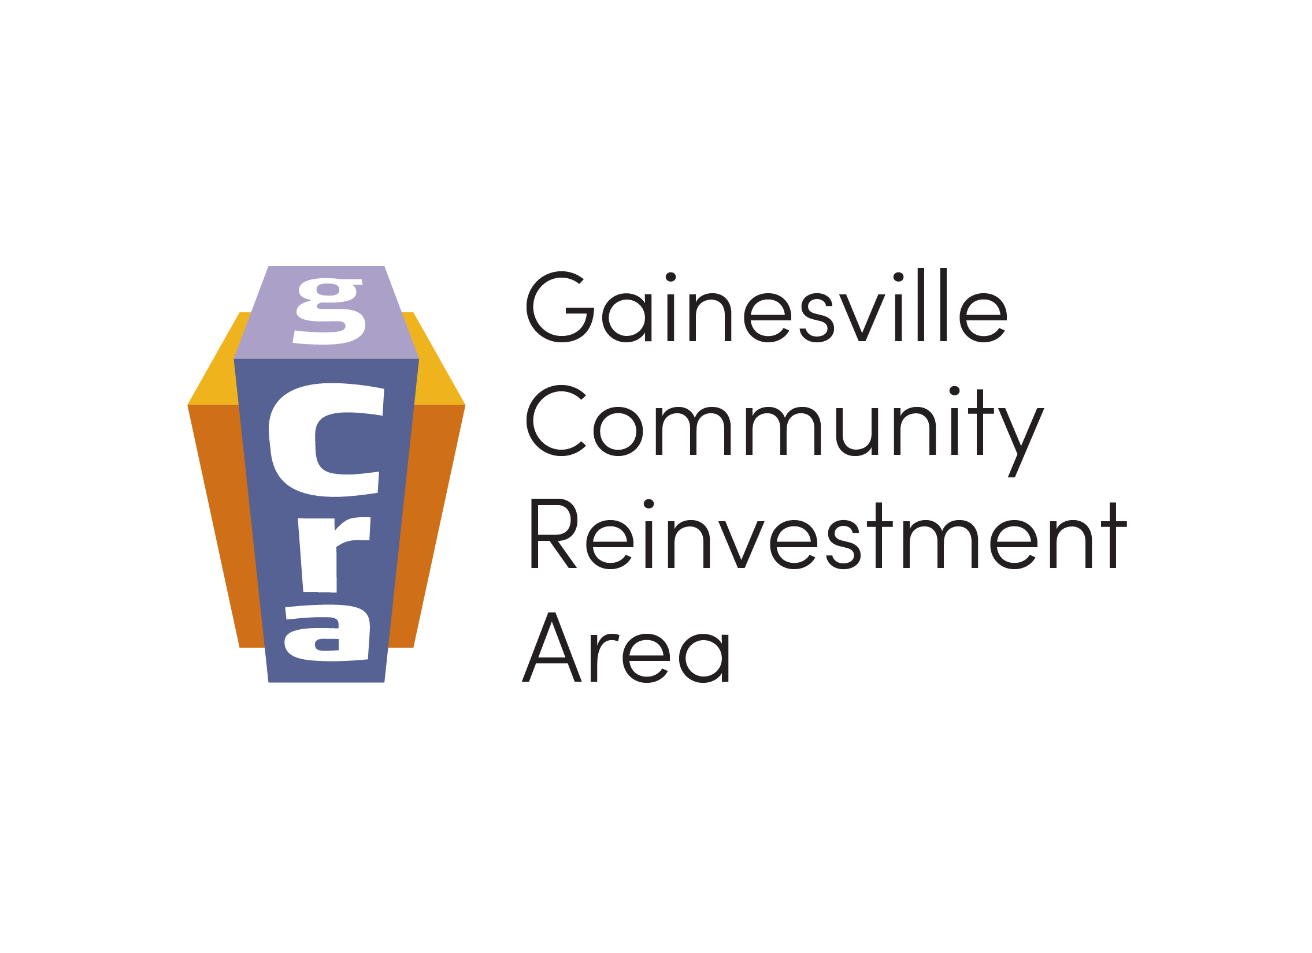




Celebrating
Our
Partnerships!

Slide 3

Spotlight Partner

Slide 4


“Alone we can do so little. Together we can do so much.”
– Helen Keller
RESOURCE CENTERS

Slide 5
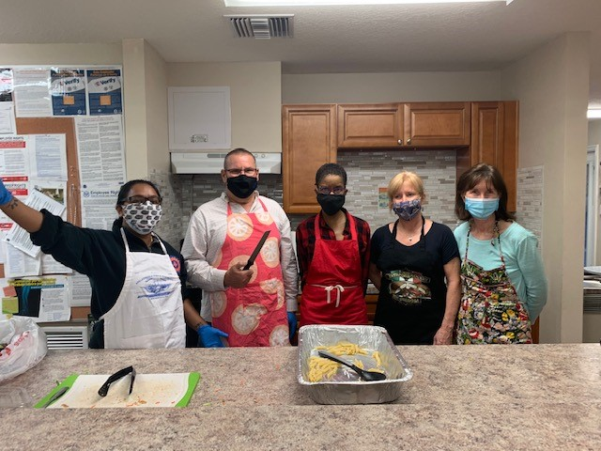

Slide 6
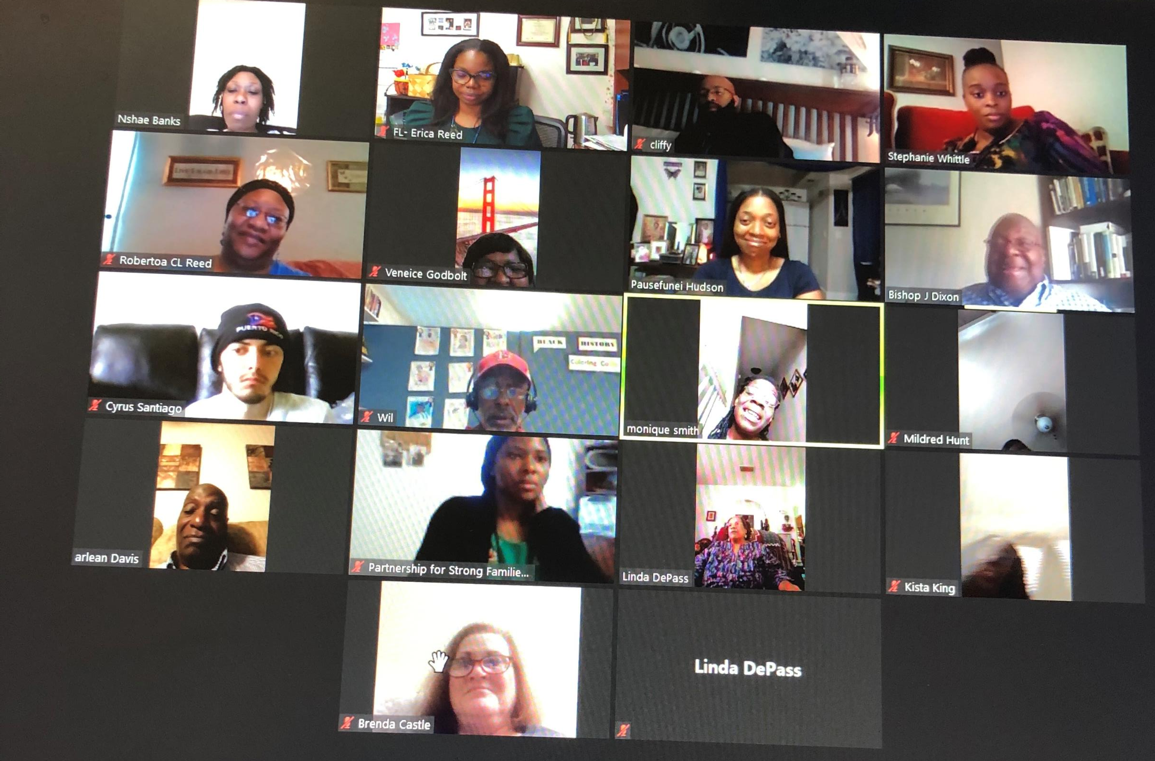

Slide 7
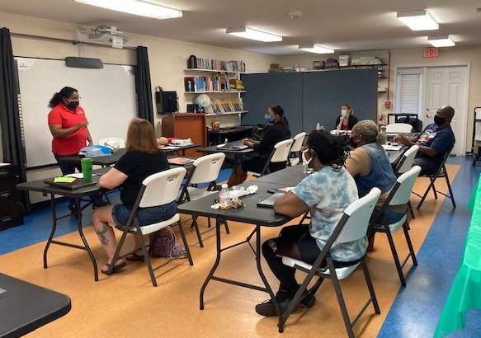

Slide 8
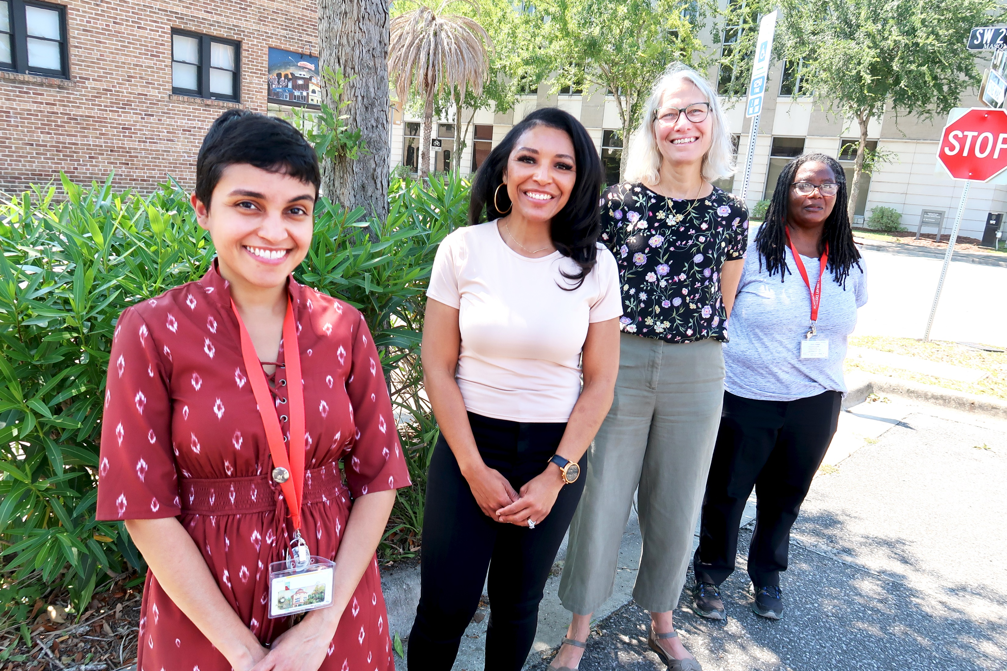

Slide 9
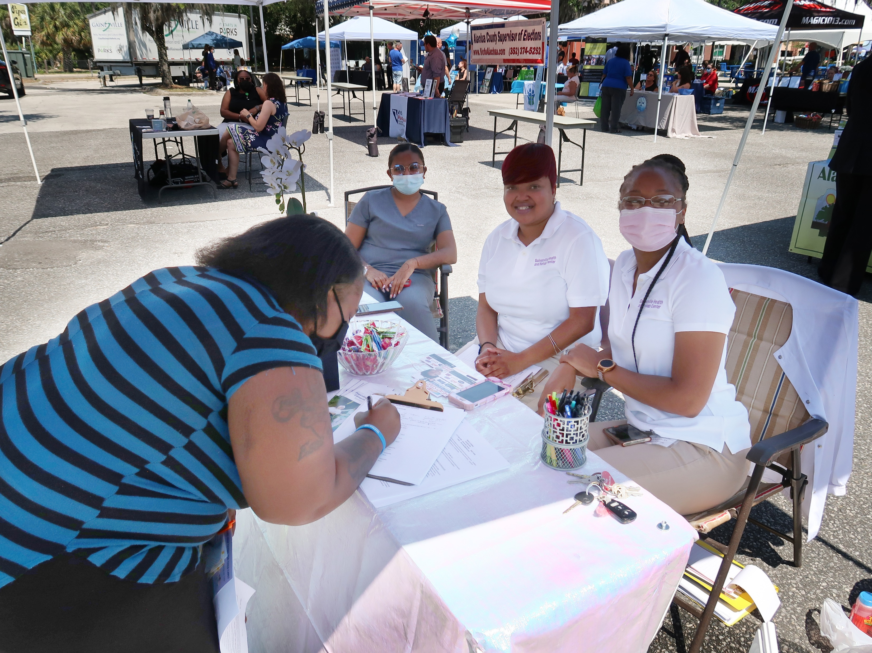

Slide 10
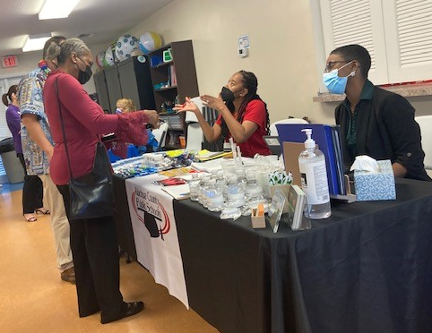

Slide 11
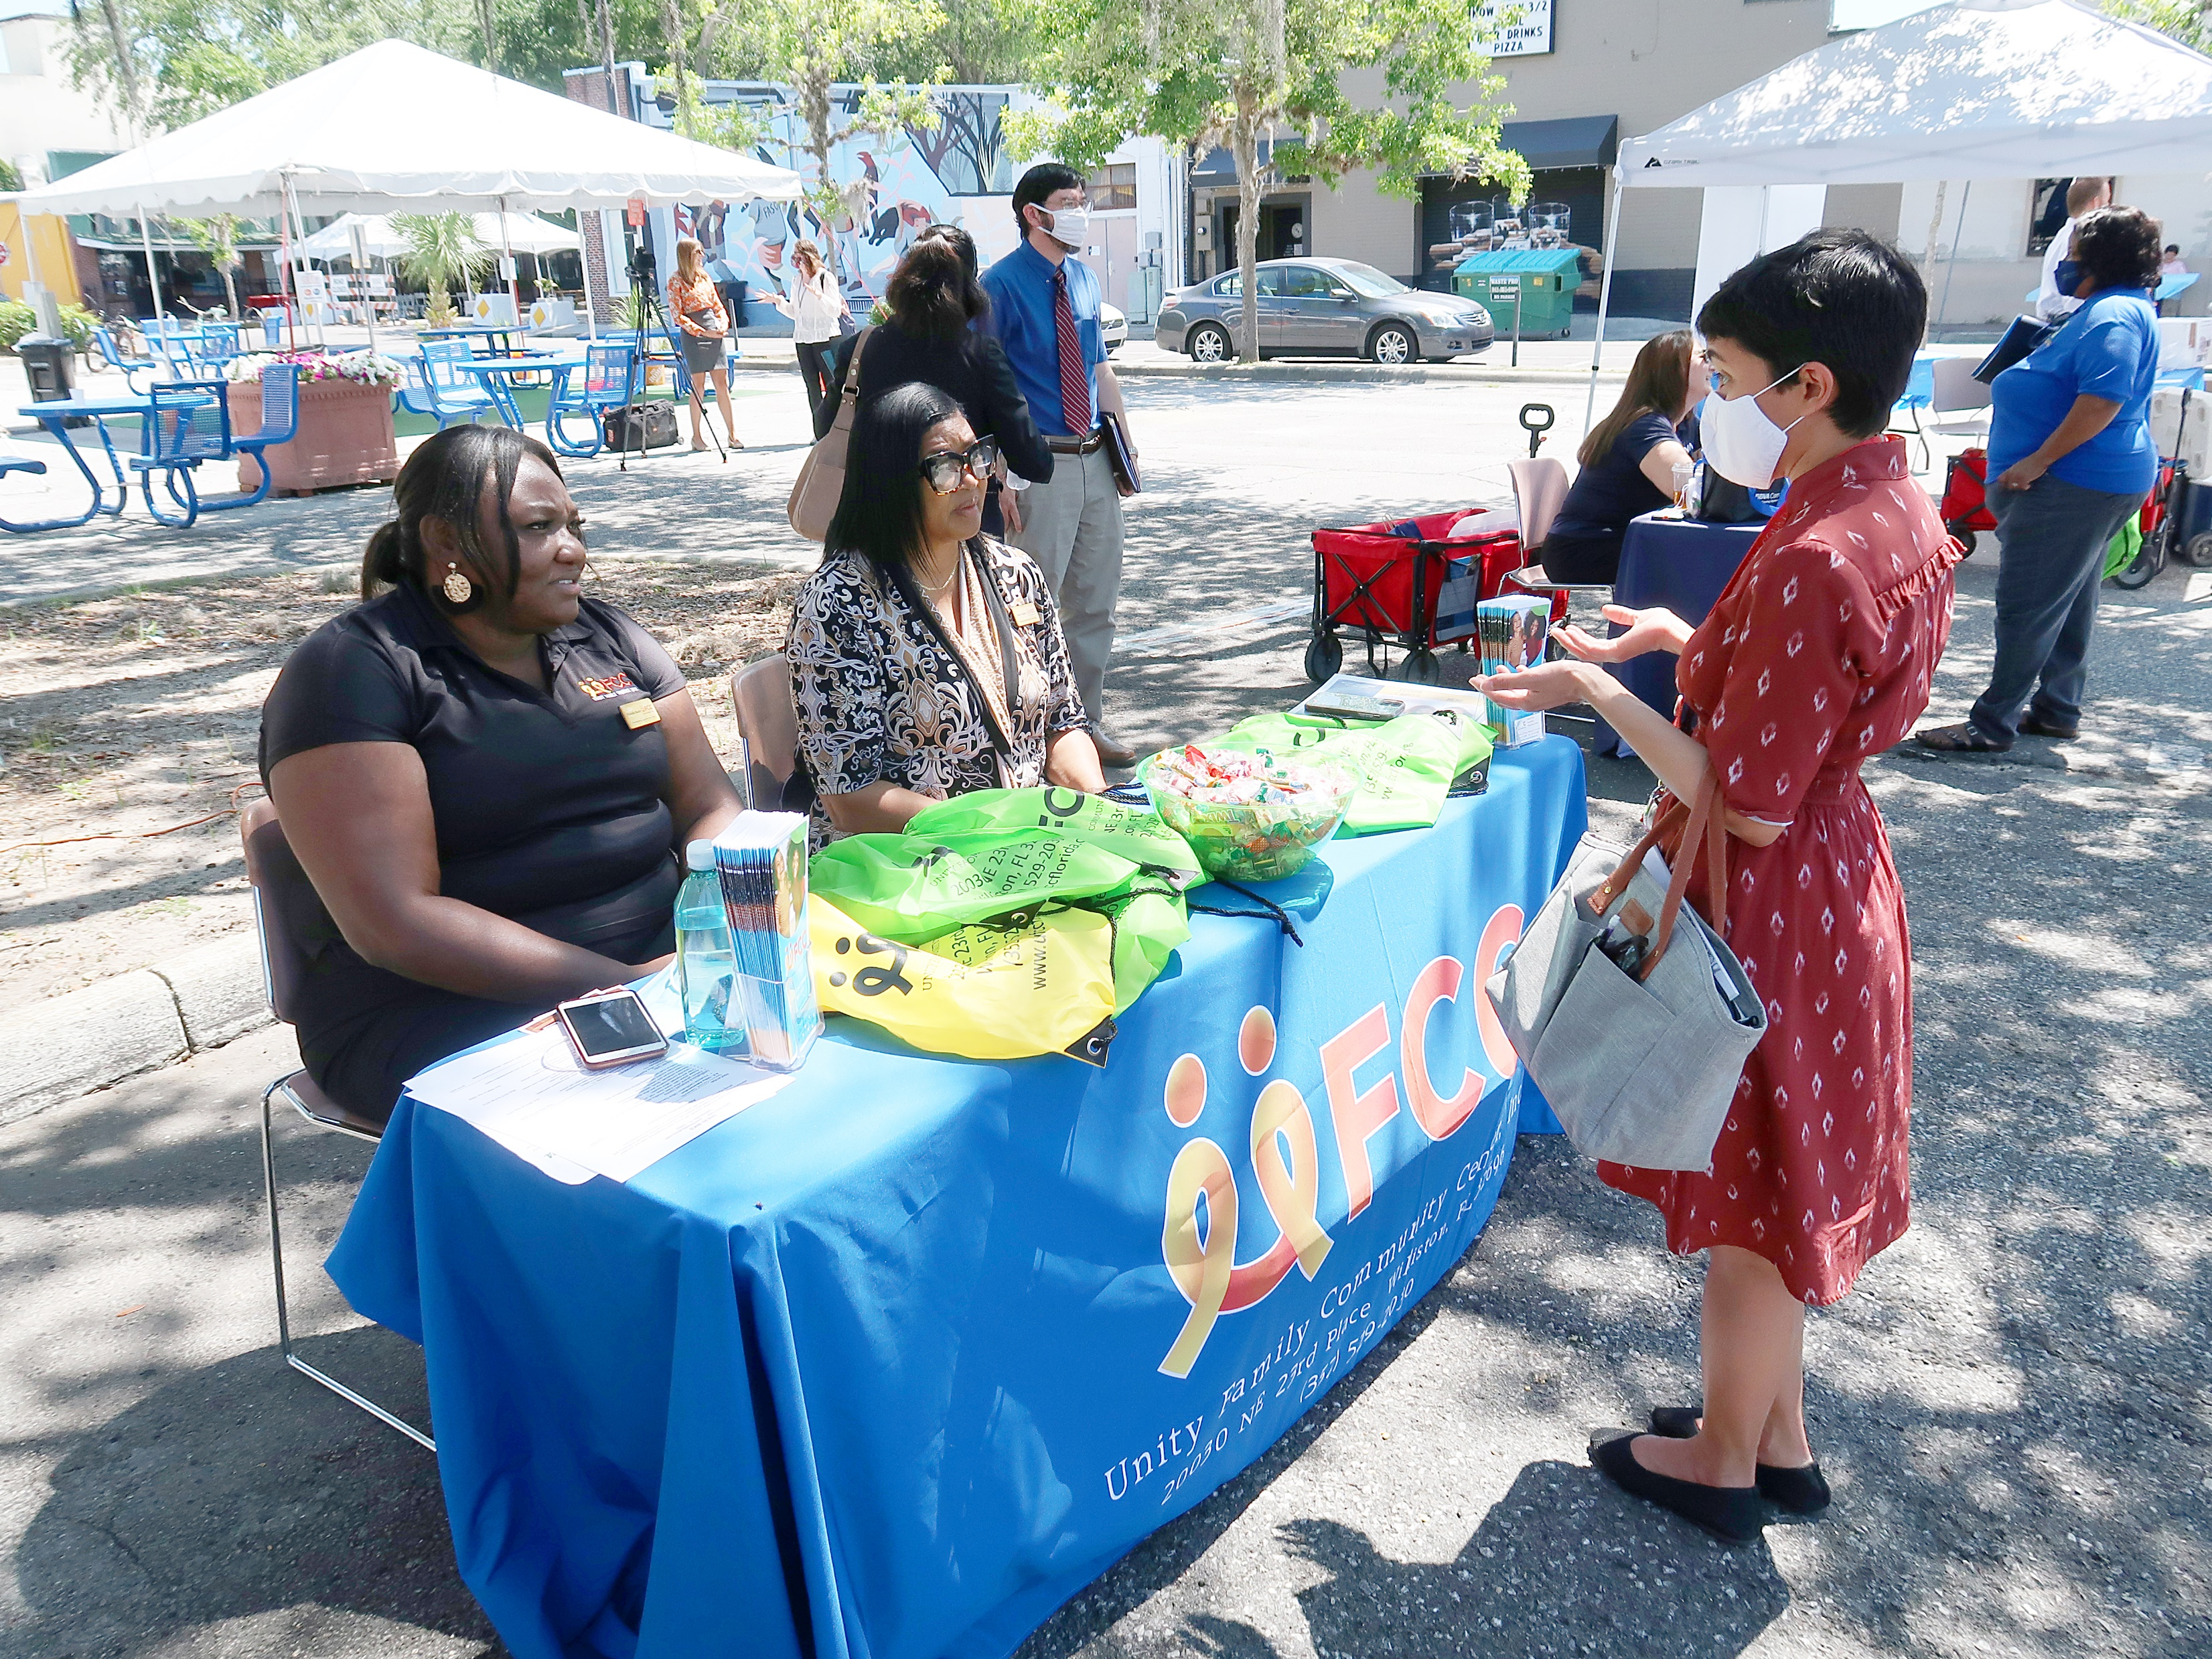

Slide 12
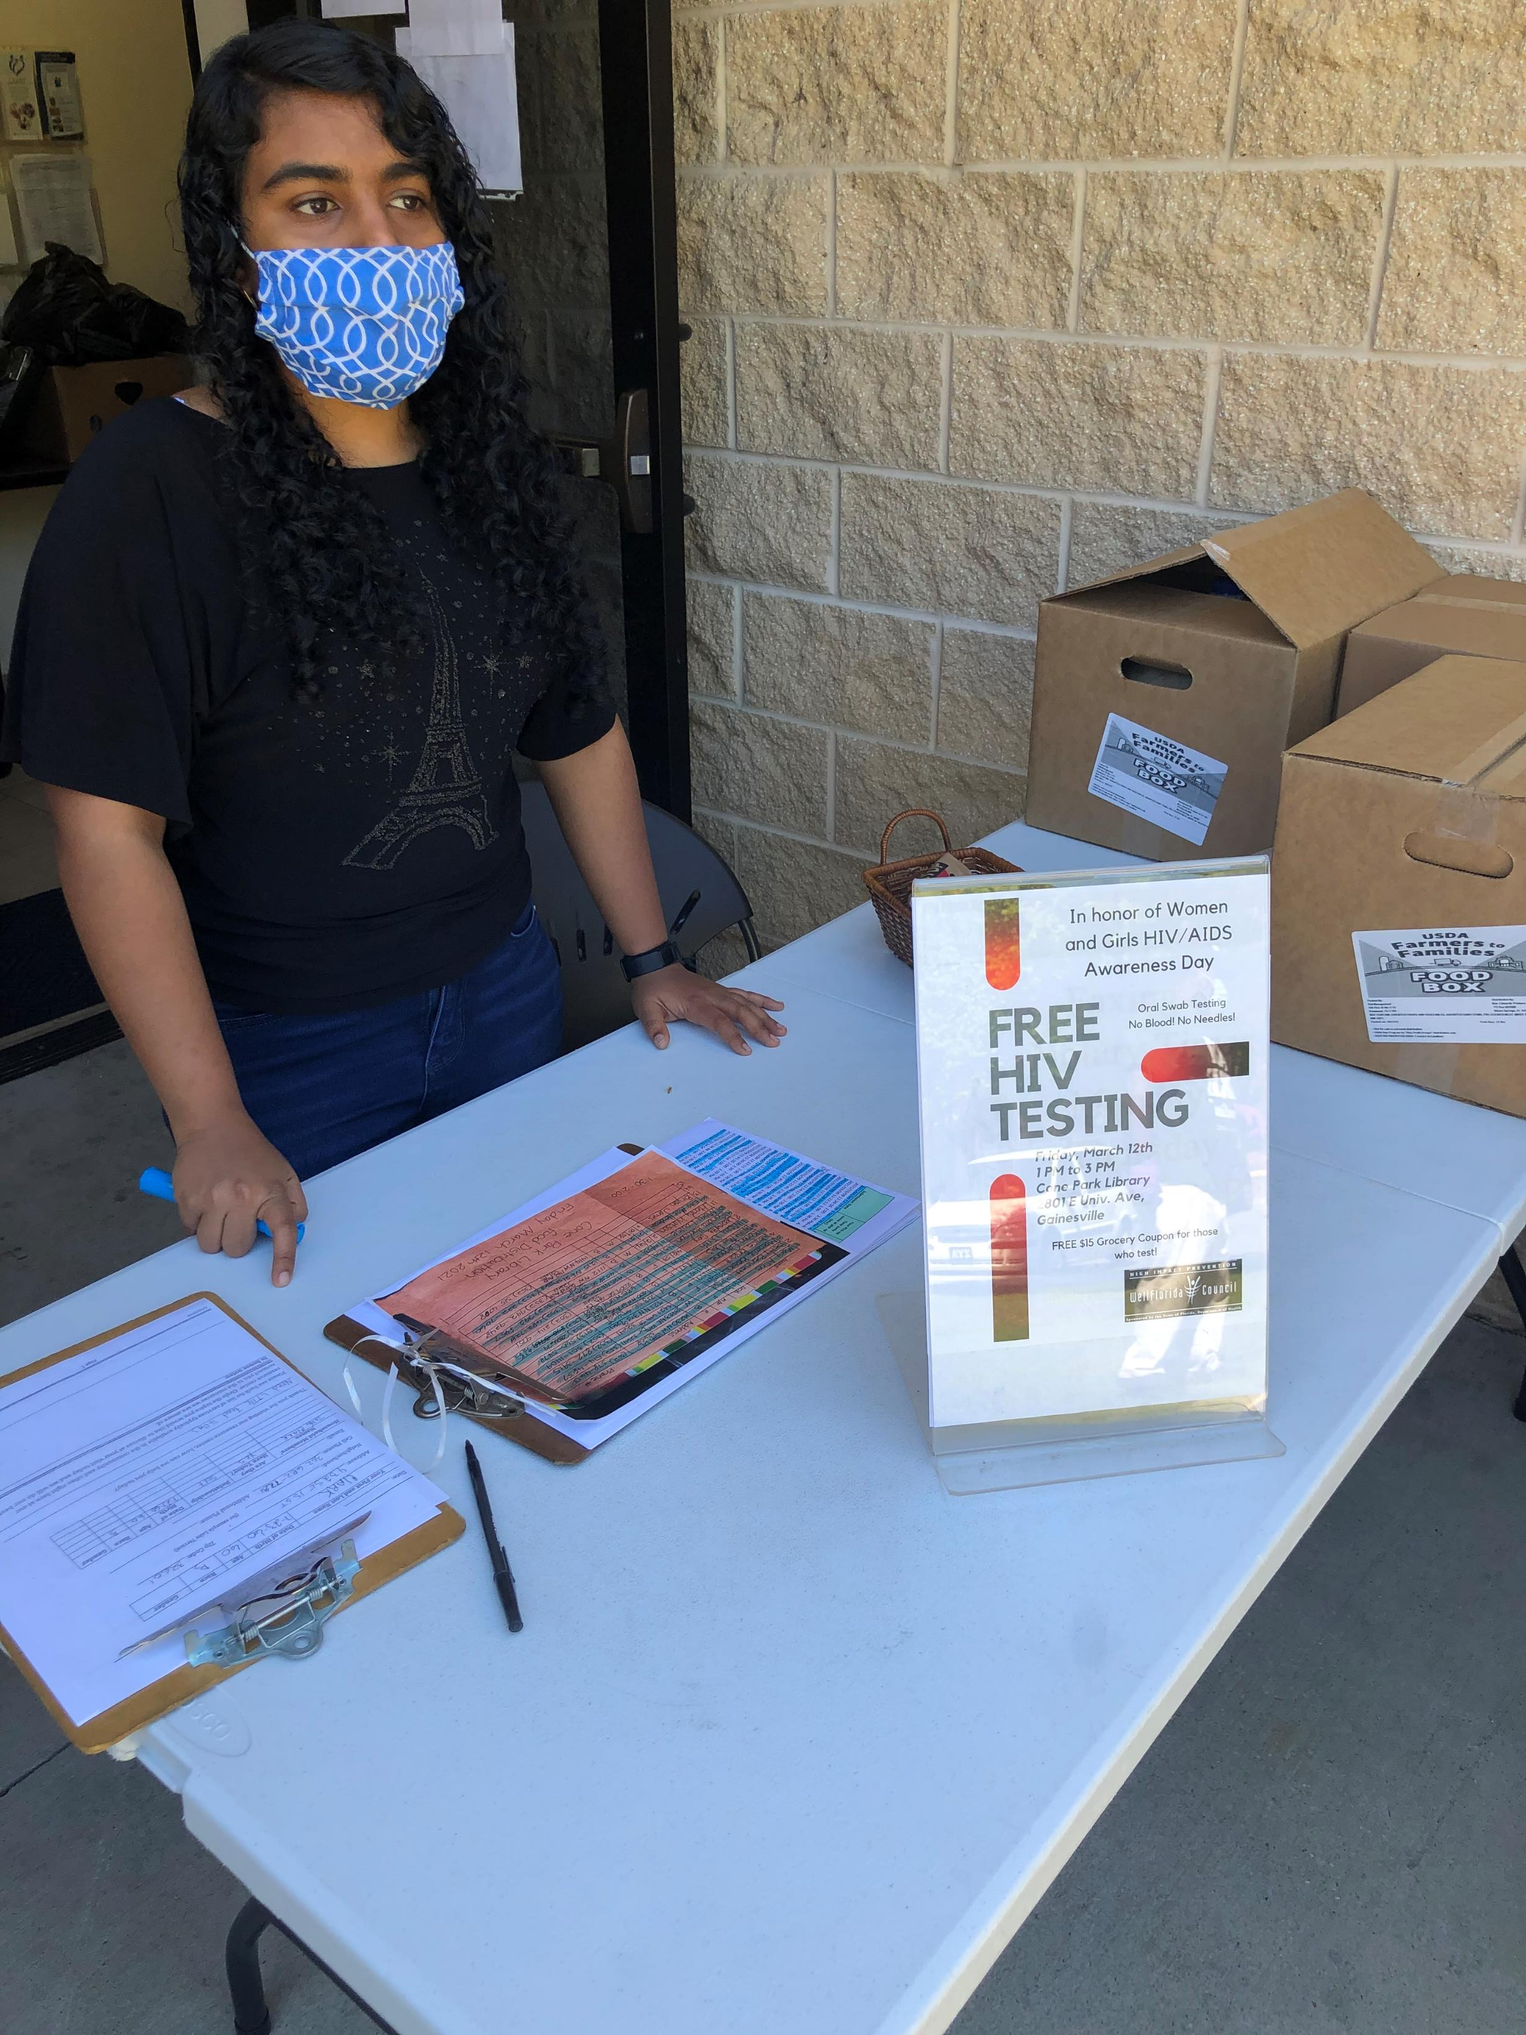

Slide 13
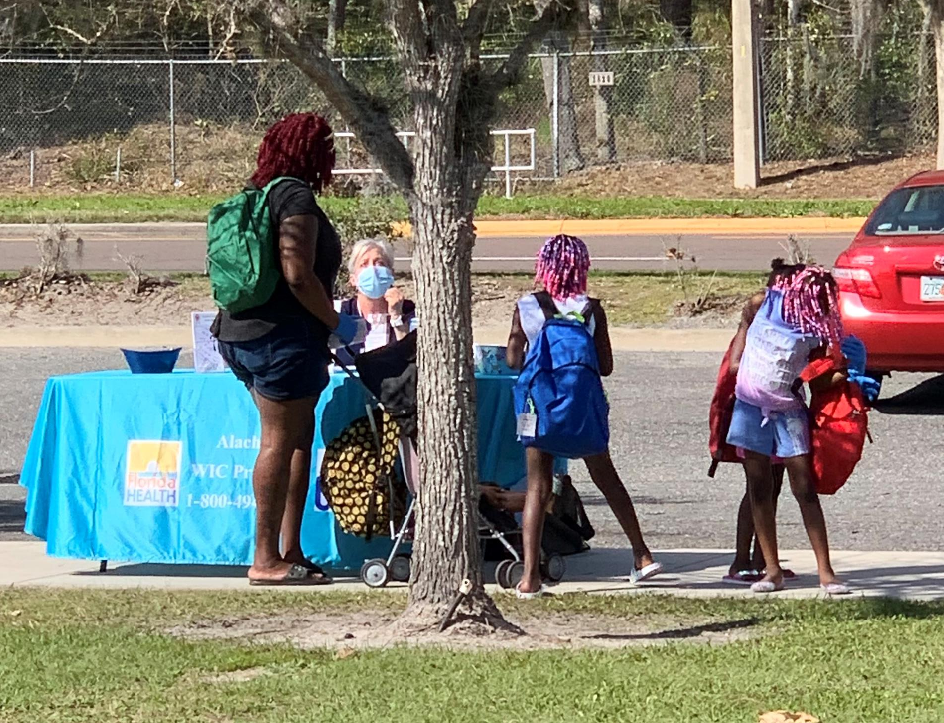

Slide 14
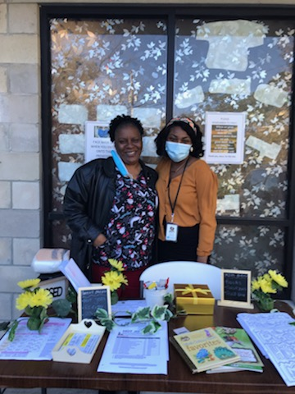
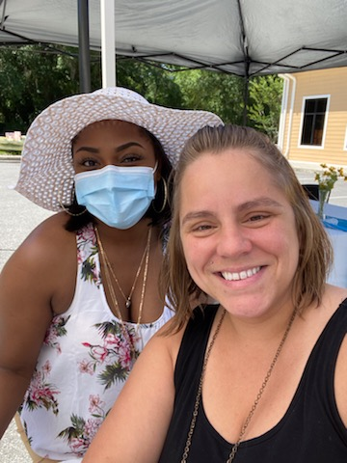

Slide 15
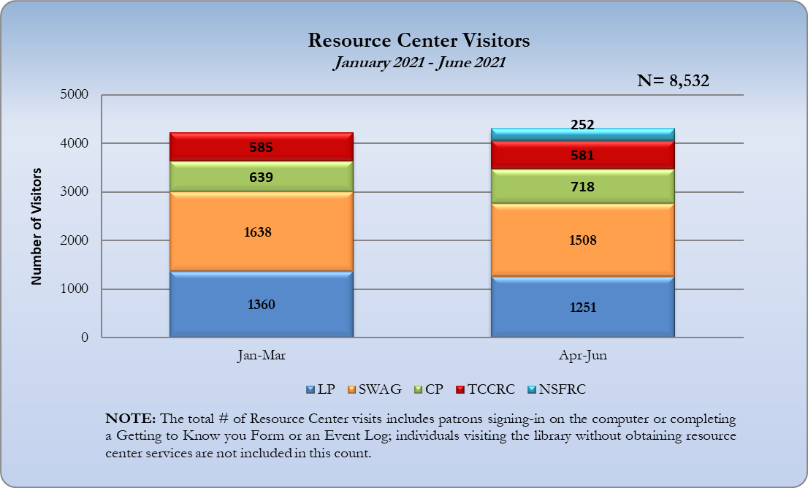

Slide 16



Of the 20,442 visits to the Alachua county Resource Centers in 2020, 25% directly involved services for children between the ages of 0-17.
Notes:
A hallmark of Partnership’s system of care is the belief that child abuse and neglect is preventable.
Research has found that successful interventions must both reduce risk factors and promote protective factors to ensure the well-being of children and families. Focusing on promoting protective factors is a more productive approach than reducing risk factors alone.
Promoting healthy development, facilitating nurturing relationships, and providing resources, supports, and coping strategies serve to build upon the existing strengths and assets within families and the community.

Slide 17
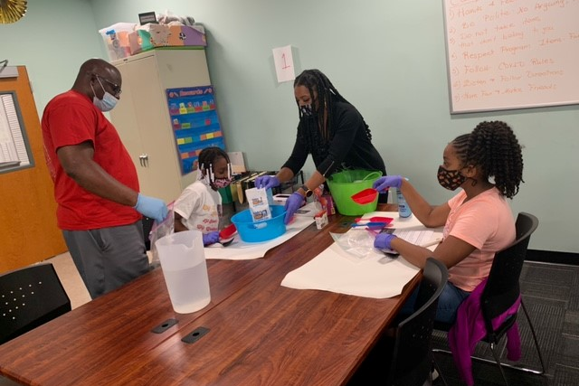

Slide 18
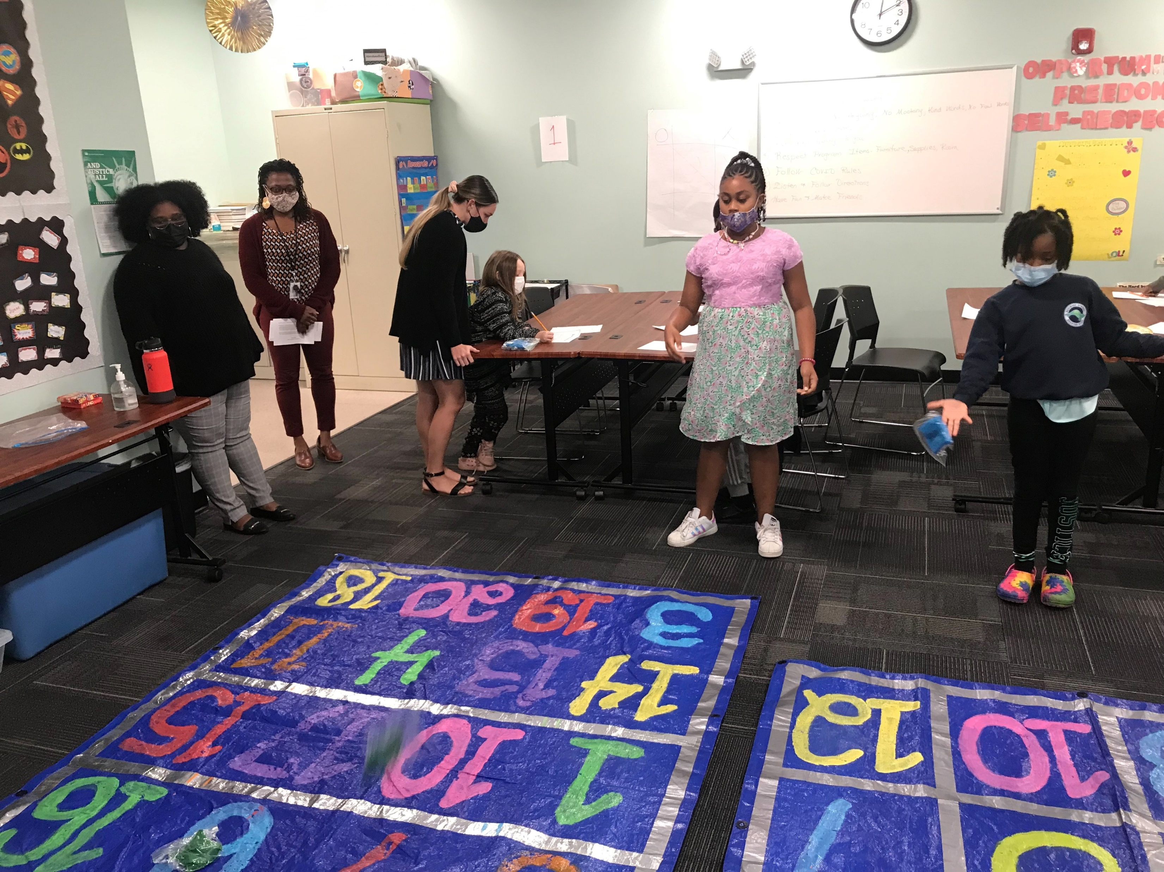

Slide 19
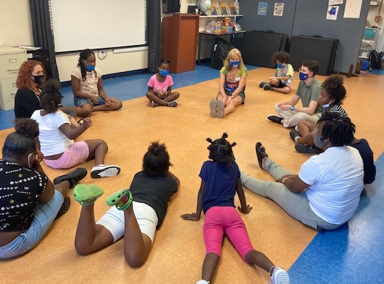

Slide 20
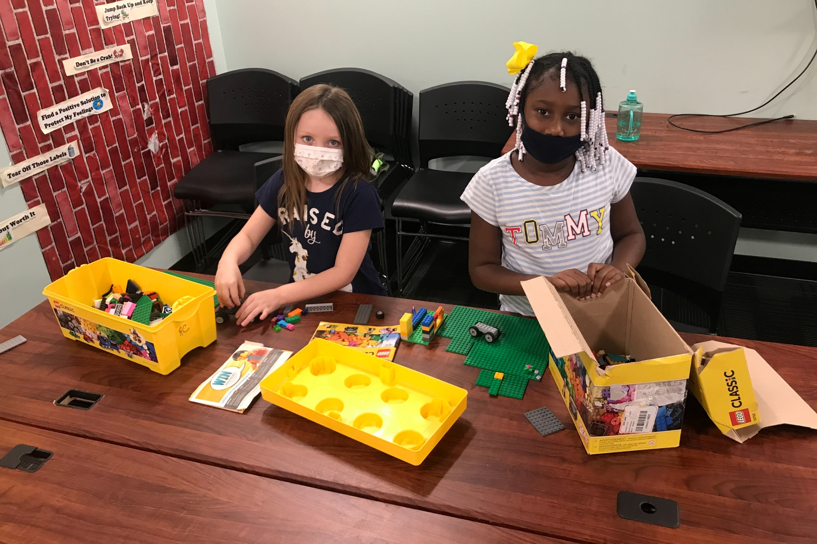
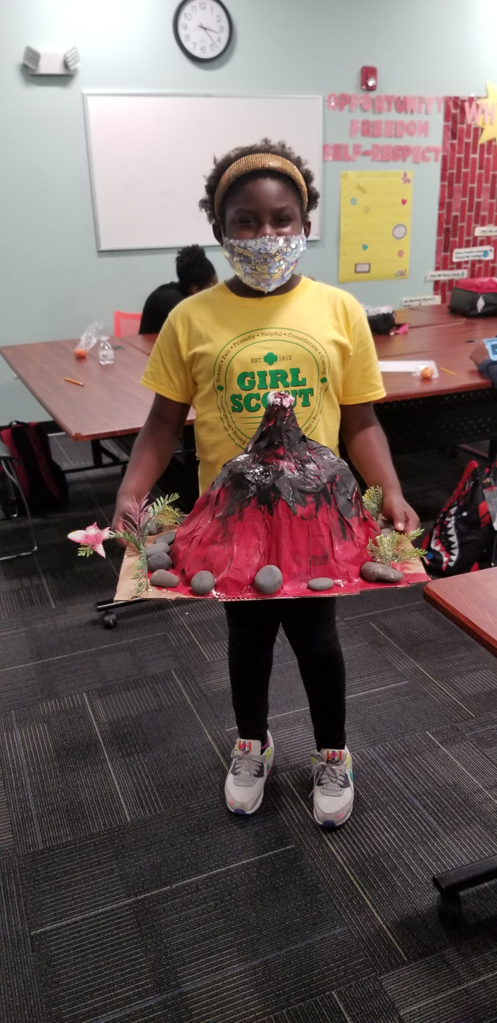

Slide 21
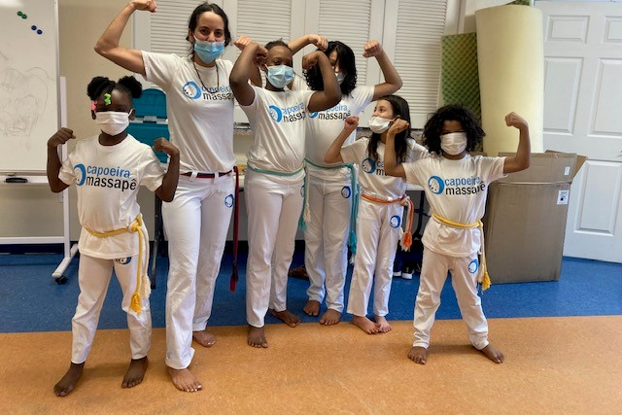

Slide 22
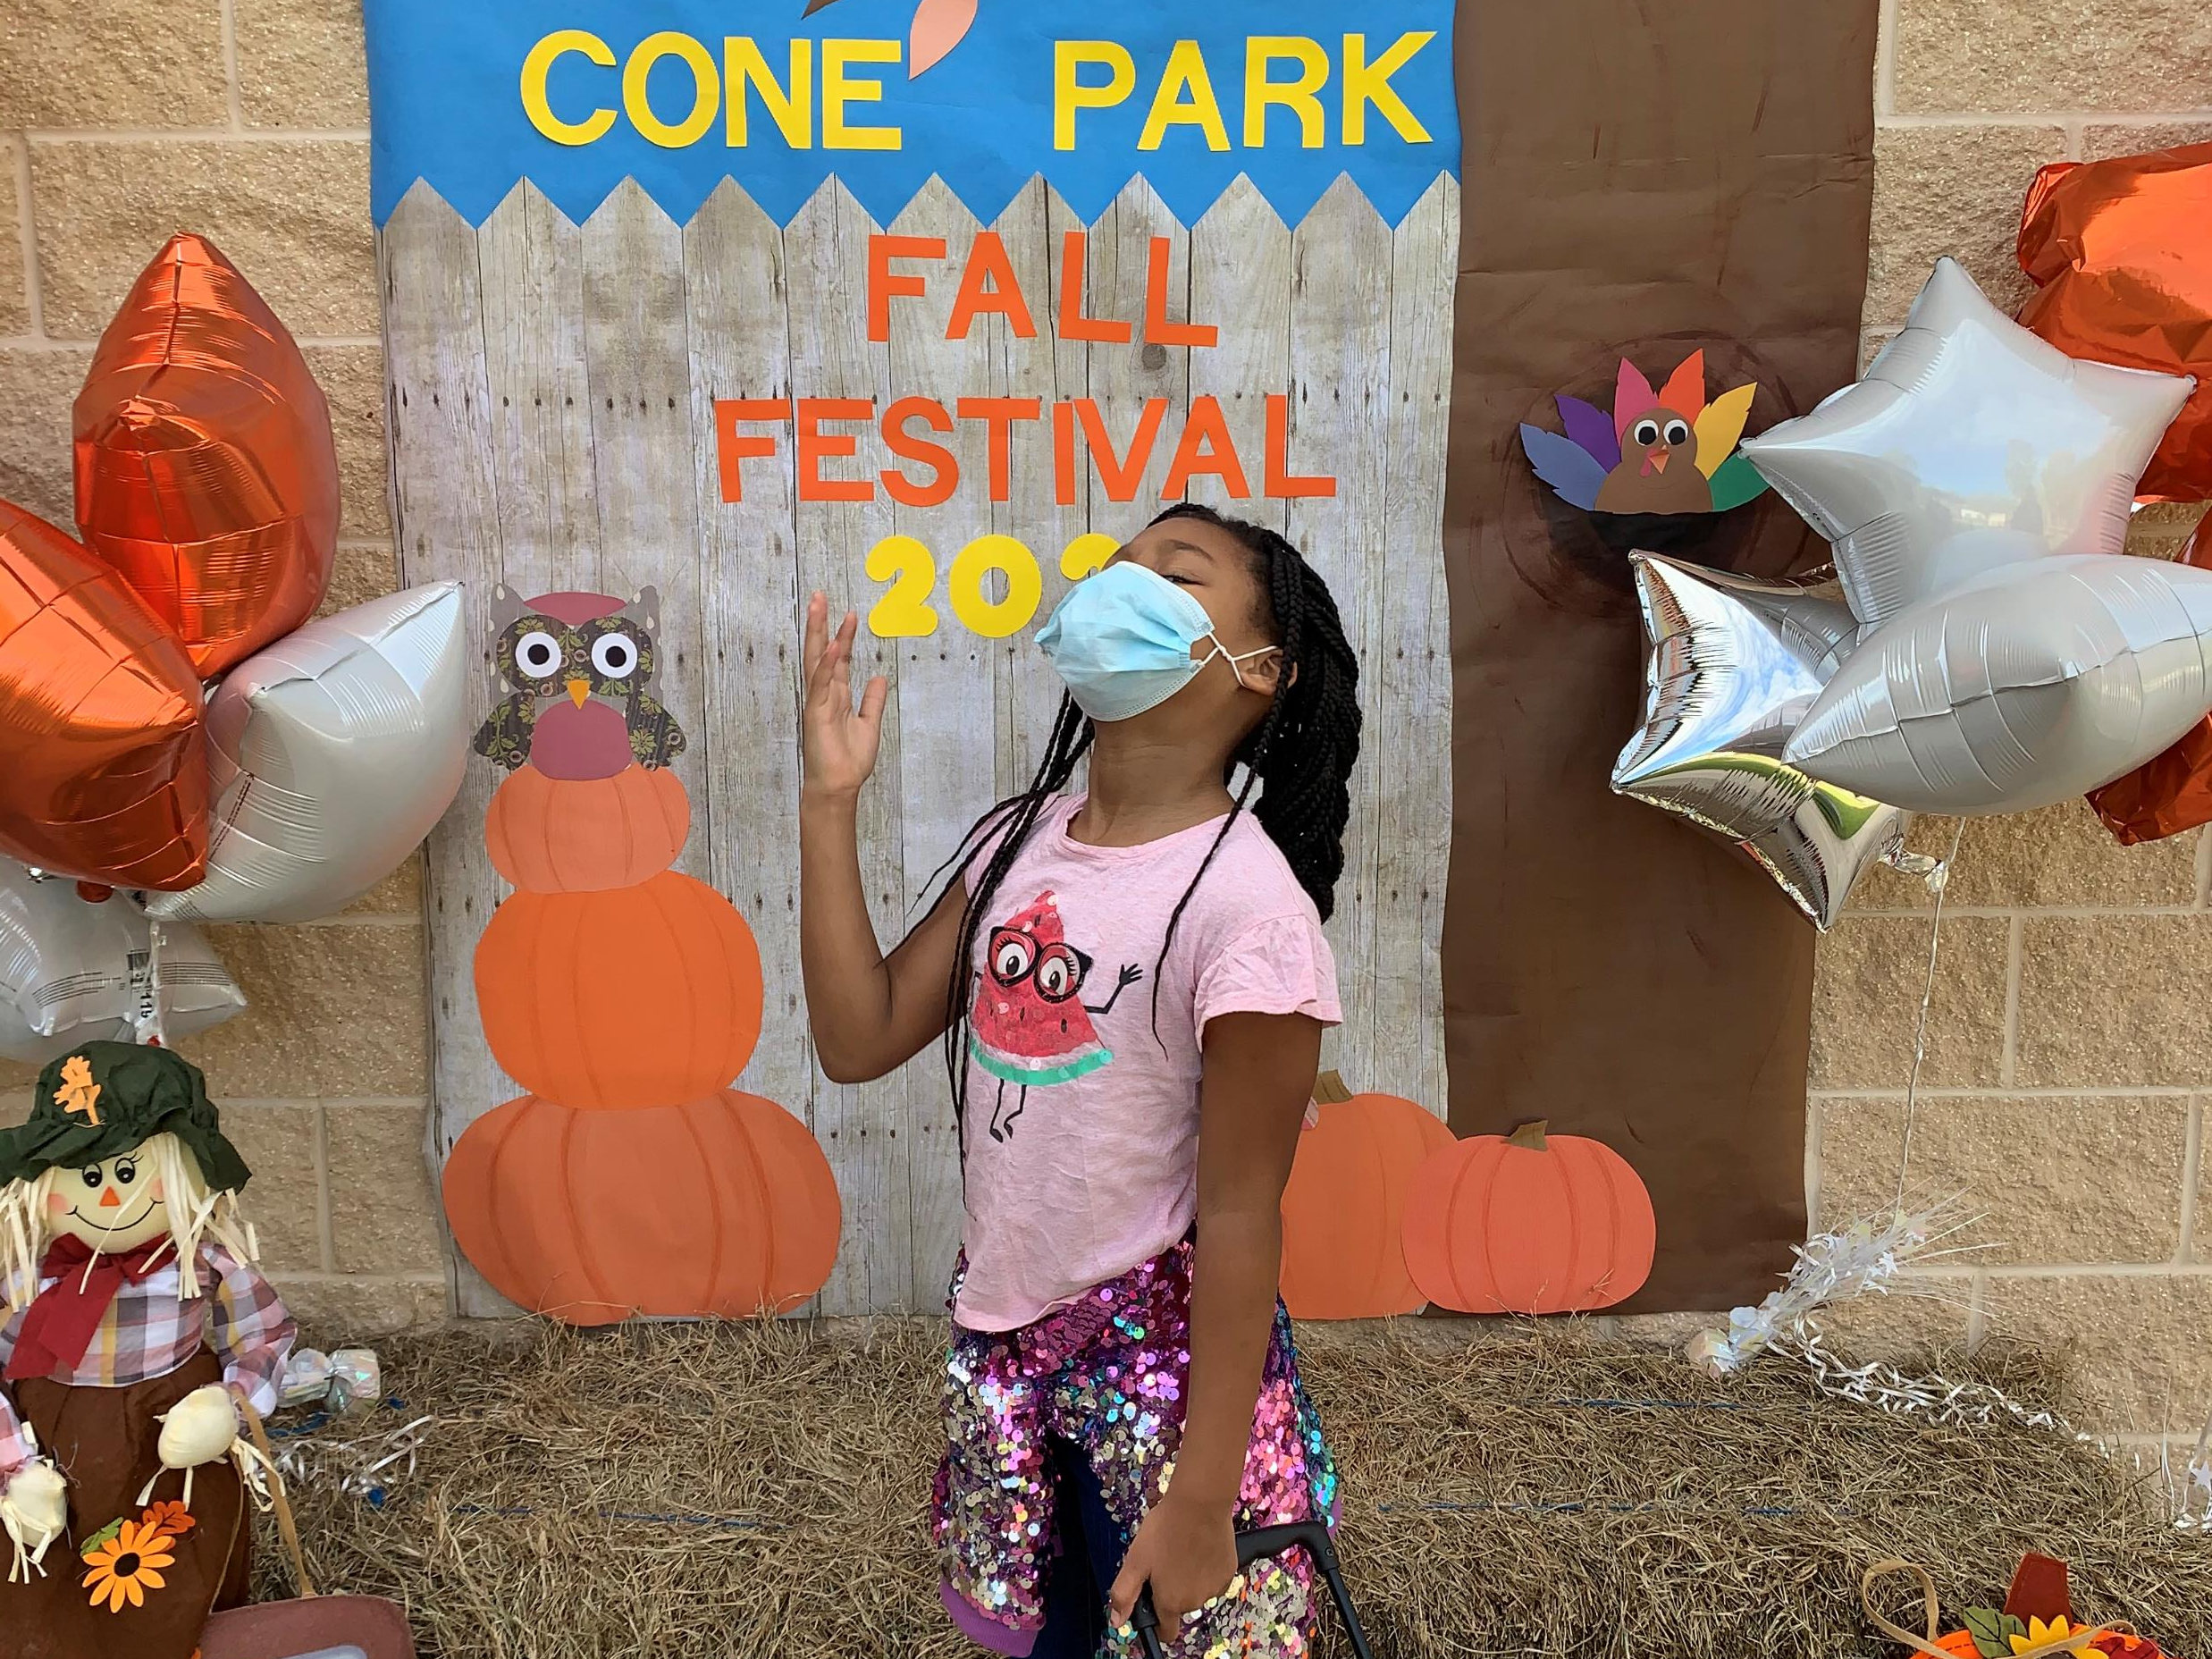

Slide 23
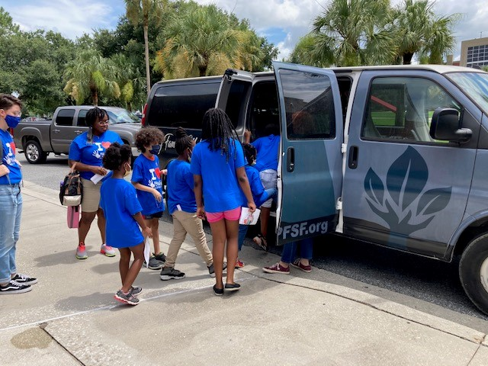

Slide 24
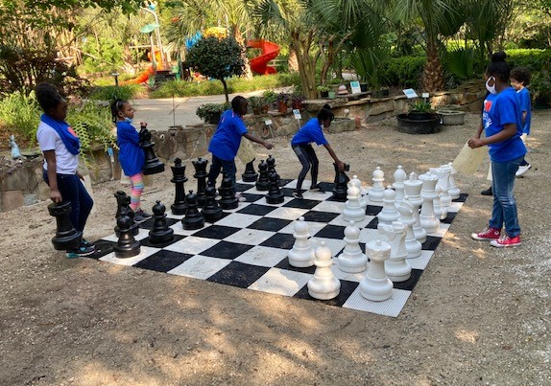

Slide 25
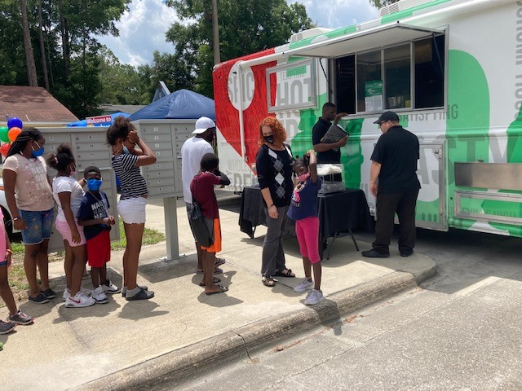

Slide 26
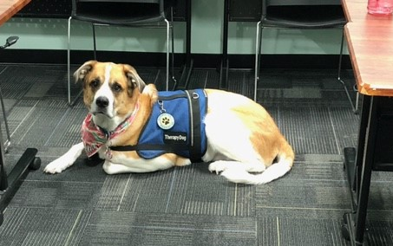

Slide 27
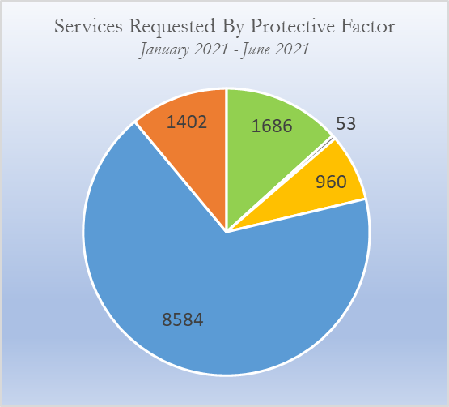
Concrete Supports
Food Pantries
Clothing Closets
Hygiene Products
Social Connections
Community Events
Resource Fairs
Special Interest Activities
Social & Emotional Development
Homework Help
After-School Enrichment Programs
Parent-Child Activities
Parenting & Child Development
Parent-Child Activities
ABC Diaper Program
Resource Sharing
Parental Resilience
Financial Literacy Workshops
Employment Skills Training
Referrals to outside agencies
N=12,685
Strengthening Families Protective Factors Framework

Slide 28
Amid the COVID pandemic, more than 20,000 concrete supports were provided by the Resource Centers, including more than 3,000 lunches
and family-style meals, financial assistance, family activities, and more.
Notes:
A hallmark of Partnership’s system of care is the belief that child abuse and neglect is preventable.
Research has found that successful interventions must both reduce risk factors and promote protective factors to ensure the well-being of children and families. Focusing on promoting protective factors is a more productive approach than reducing risk factors alone.
Promoting healthy development, facilitating nurturing relationships, and providing resources, supports, and coping strategies serve to build upon the existing strengths and assets within families and the community.

Slide 29
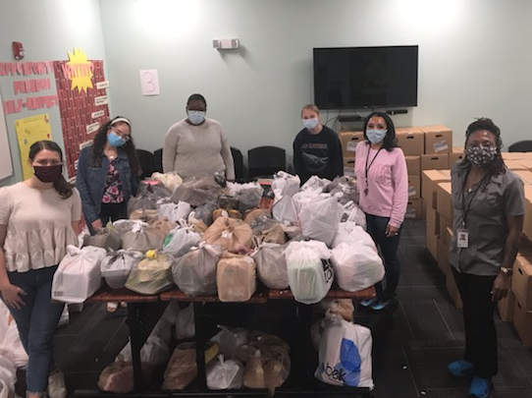

Slide 30
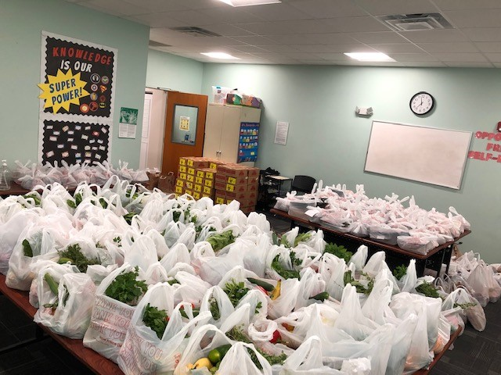

Slide 31
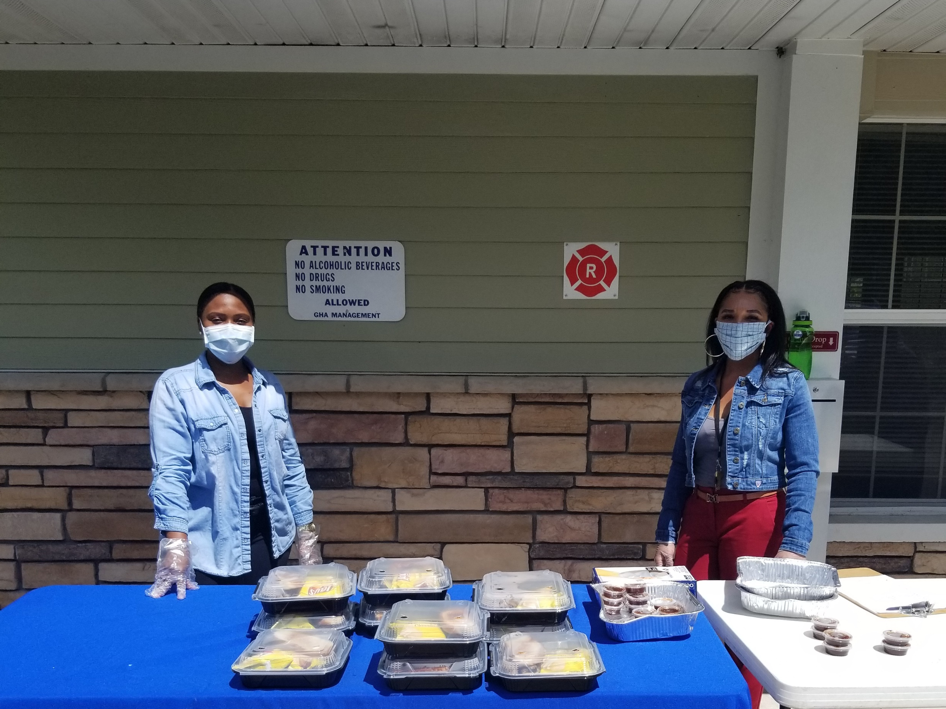

Slide 32
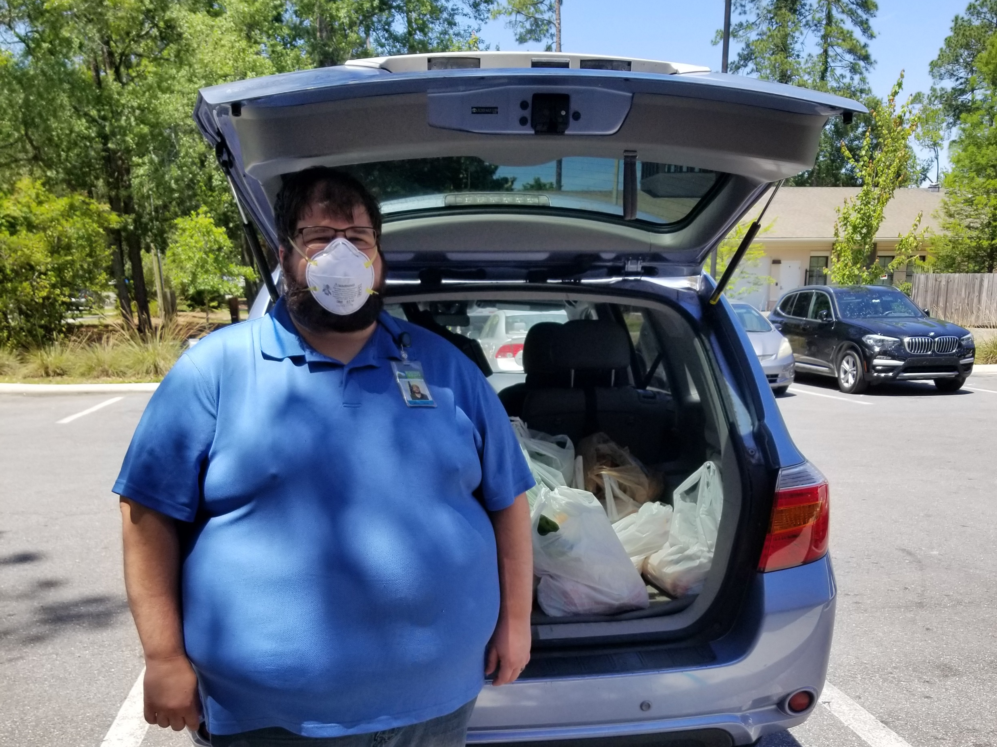

Slide 33
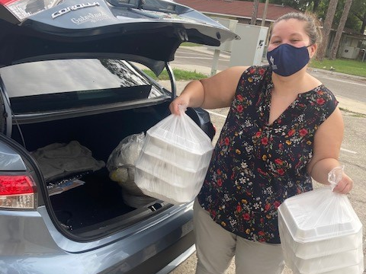

Slide 34
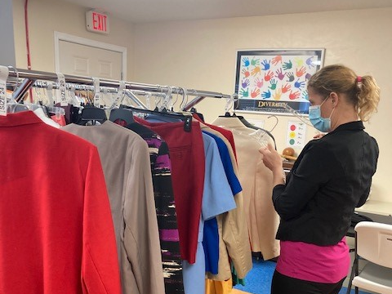

Slide 35
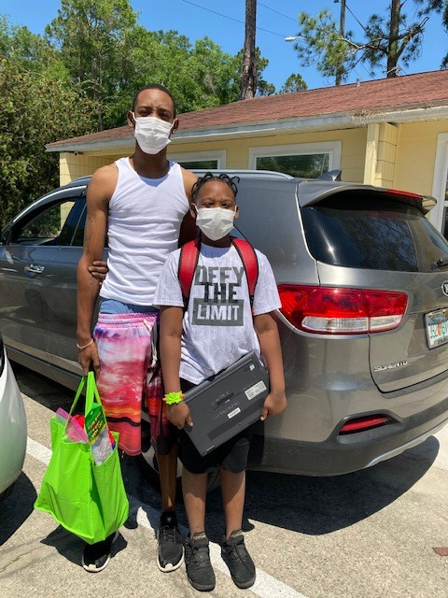
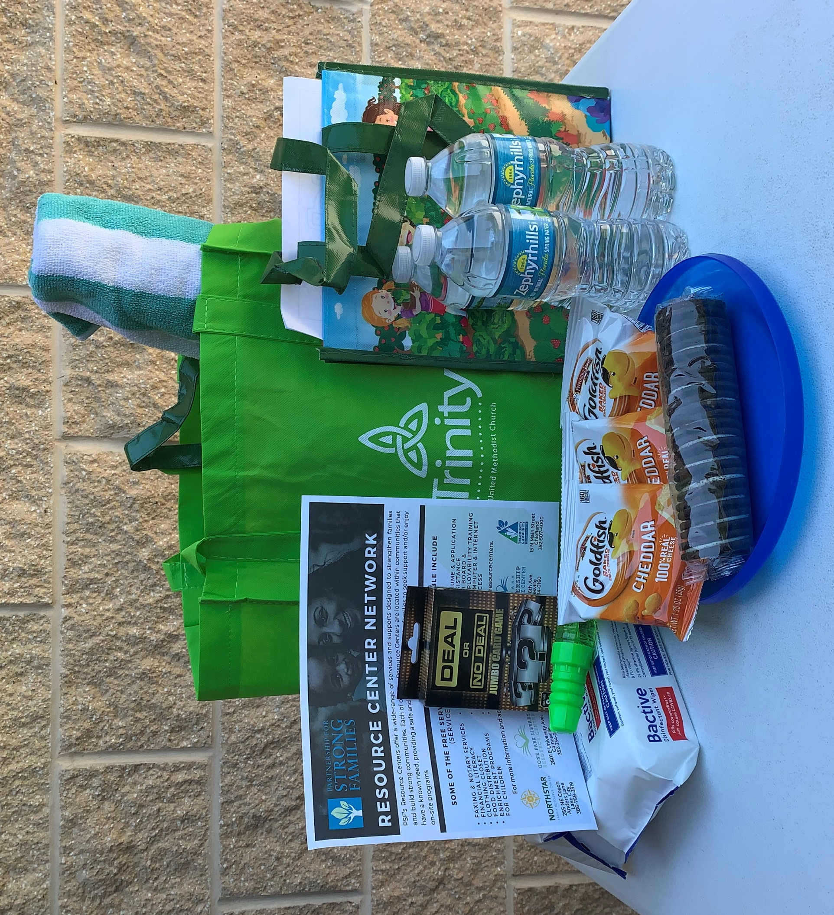

Slide 36
Between FY08/09 and FY19/20, data from the Department of Children and Families shows a remarkable 79% decrease in the rates of verified child maltreatment in the five zip codes served by our Alachua County Resource Centers.

Slide 37
2020
Grants
&
Donations
Alachua County-CAPP
Alachua County Cares
Aldi
Capital City Bank
Children's Bureau-ACF
Children's Trust of Alachua County
Clay Electric Foundation
Southwest Advocacy Group
Trinity United Methodist
United Way of N Central FL
United We Care
Women's Giving Circle
Generous Anonymous Donors

Slide 38

Community Collaborations to Strengthen
& Preserve Families
PSF is 1 of 9 awardees of a multi-year, federal grant through the Children’s Bureau. Funds are being used to more rigorously evaluate, refine and expand our Model to Lake City.

Slide 39
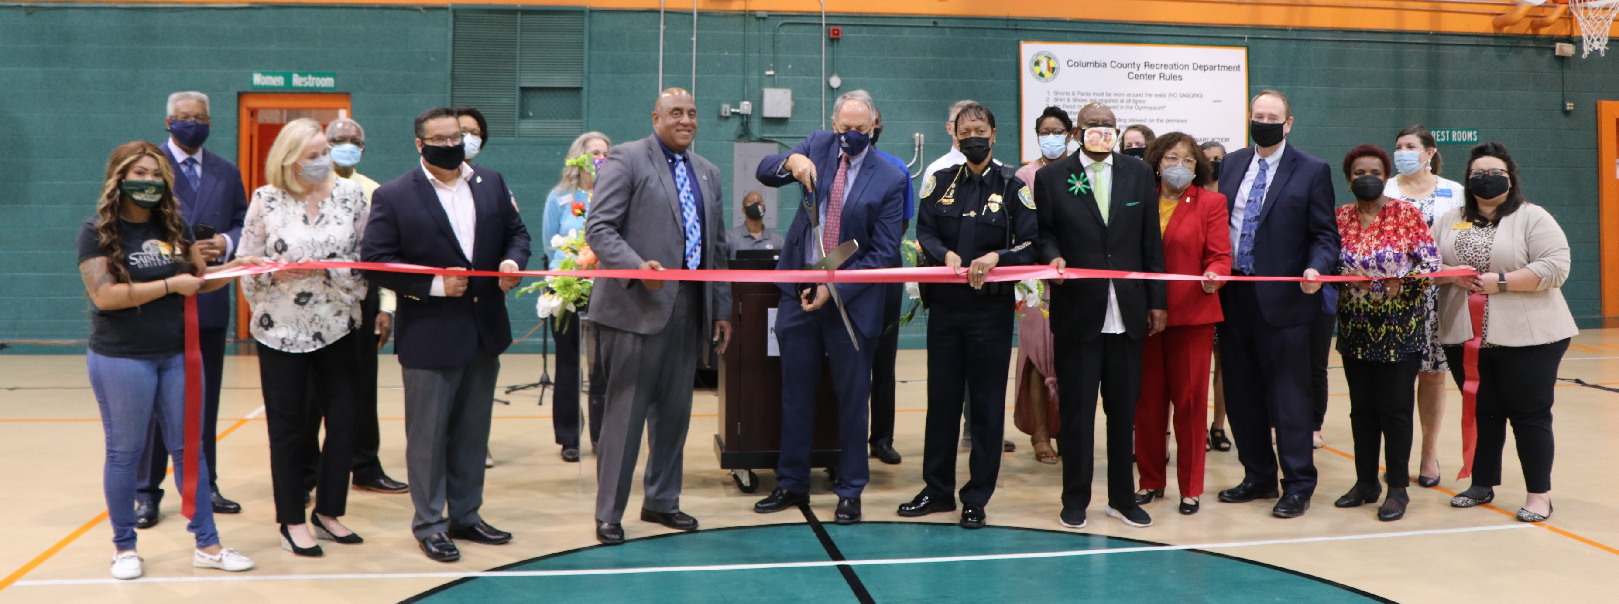

Grand Opening/Ribbon Cutting
March 18, 2021

Slide 40
“[Family Resource Centers] have been there all the time, doing their jobs without fanfare or thanks…It’s just taken a crisis to reveal how important they are.” - Lexington Herald
RESOURCE CENTERS

Slide 41
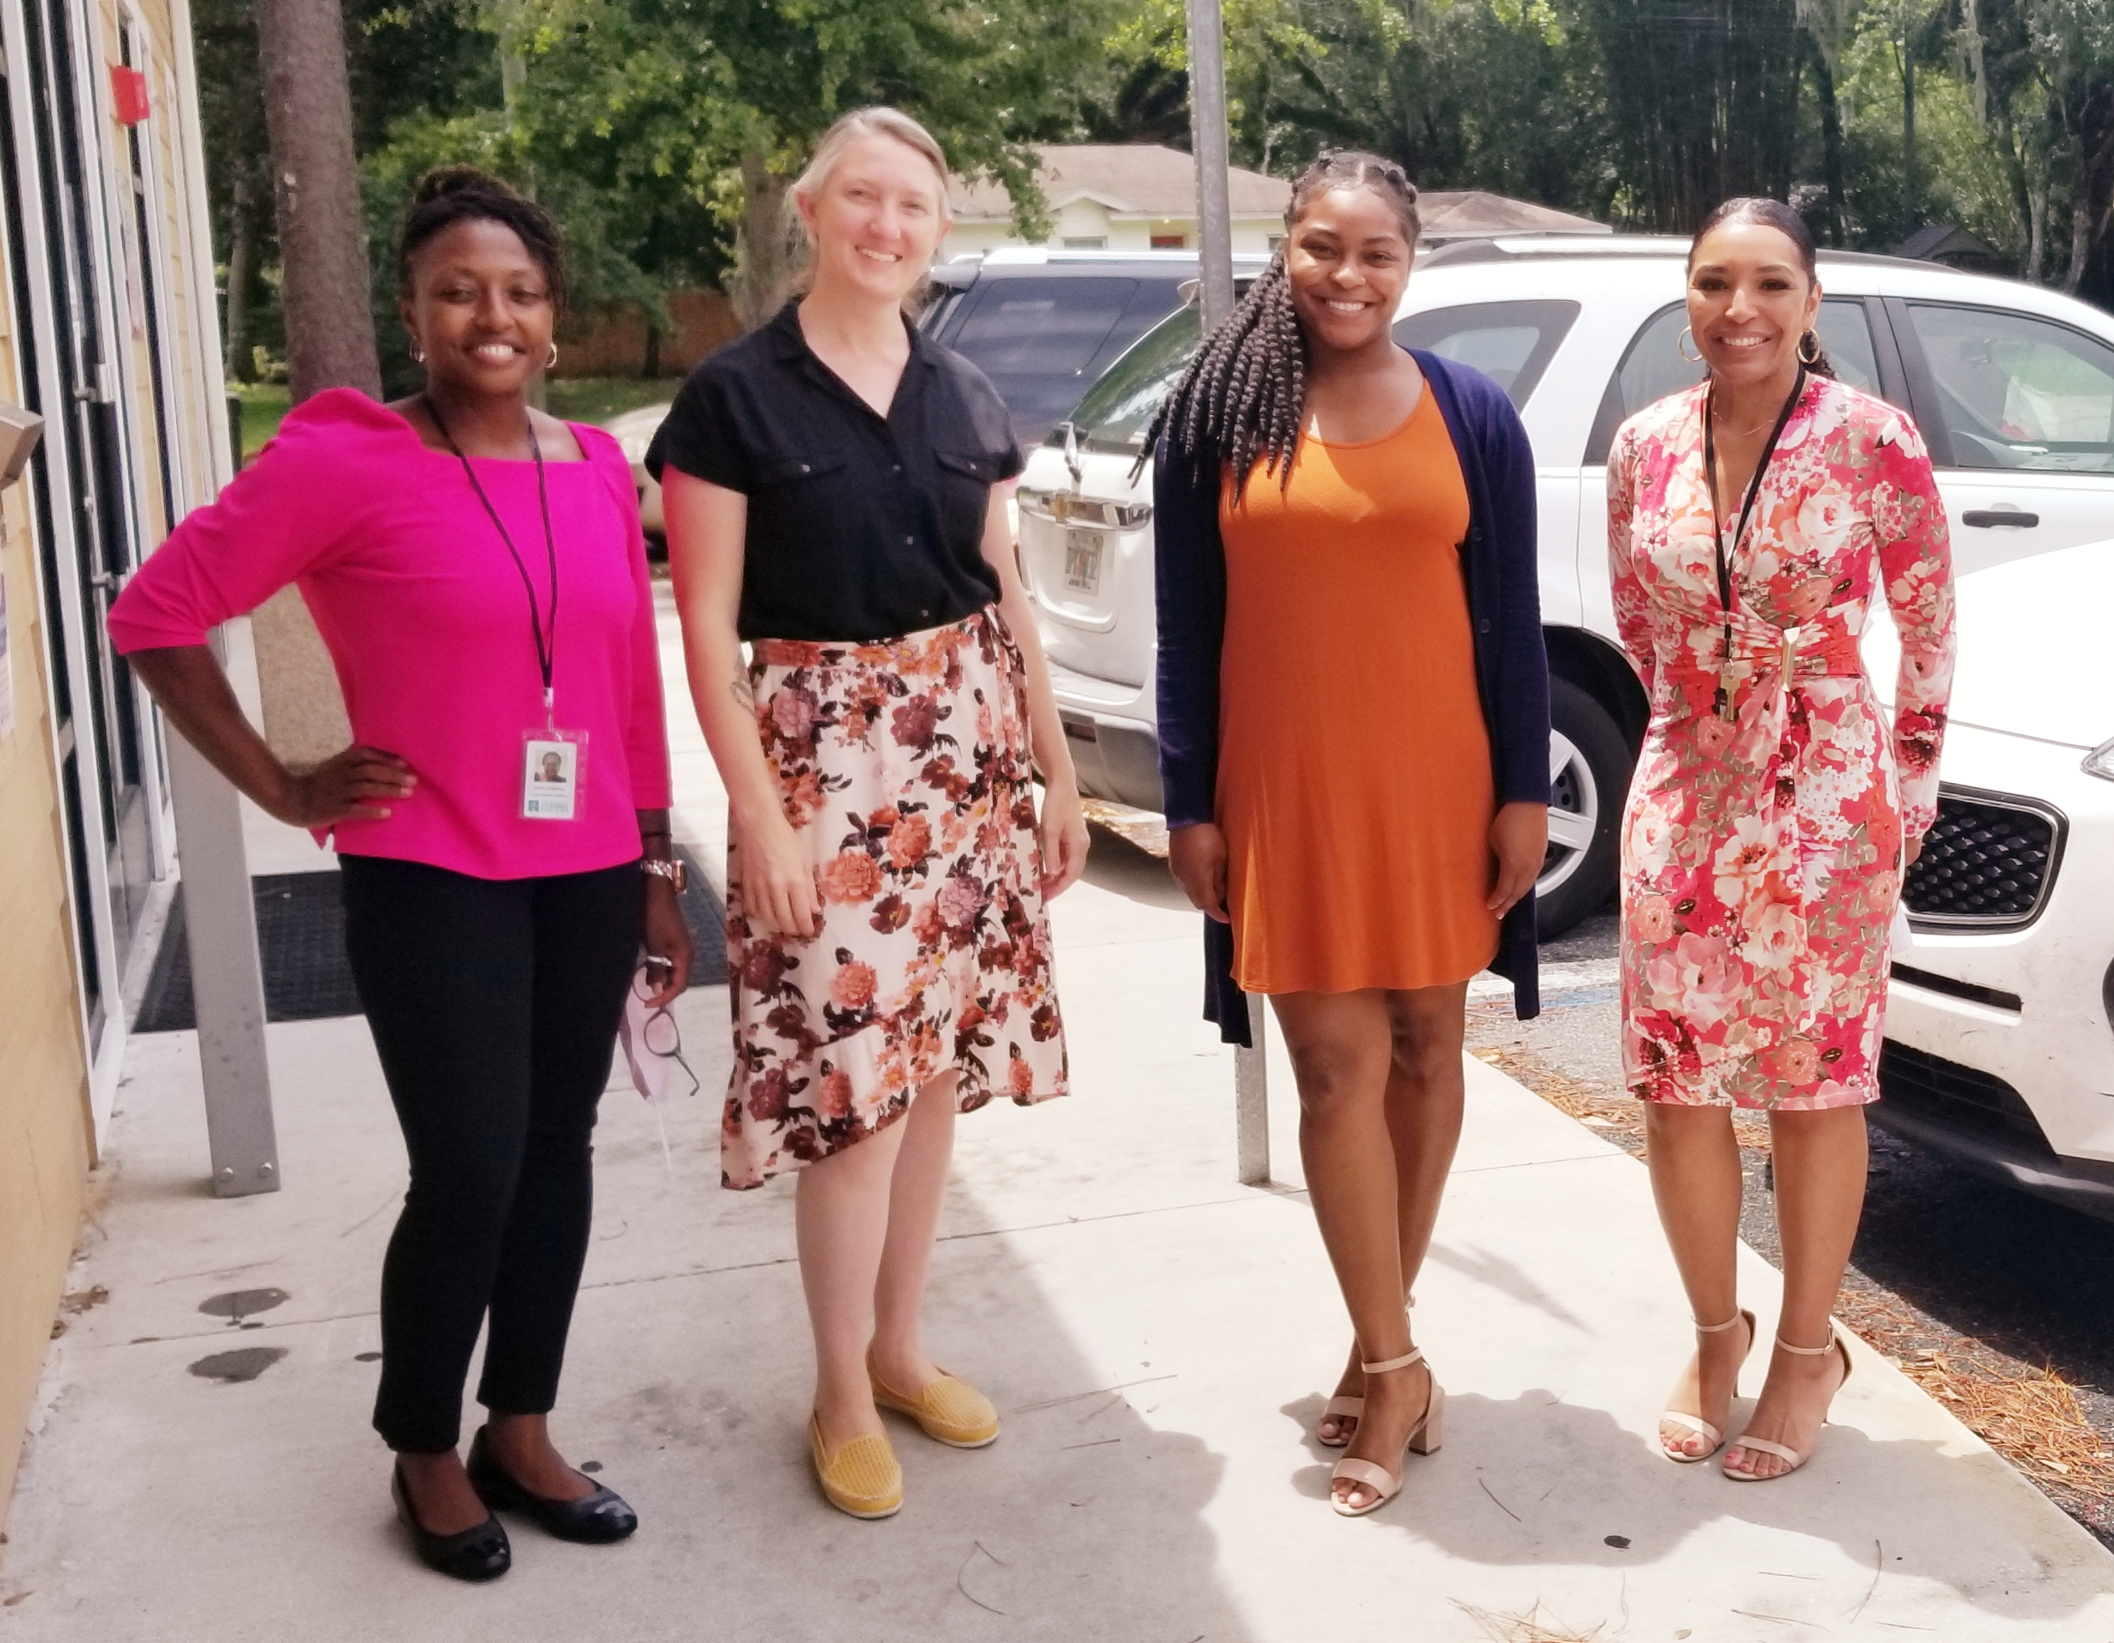
Library Partnership Resource Center

Slide 42
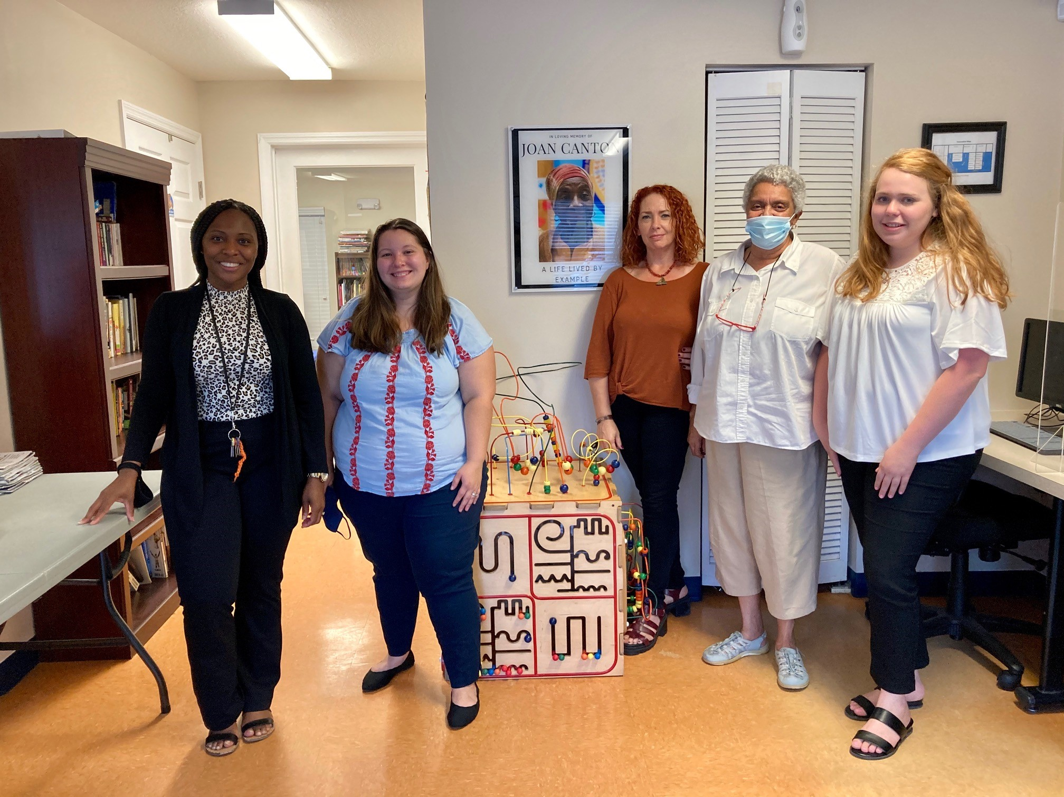
SWAG Family Resource Center

Slide 43

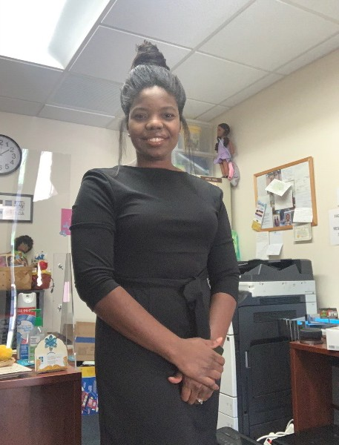
Cone Park Library Resource Center

Slide 44
We love our partners!
Thank you for working
along side us to support
local families and
build stronger communities!
RESOURCE CENTERS

Slide 45

Spotlight Partner
Circles Gainesville is an anti-poverty initiative that supports families as they move toward their goals of financial empowerment while also working to reduce local barriers that keep many in poverty. Circles Gainesville centers the experience of families making between 100-200% of the federal poverty level and partners them with two middle-income individuals for encouragement and mutual learning. Together they work towards the goals set by the family and are supported by the Circles Gainesville community which includes meeting Tuesday evenings for free dinner, child care, and programming.

